Slide 1
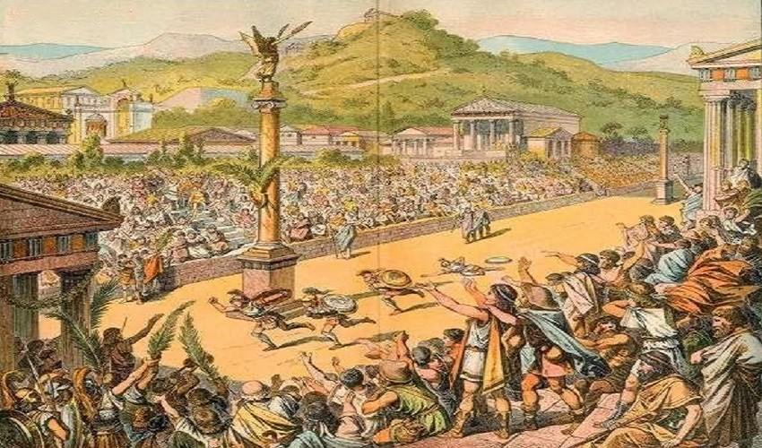
UNIT 2
HISTORICAL FOUNDATION
COURSE 1
FOUNDATION OF EDUCATION, PHYSICAL EDUCATION & SPORTS
C. HISTORY OF ANCIENT OLYMPICS

Slide 2
THE GAMES
The ancient Olympic Games were primarily a part of a religious festival in honor of Zeus, the father of the Greek gods and goddesses. The festival and the games were held in Olympia (see 'Did you know' in the glossary), a rural sanctuary site (model shown here, courtesy of the British Museum) in the western Peloponnesos.
The Greeks that came to the Sanctuary of Zeus at Olympia shared the same religious beliefs and spoke the same language. The athletes were all male citizens of the city-states from every corner of the Greek world, coming from as far away as Iberia (Spain) in the west and the Black Sea (Turkey) in the east.
In Greek mythology, Mt. Olympos was the home of the greatest of the Greek gods and goddesses.
The ancient Olympic Games began in the year 776 BC, when Koroibos, a cook from the nearby city of Elis, won the stadion race, a foot race 600 feet long.

Slide 3
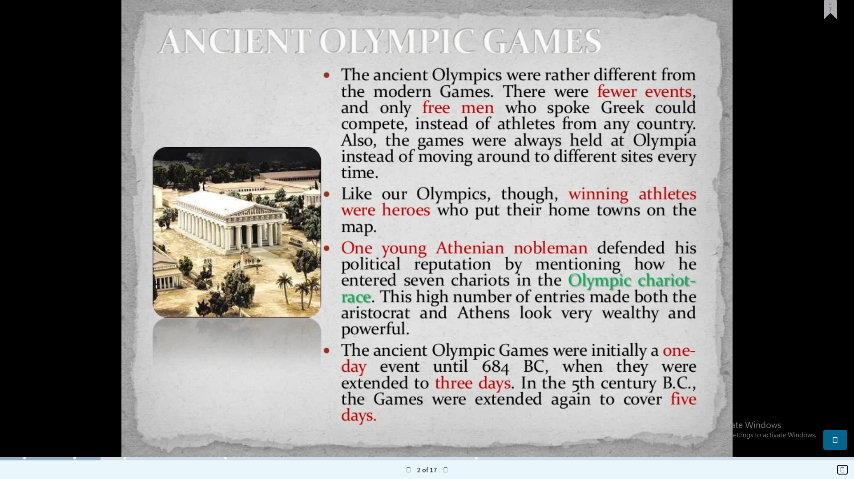

Slide 4
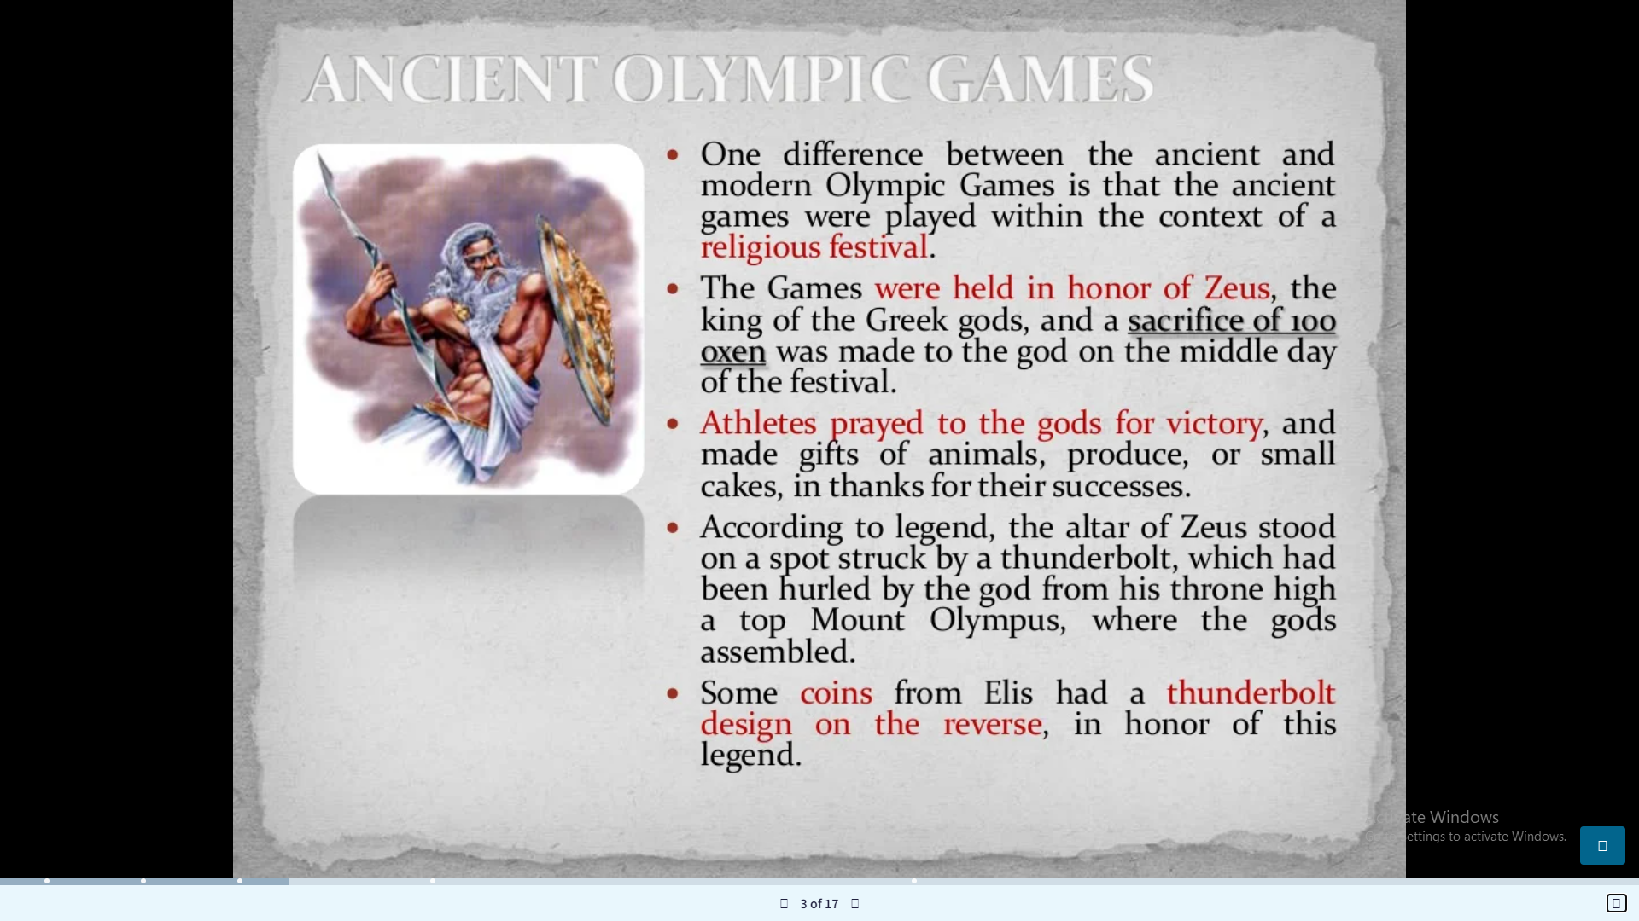

Slide 5
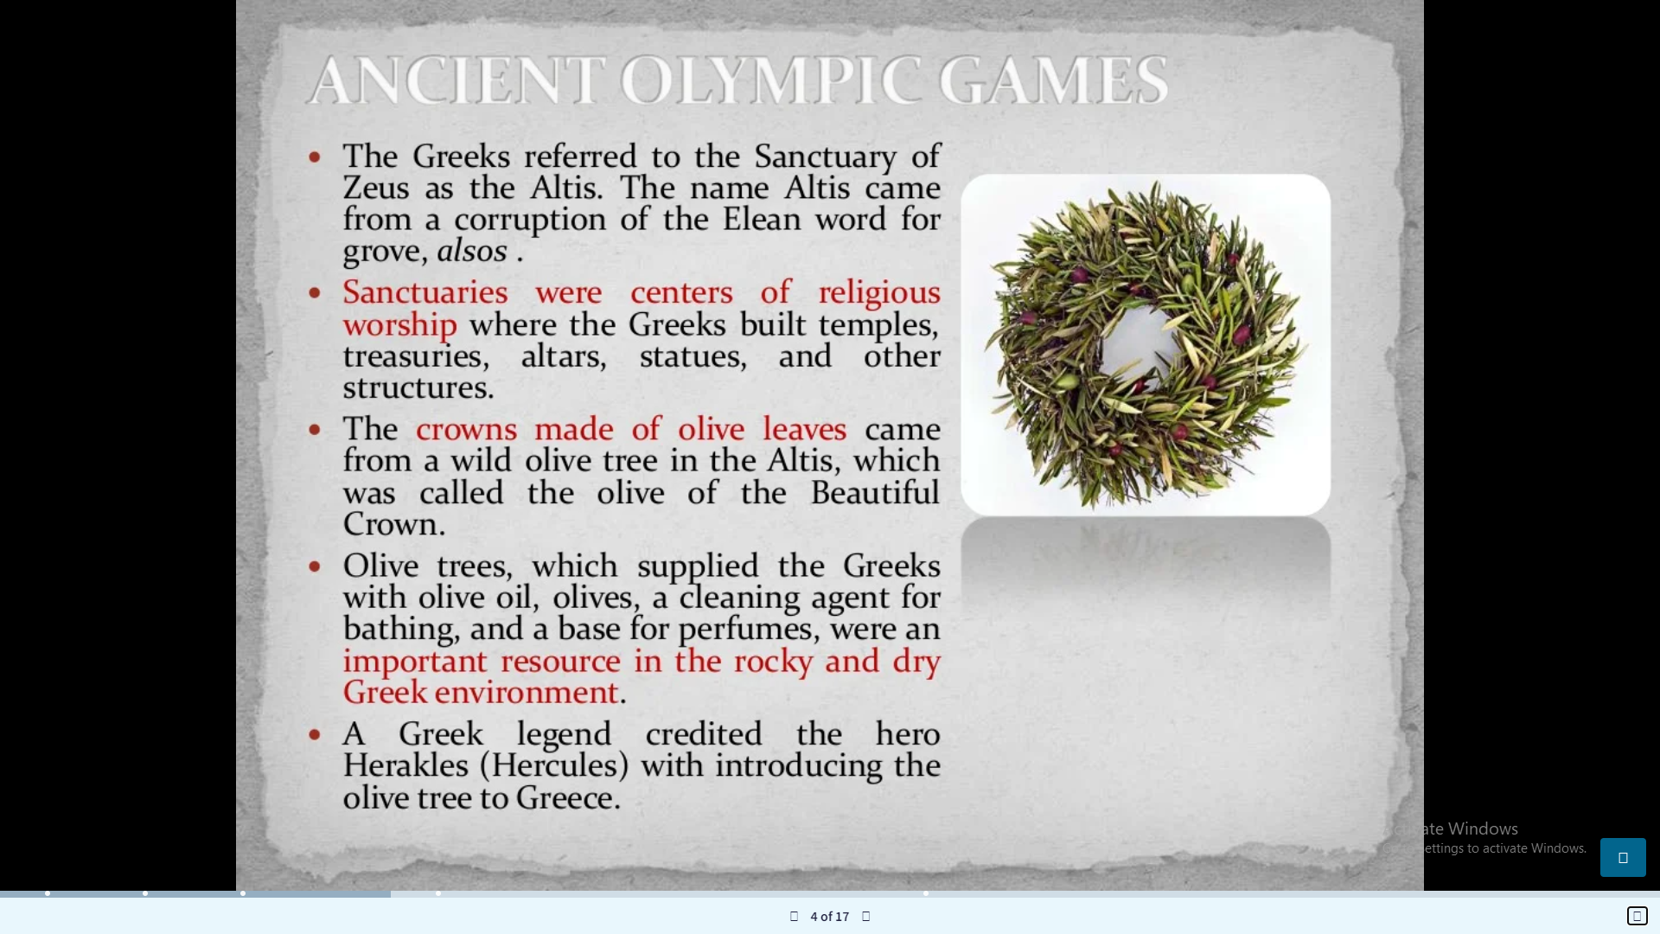

Slide 6
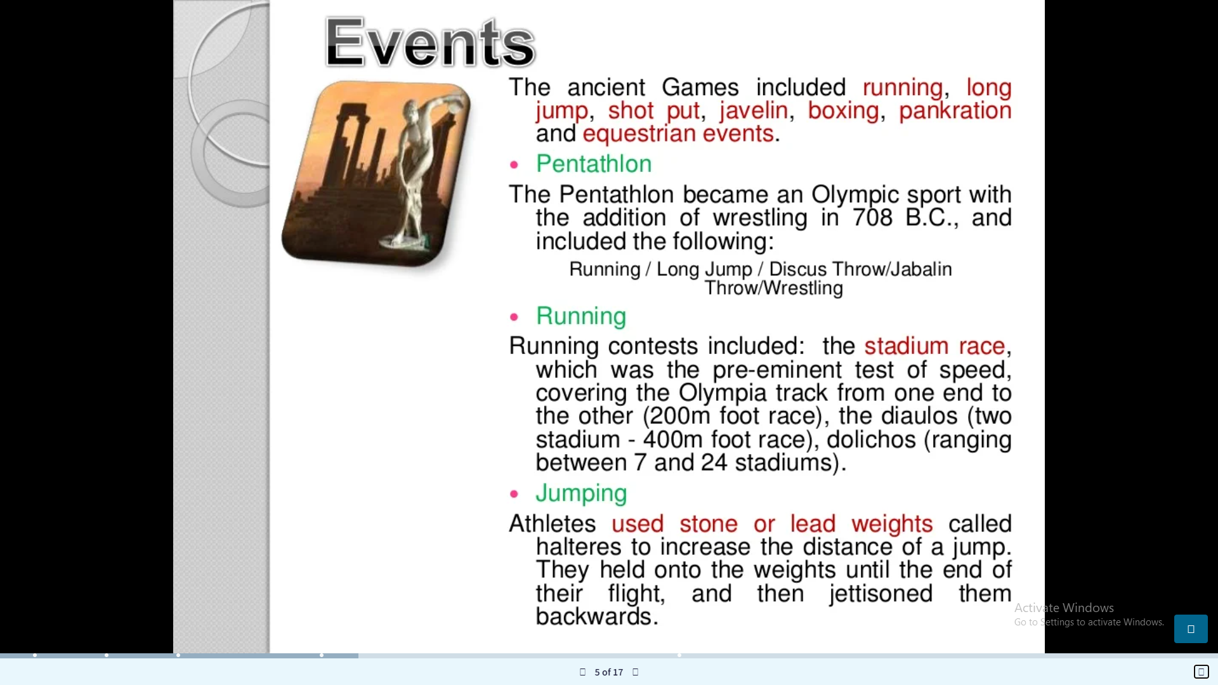

Slide 7
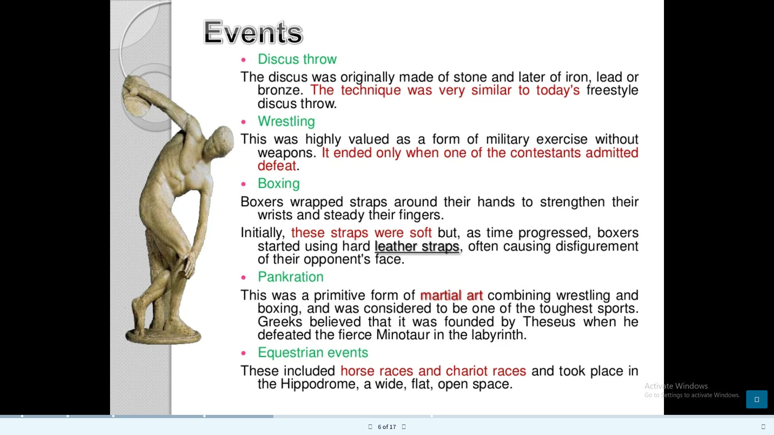

Slide 8
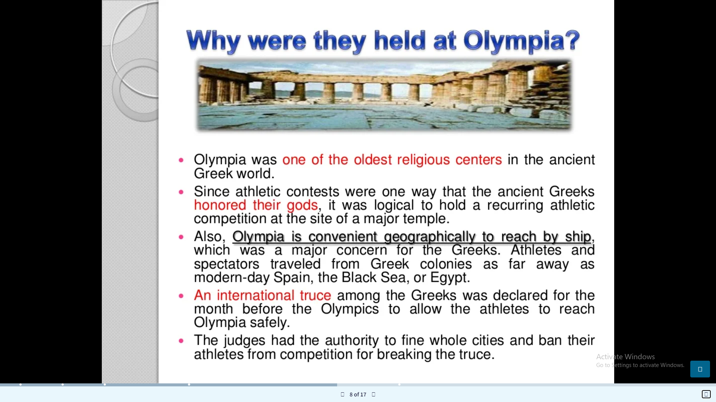

Slide 9
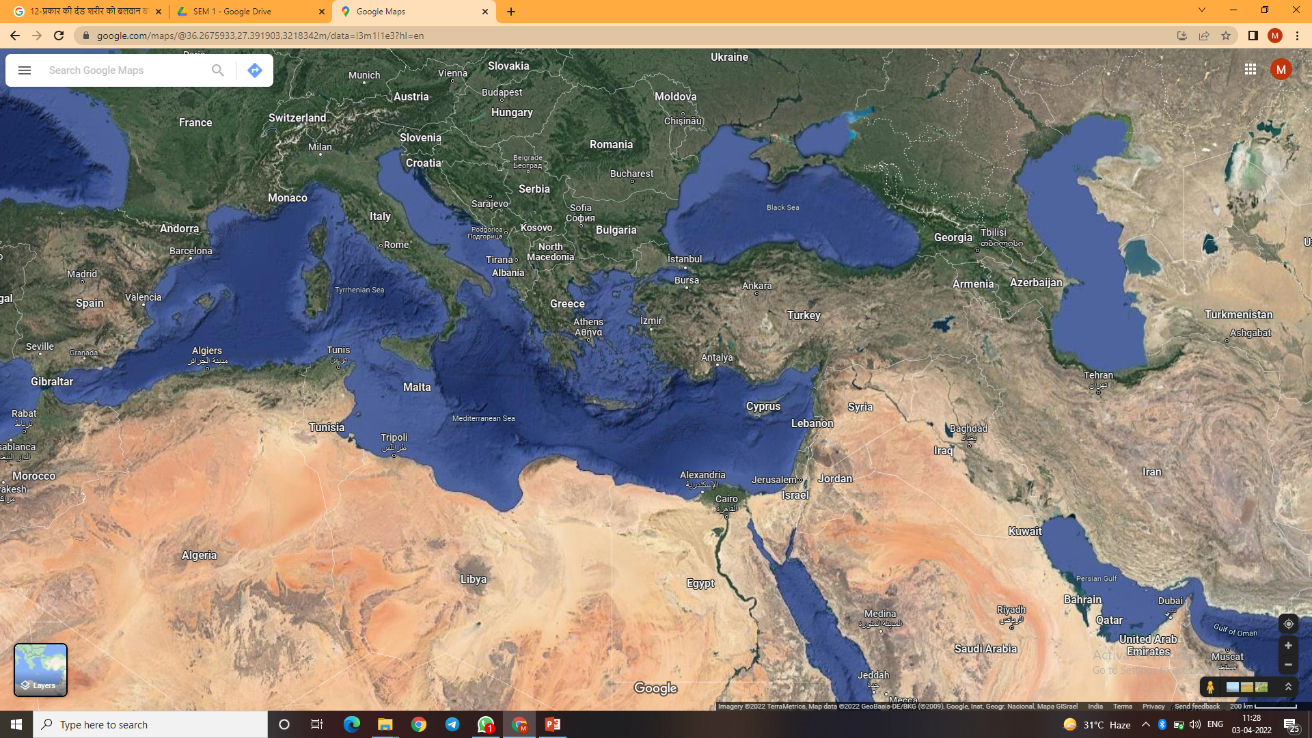

Slide 10
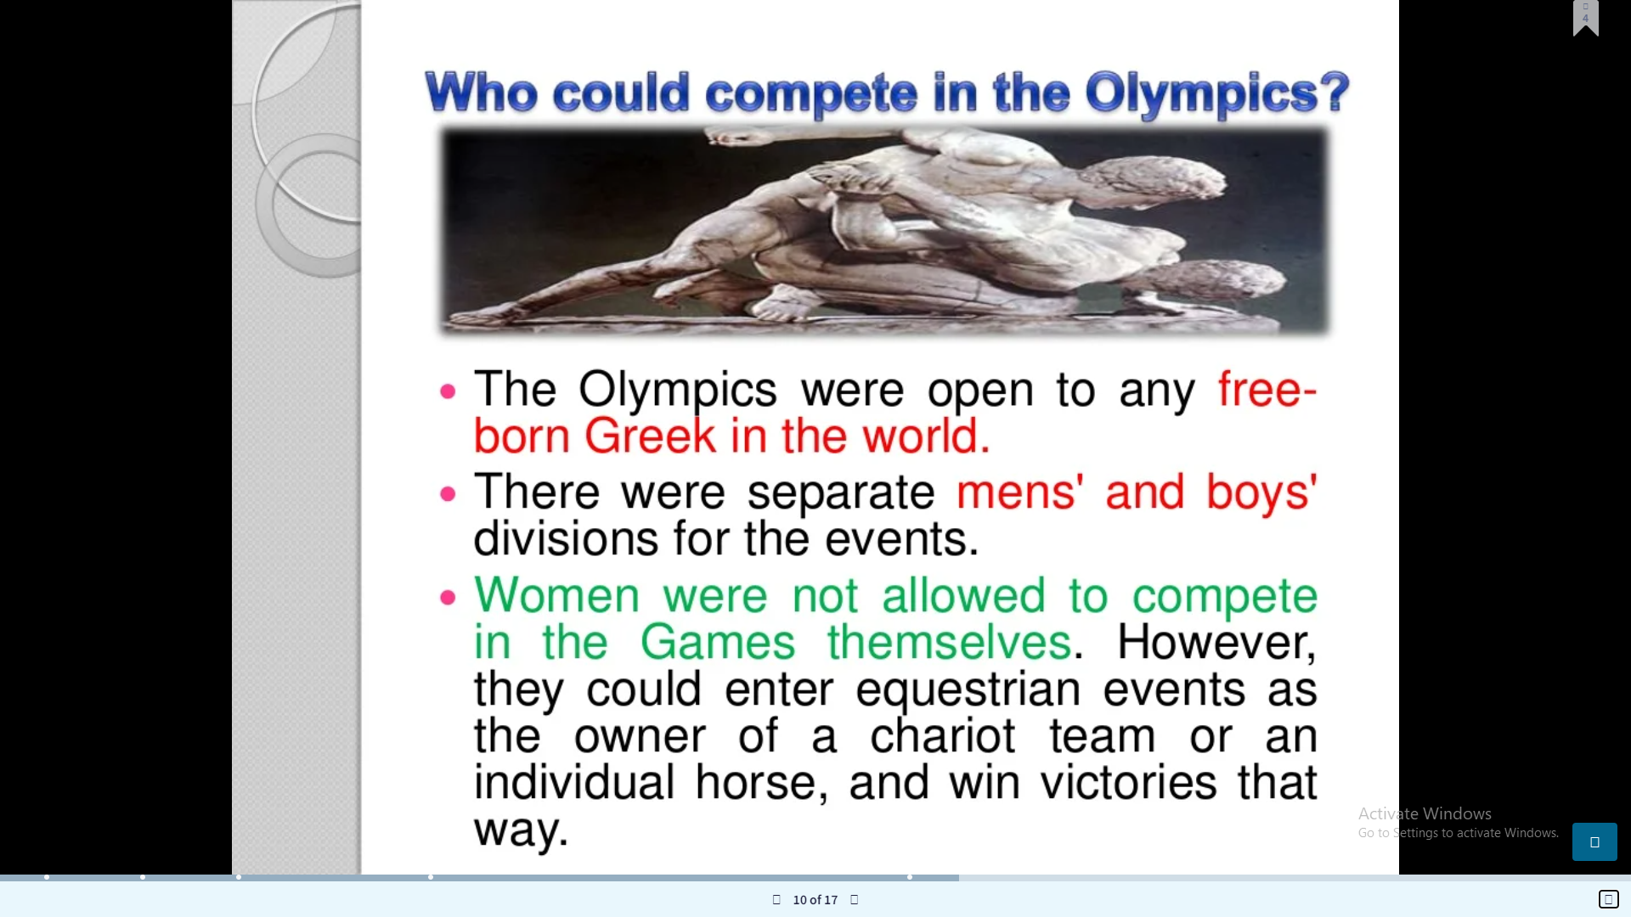

Slide 11
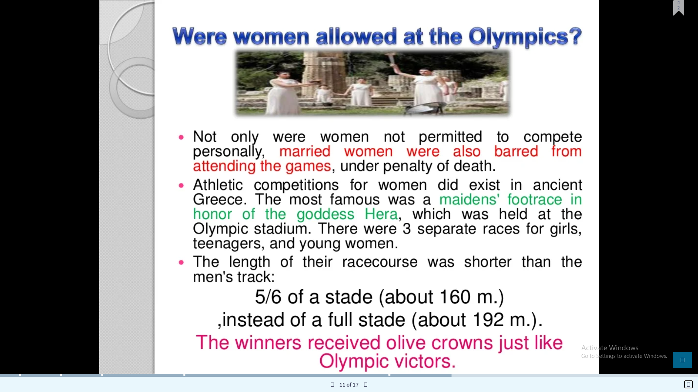

Slide 12
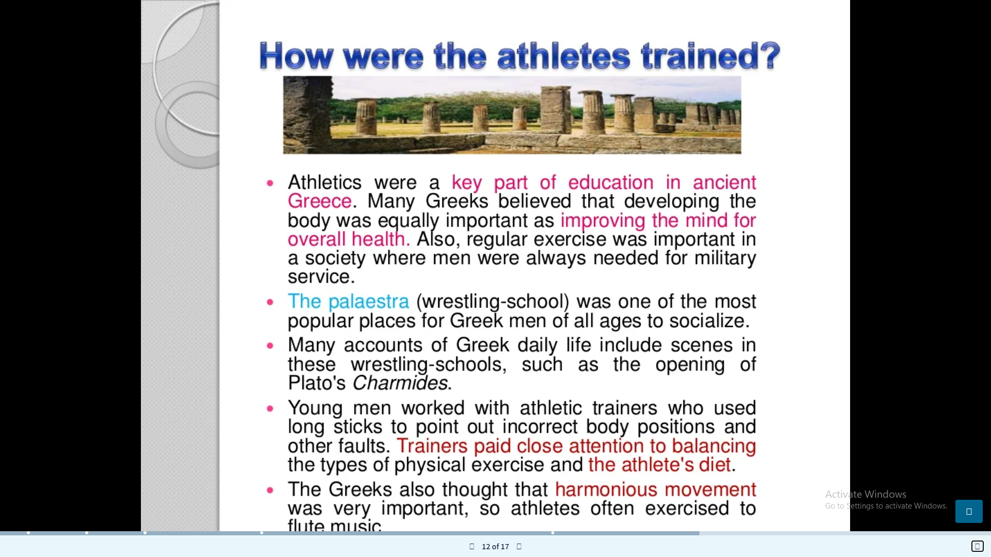

Slide 13
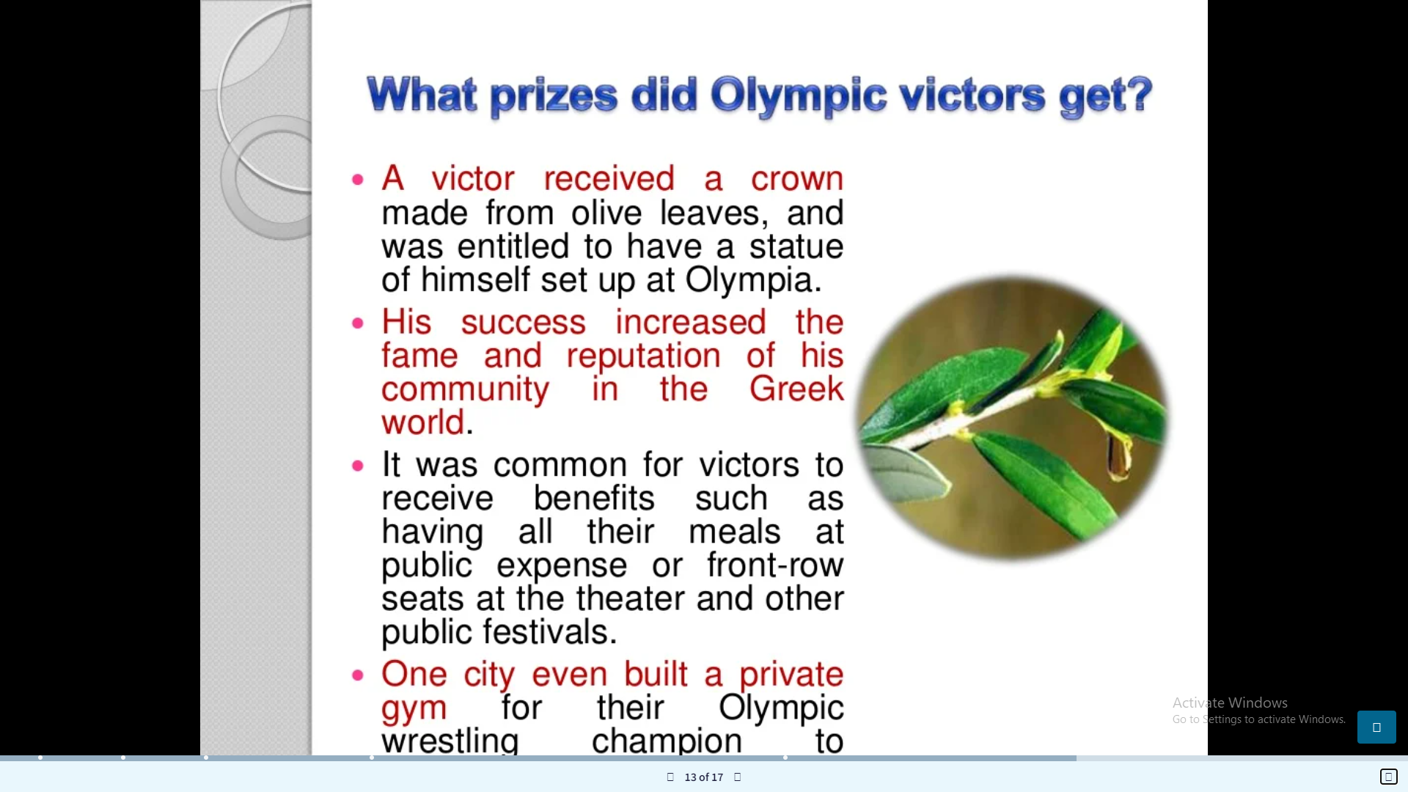

Slide 14
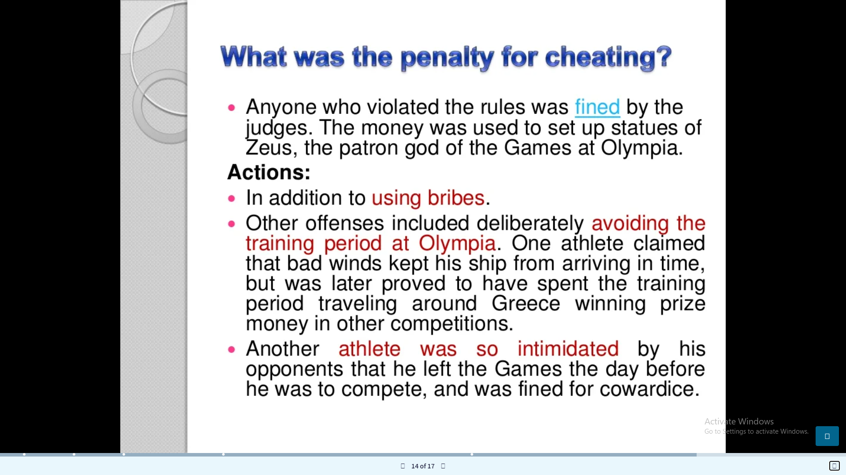

Slide 15
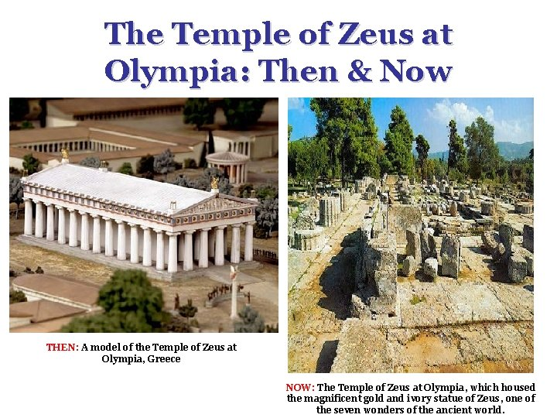

Slide 16
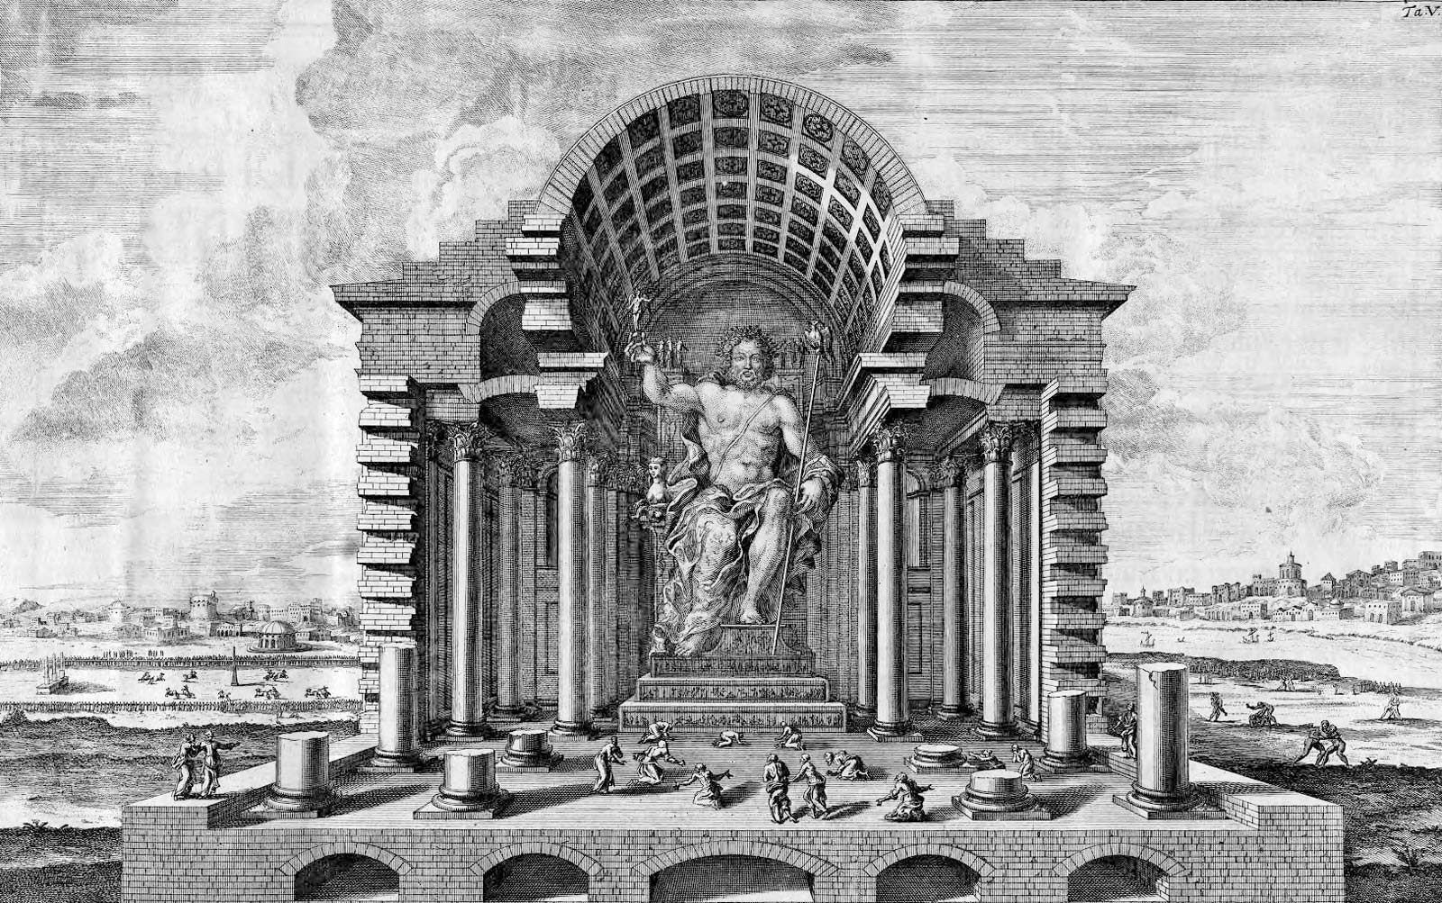
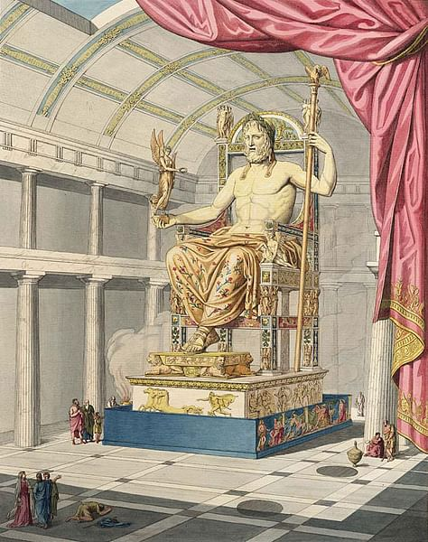

Slide 17
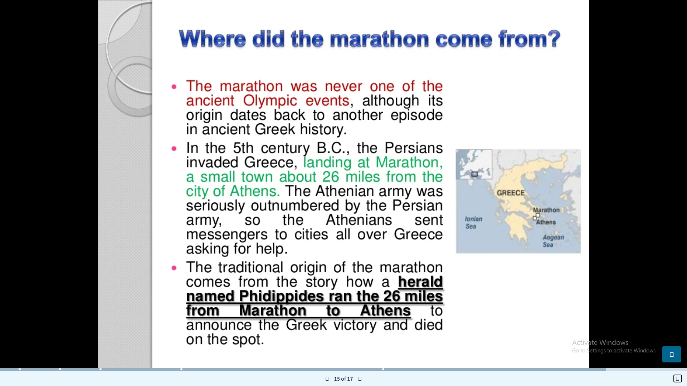

Slide 18
The marathon was NOT an event of the ancient Olympic games. The marathon is a modern event that was first introduced in the Modern Olympic Games of 1896 in Athens, a race from Marathon northeast of Athens to the Olympic Stadium, a distance of 40 kilometers.
The distance of the modern marathon was standardized as 26 miles 385 yards or 42.195 km. in 1908 when the Olympic Games were held in London. The distance was the exact measurement between Windsor Castle, the start of the race, and the finish line inside White City Stadium.

Slide 19
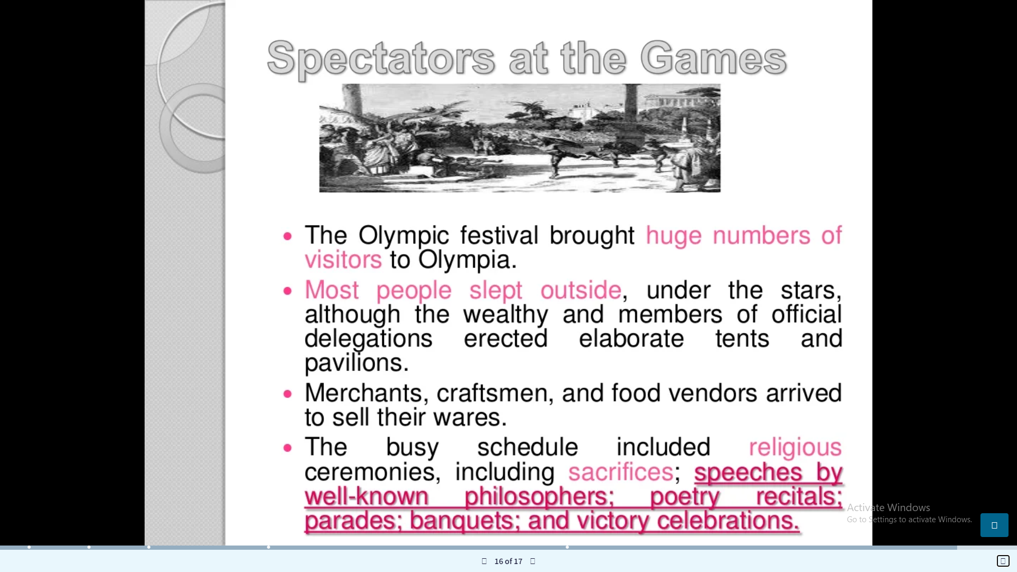

Slide 20
FROM ANCIENT TO MODERN
Although the ancient Games were staged in Olympia, Greece, from 776 BC through 393 AD, it took 1503 years for the Olympics to return. The first modern Olympics were held in Athens, Greece, in 1896. The man responsible for its rebirth was a Frenchman named Baron Pierre de Coubertin, who presented the idea in 1894. His original thought was to unveil the modern Games in 1900 in his native Paris, but delegates from 34 countries were so enthralled with the concept that they convinced him to move the Games up to 1896 and have Athens serve as the first host.

Slide 21
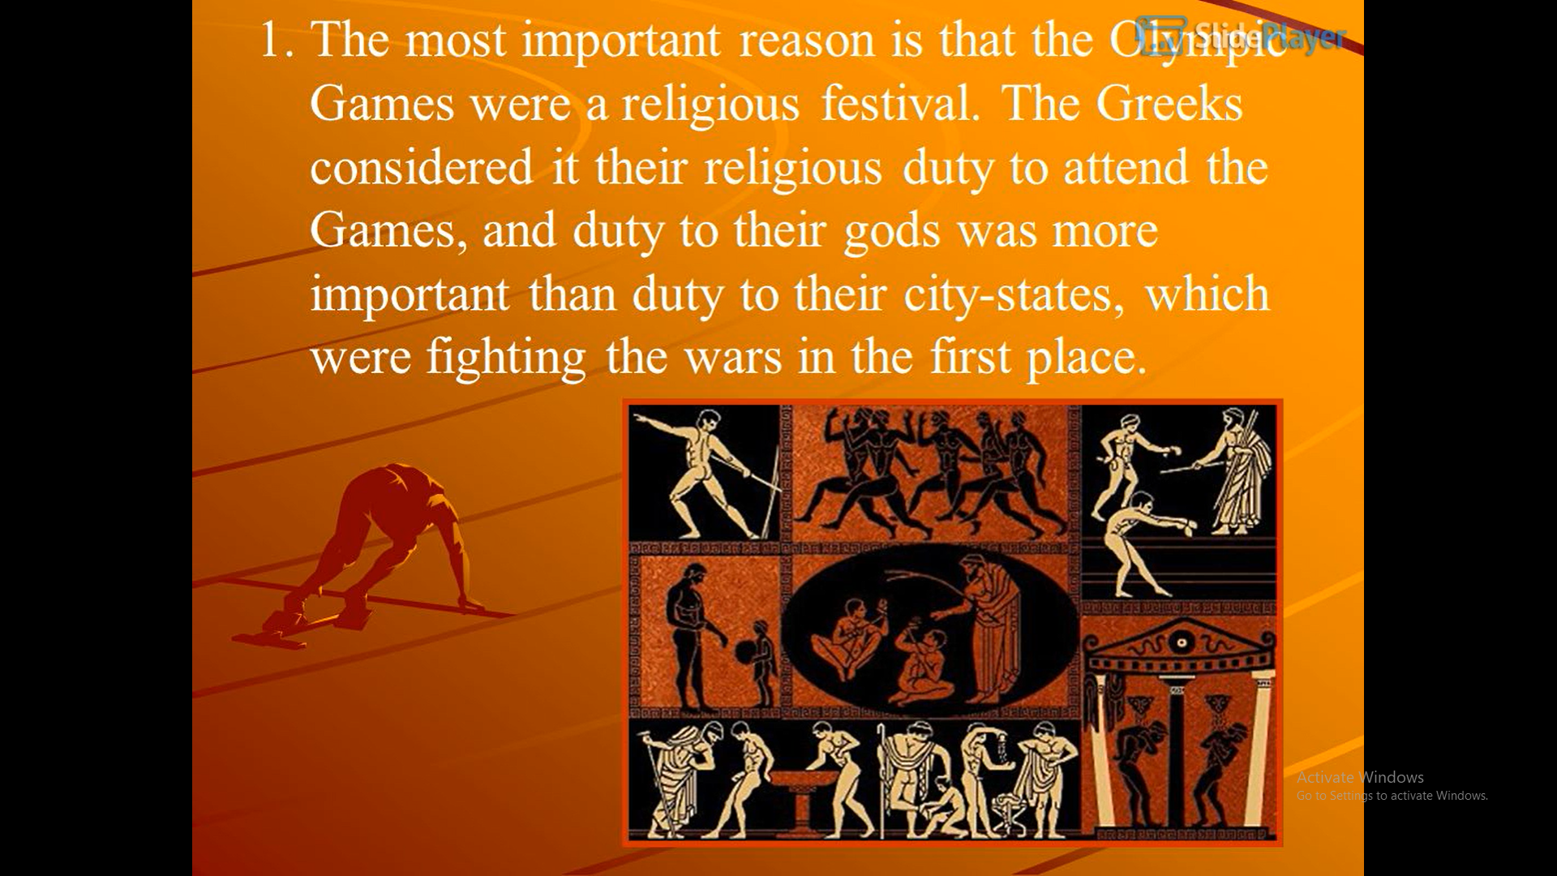

Slide 22
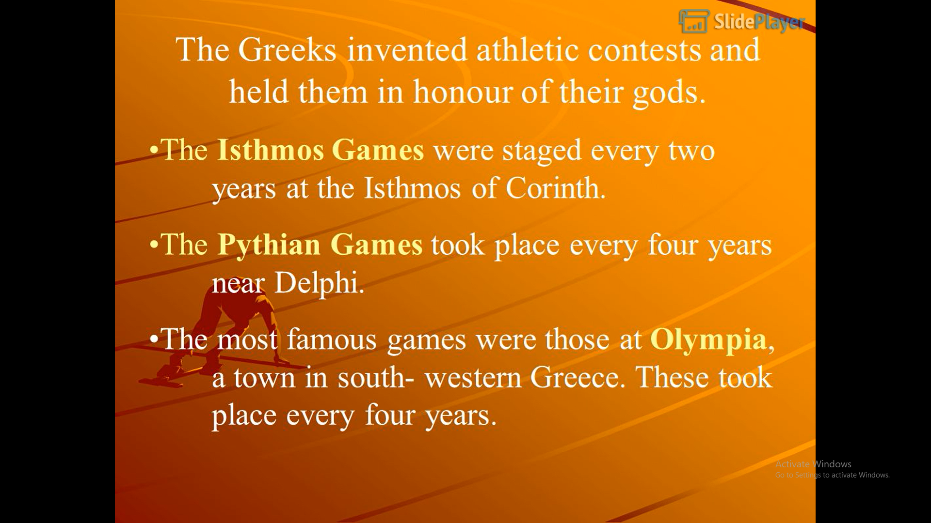

Slide 23
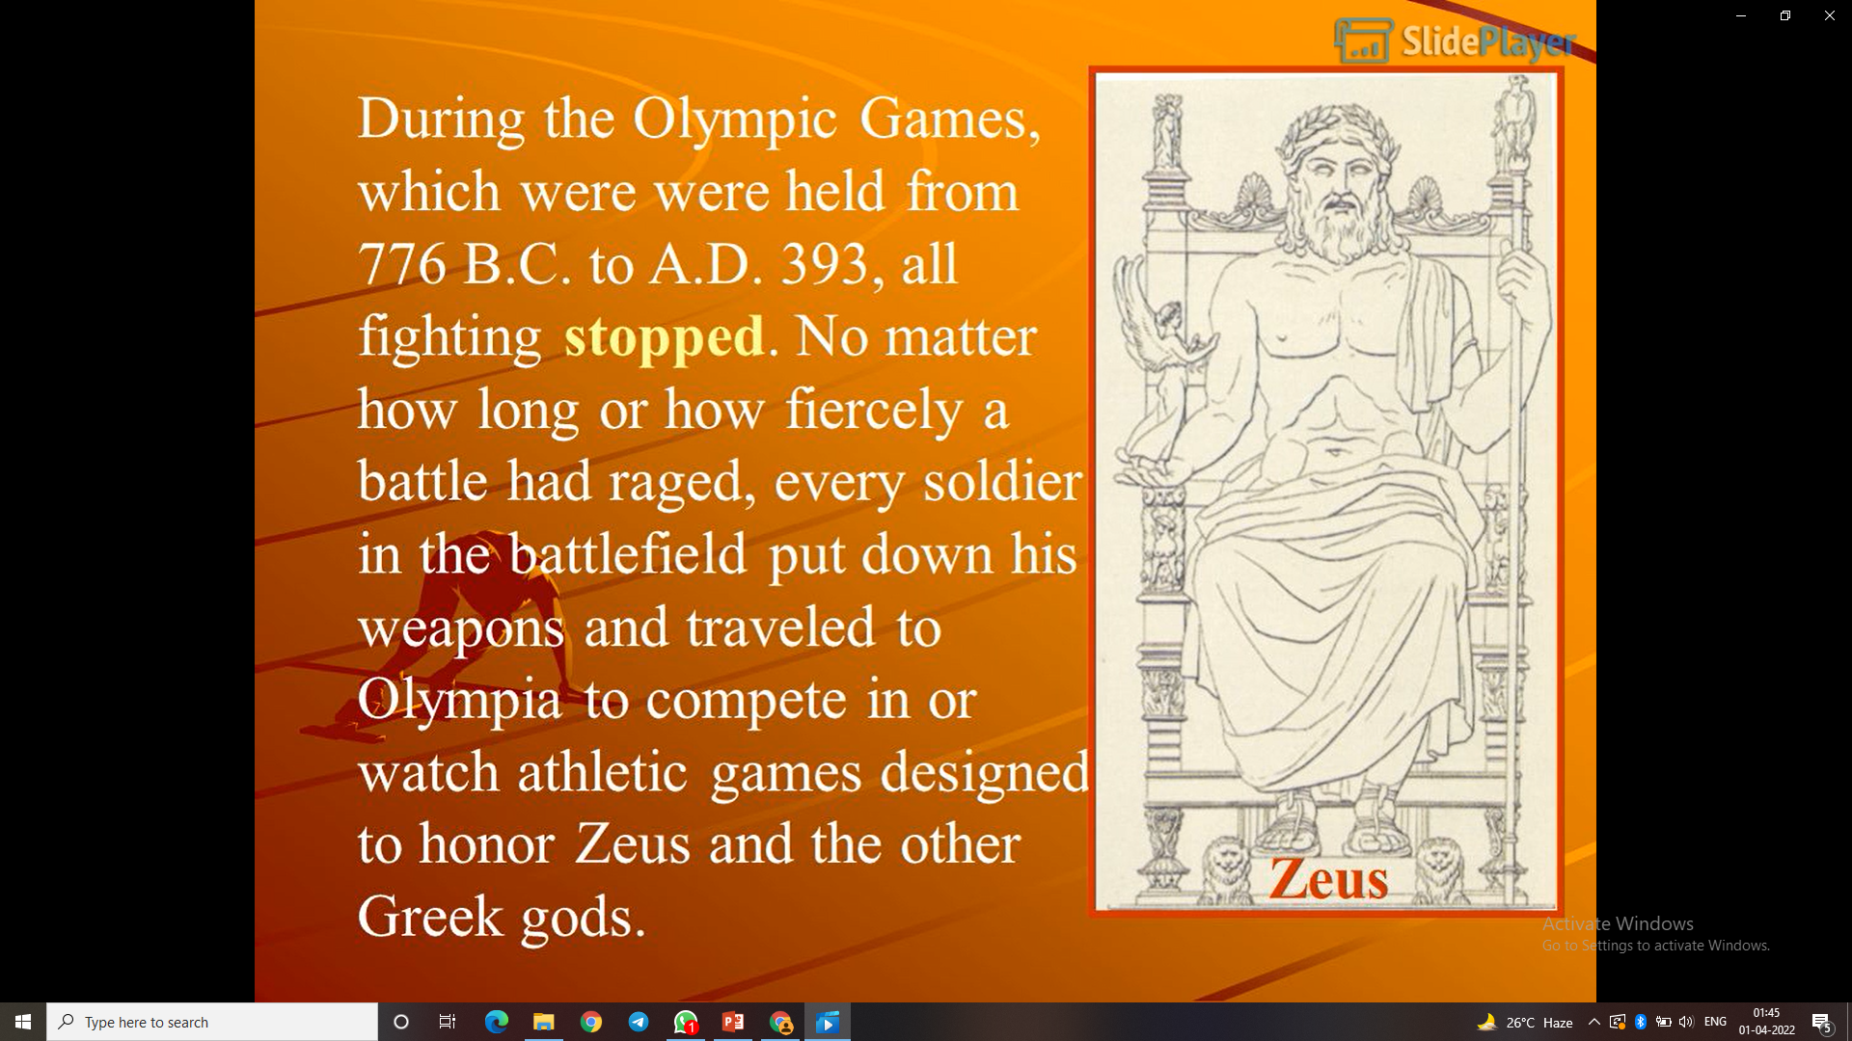

Slide 24
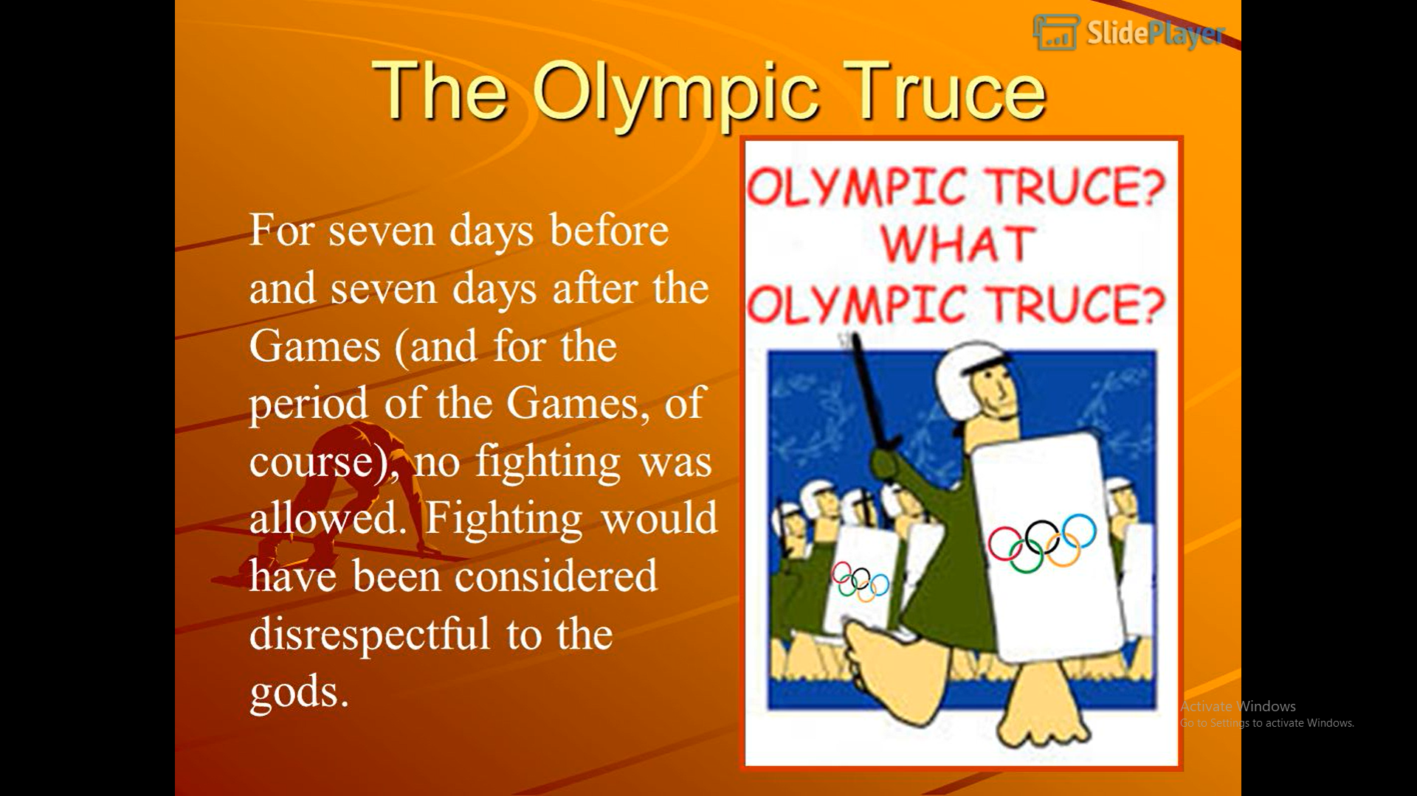

Slide 25
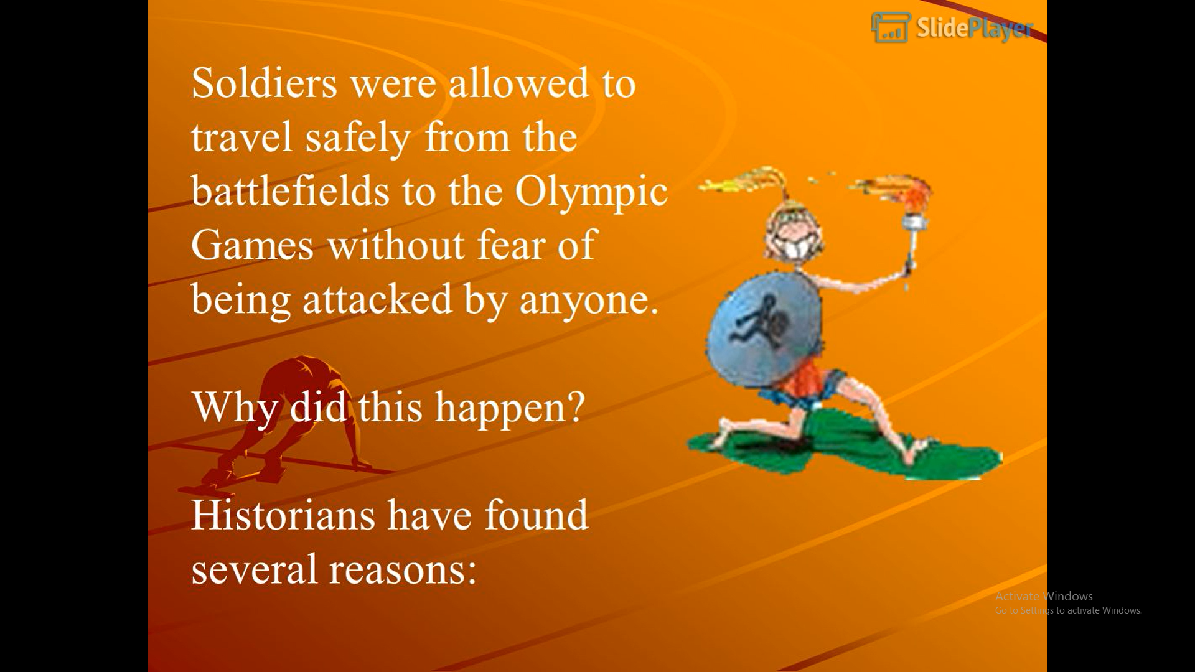

Slide 26
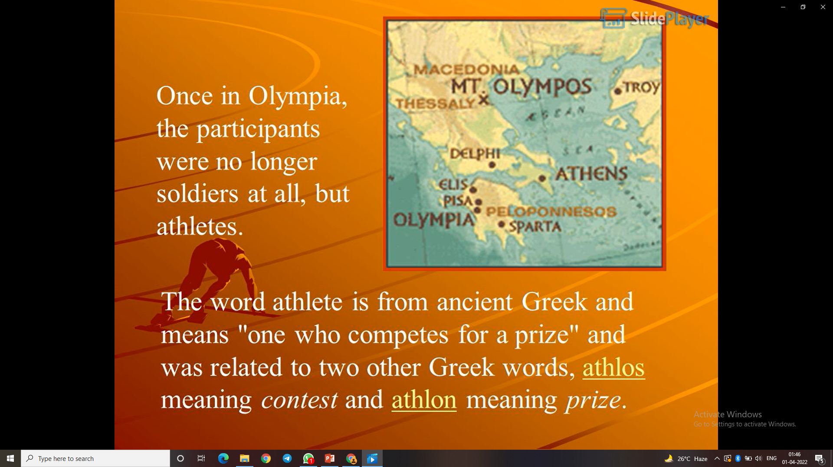

Slide 27
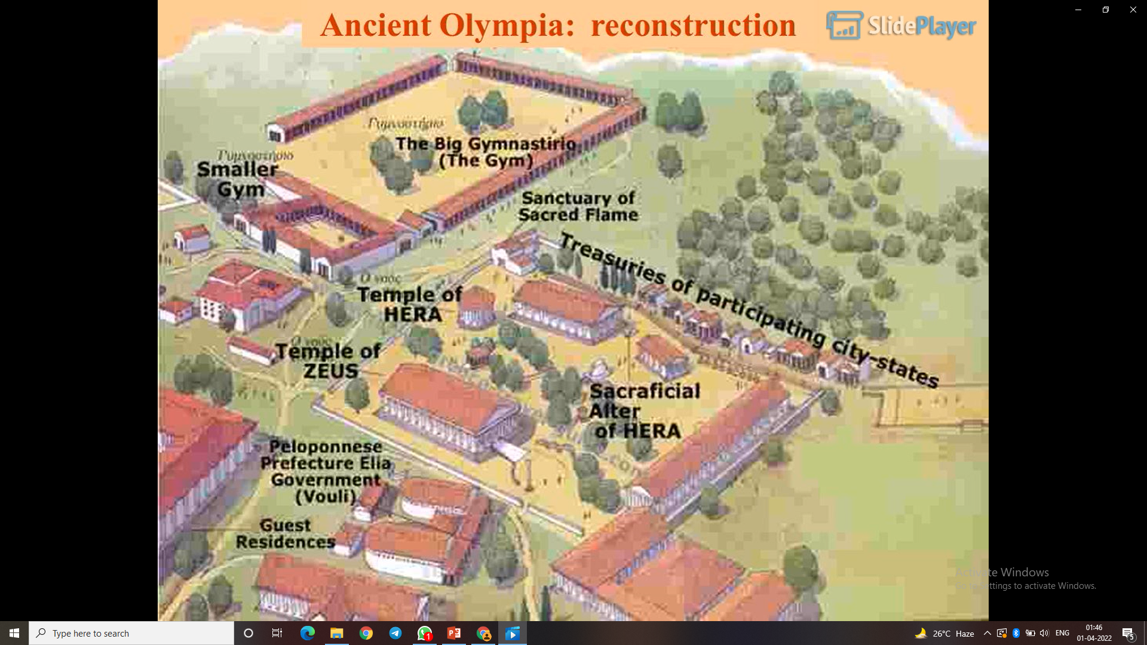

Slide 28
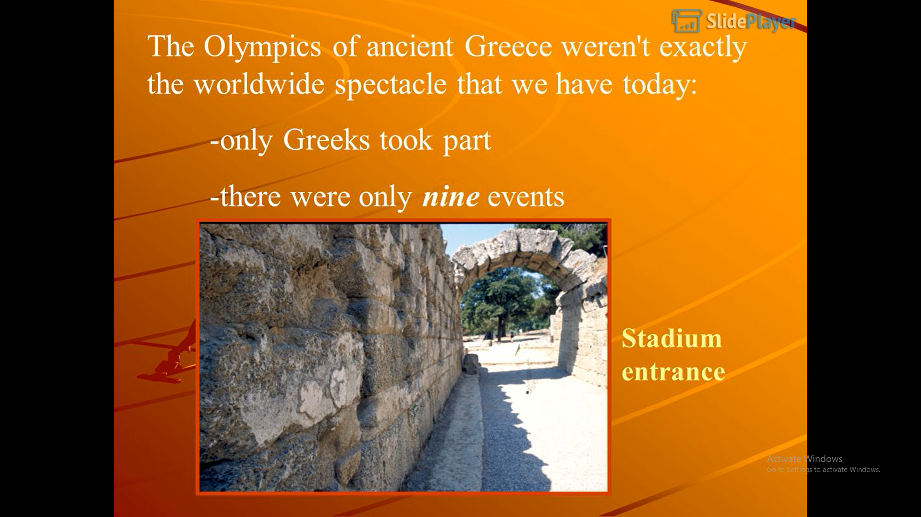

Slide 29
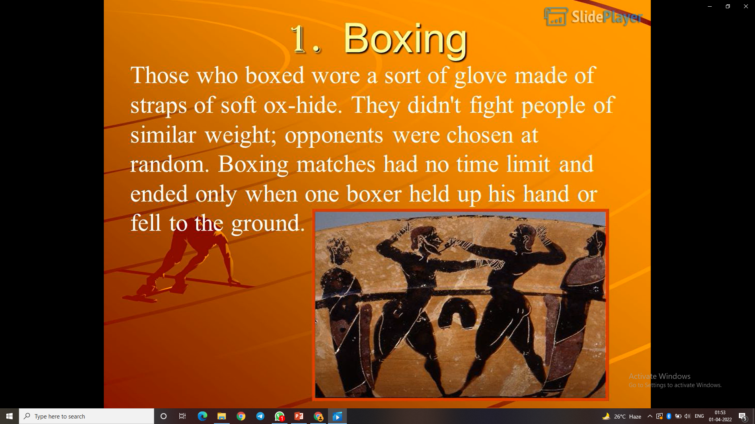

Slide 30
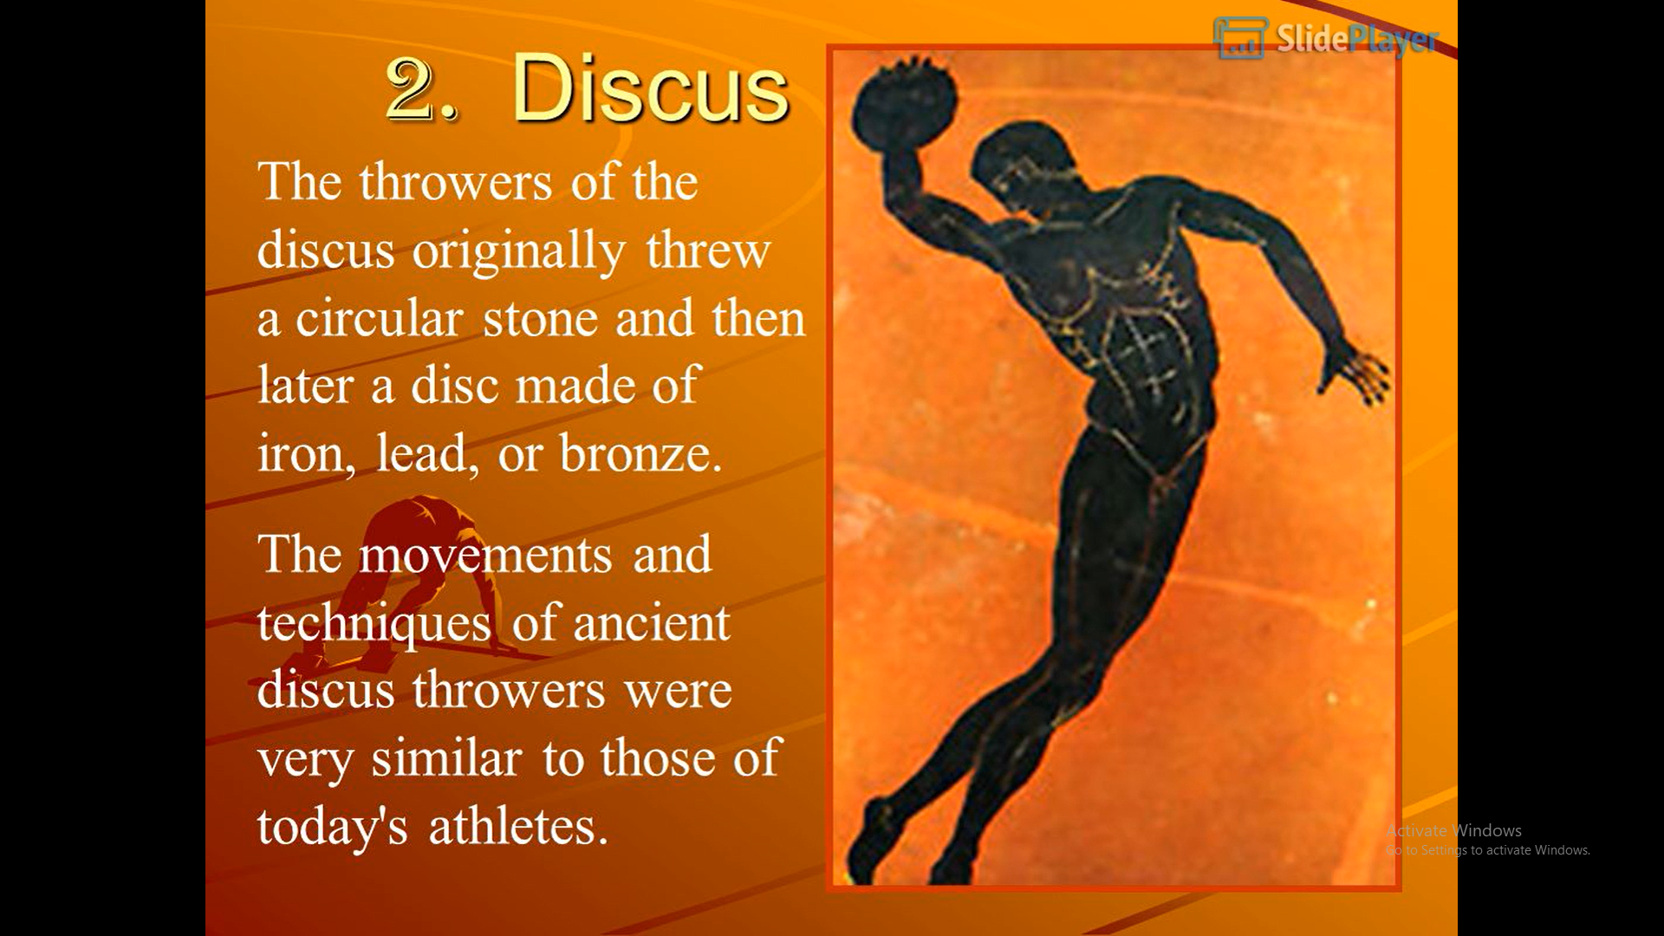

Slide 31
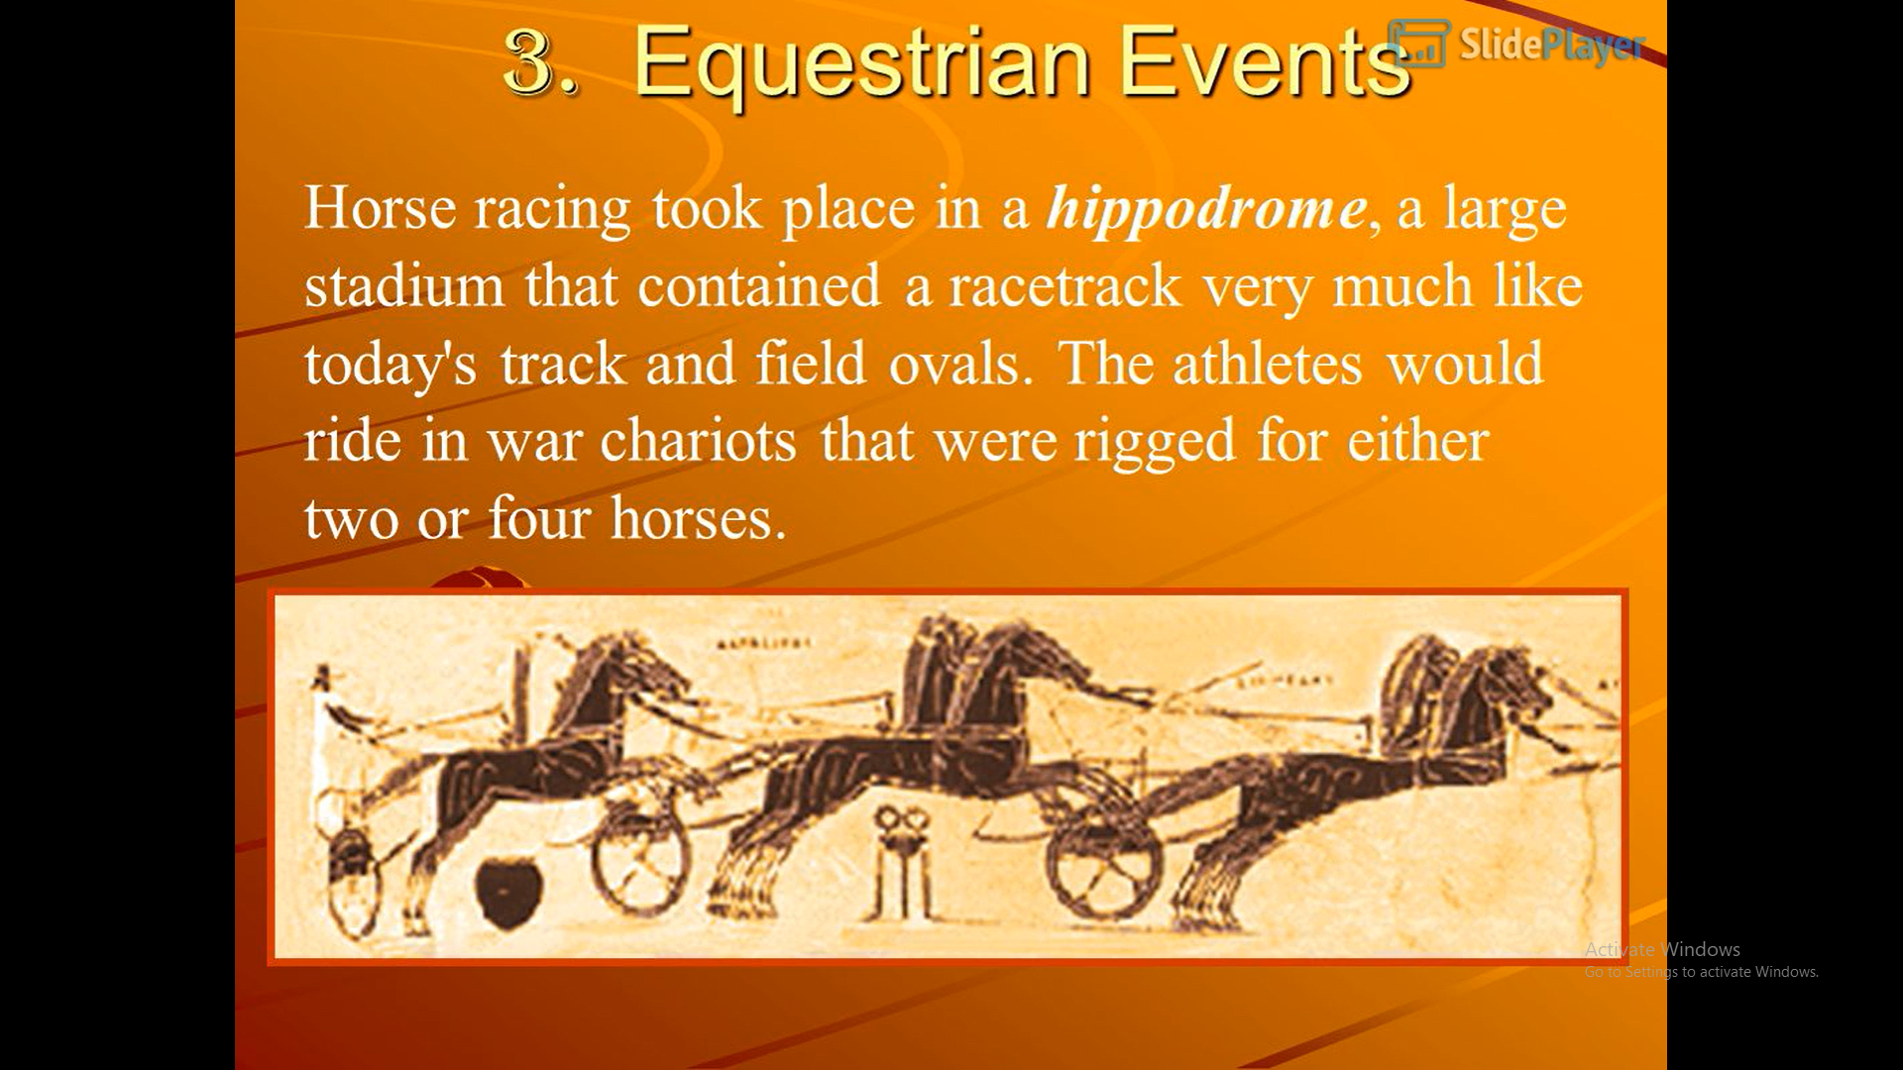

Slide 32
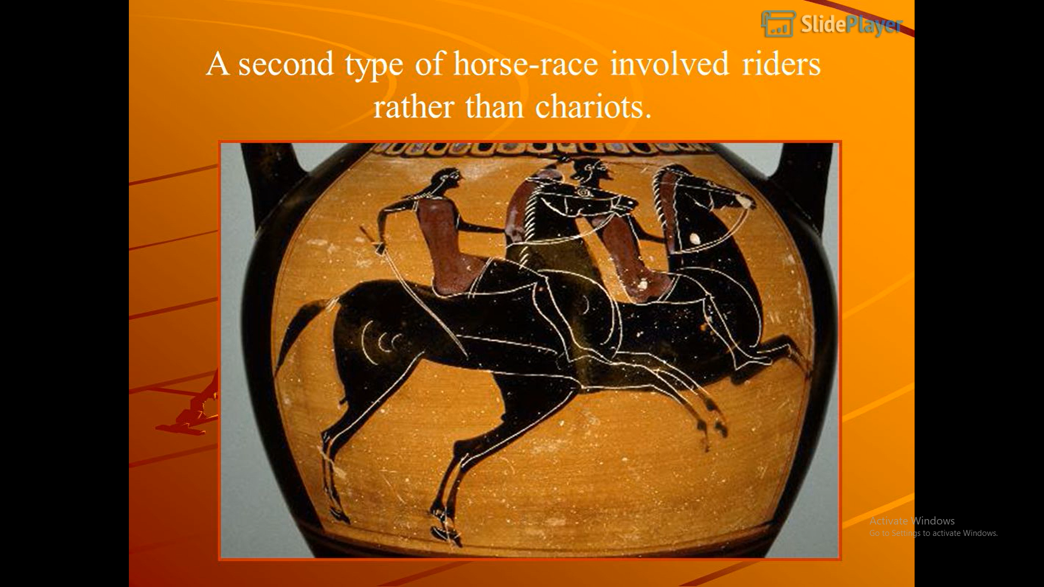

Slide 33
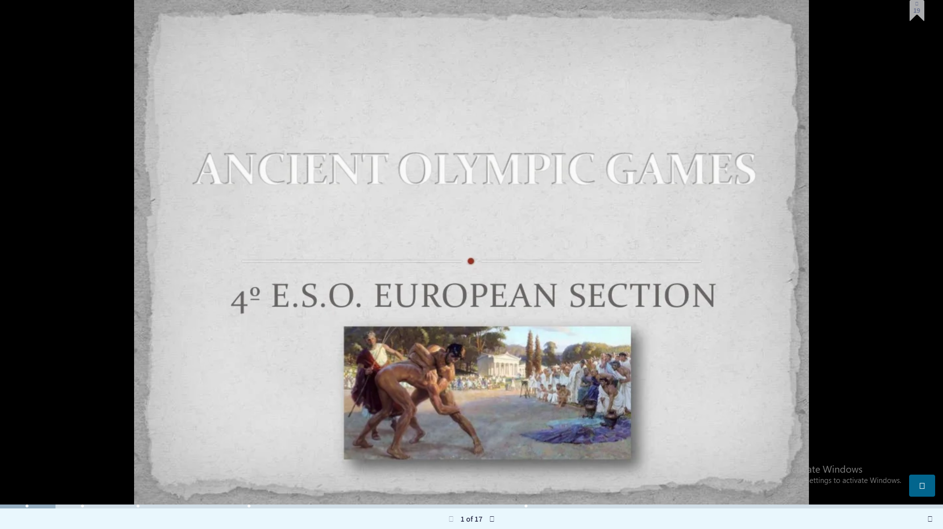
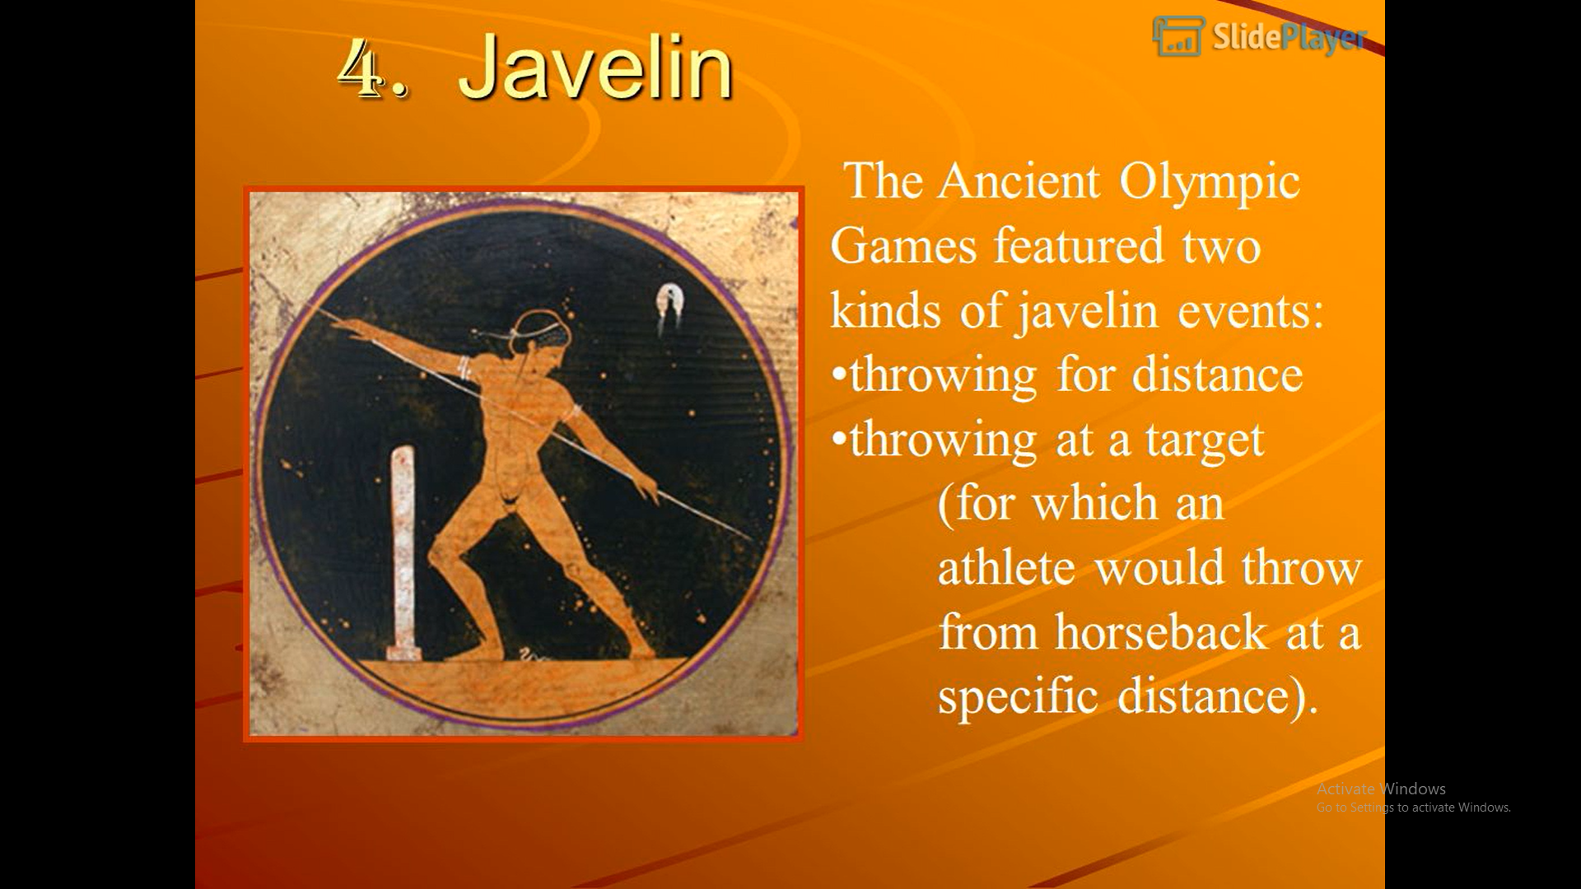

Slide 34
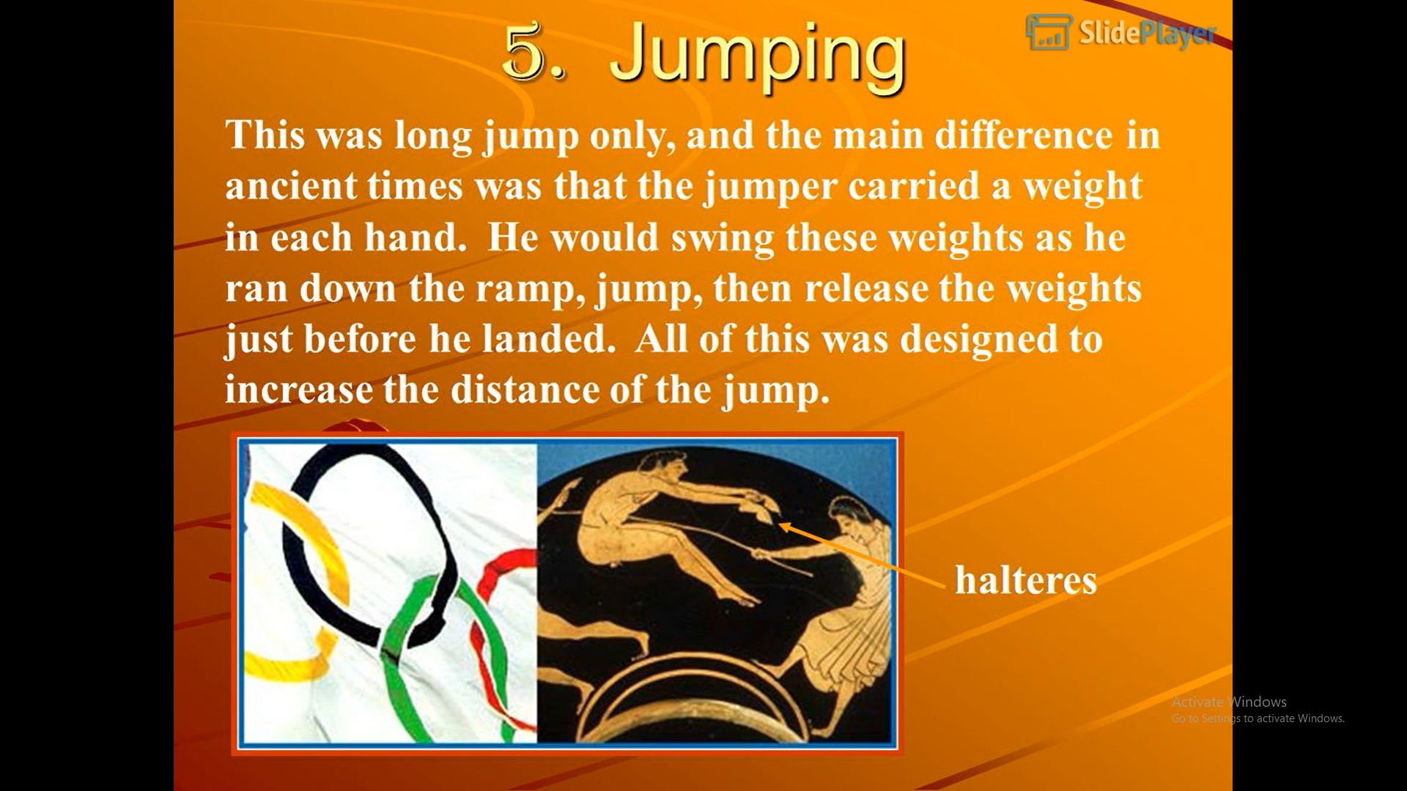

Slide 35
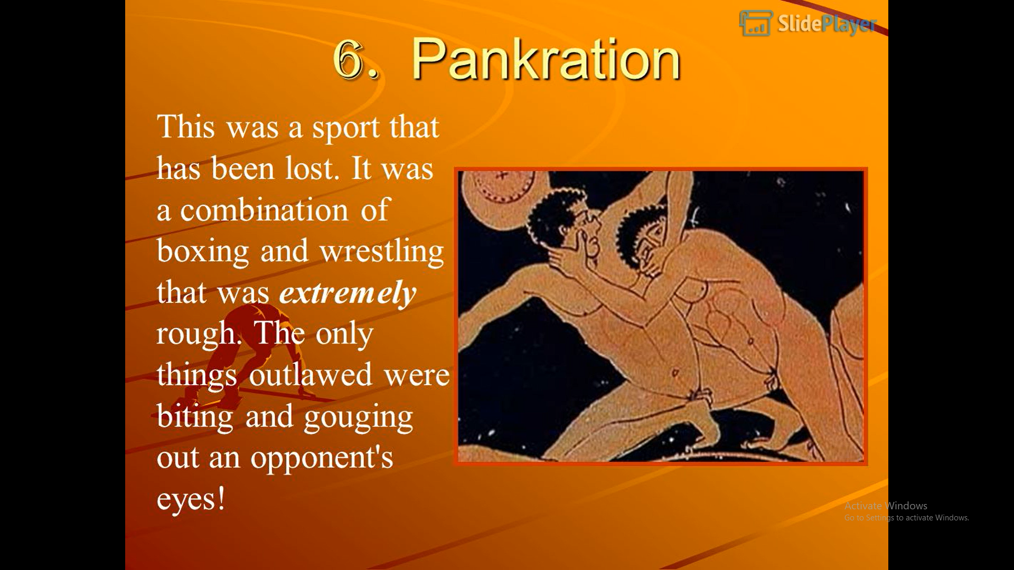

Slide 36
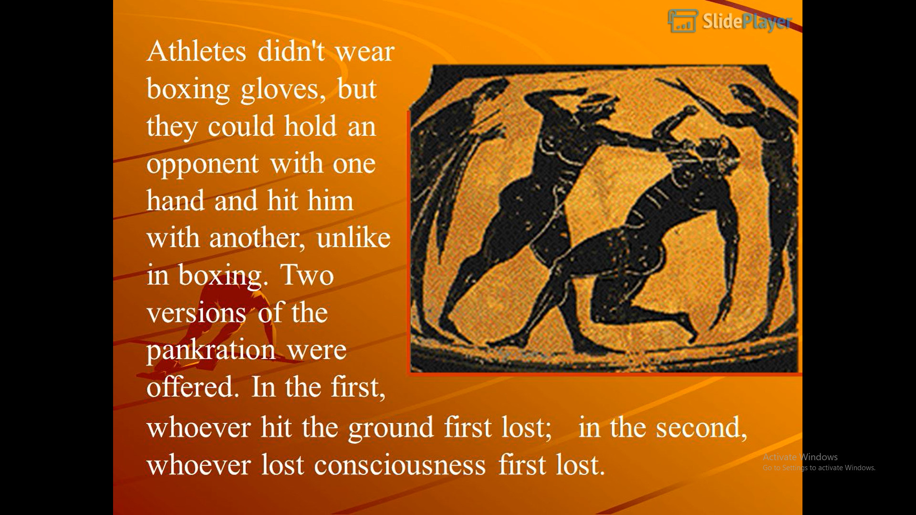

Slide 37
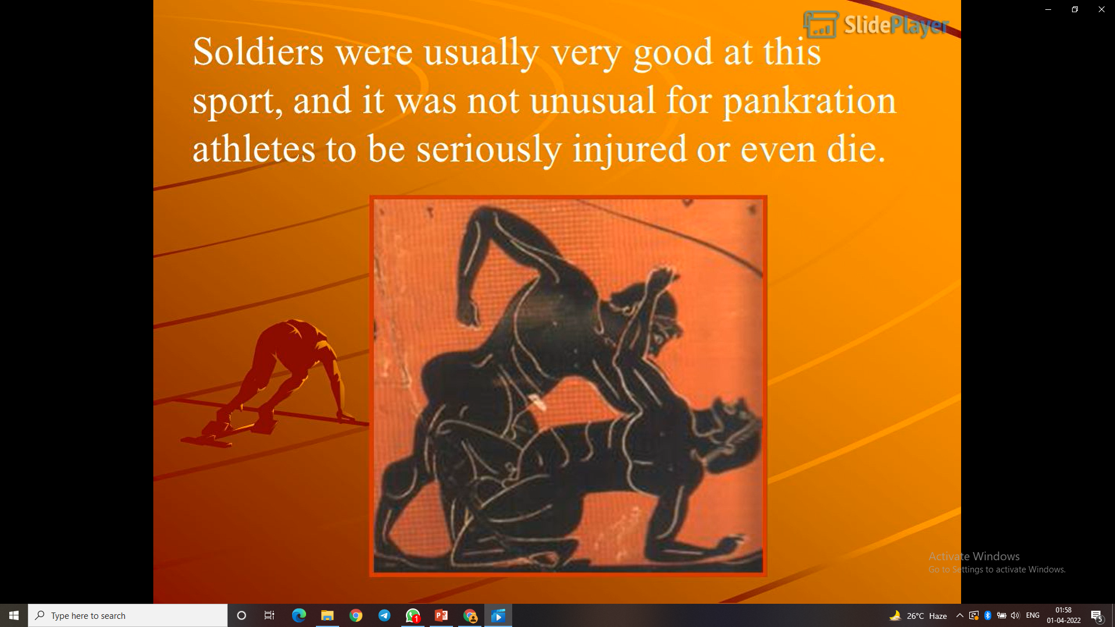

Slide 38
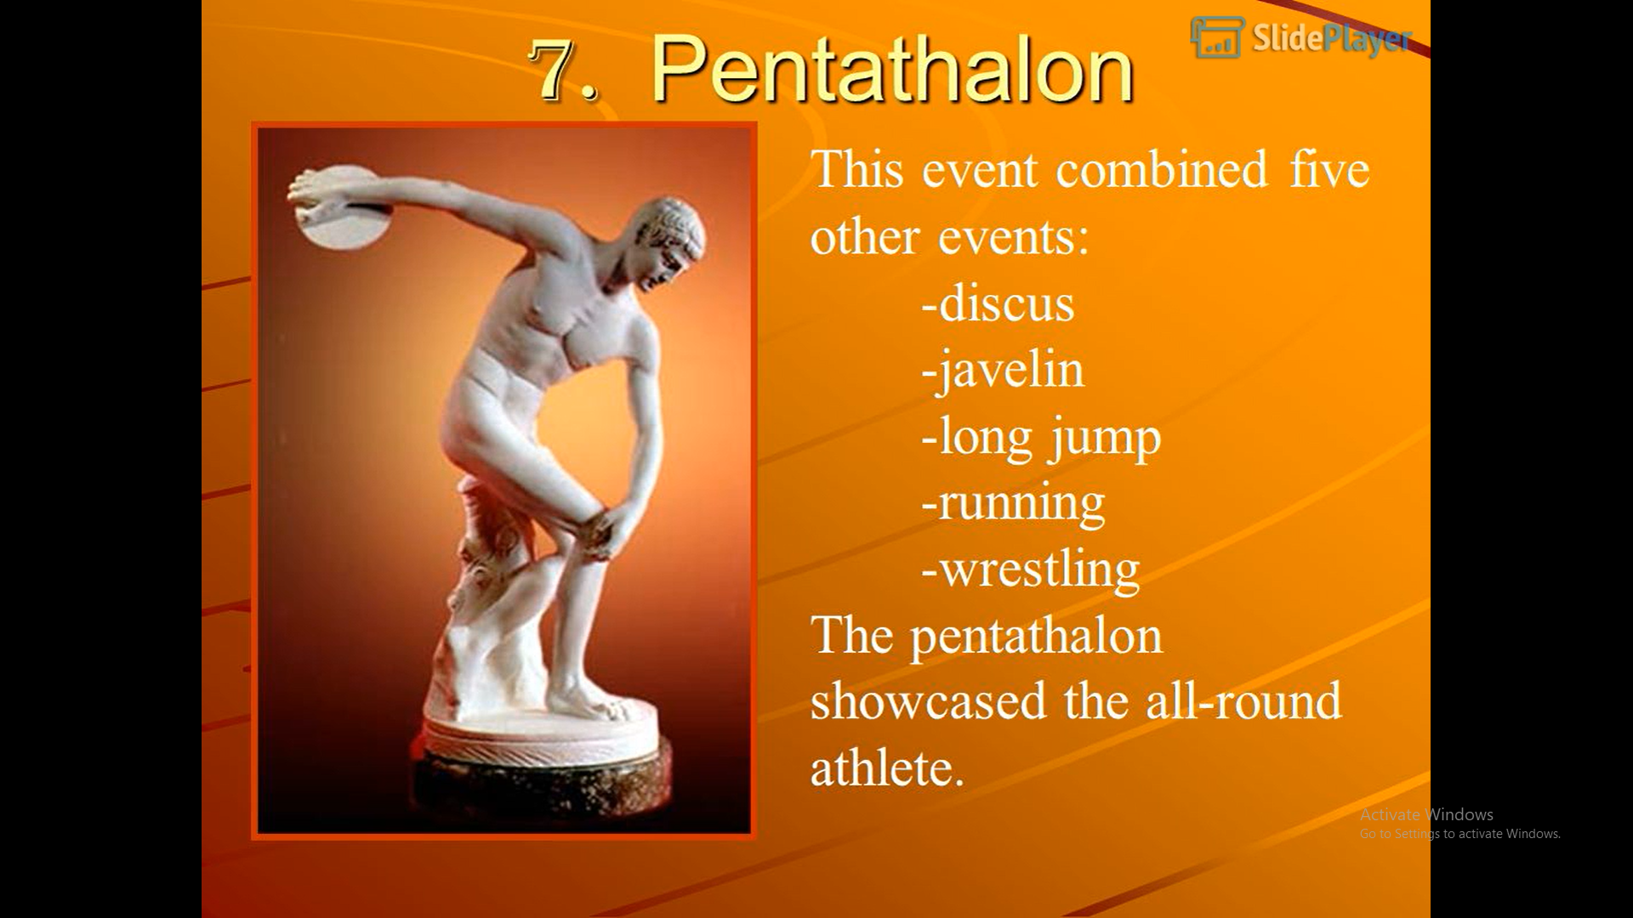

Slide 39
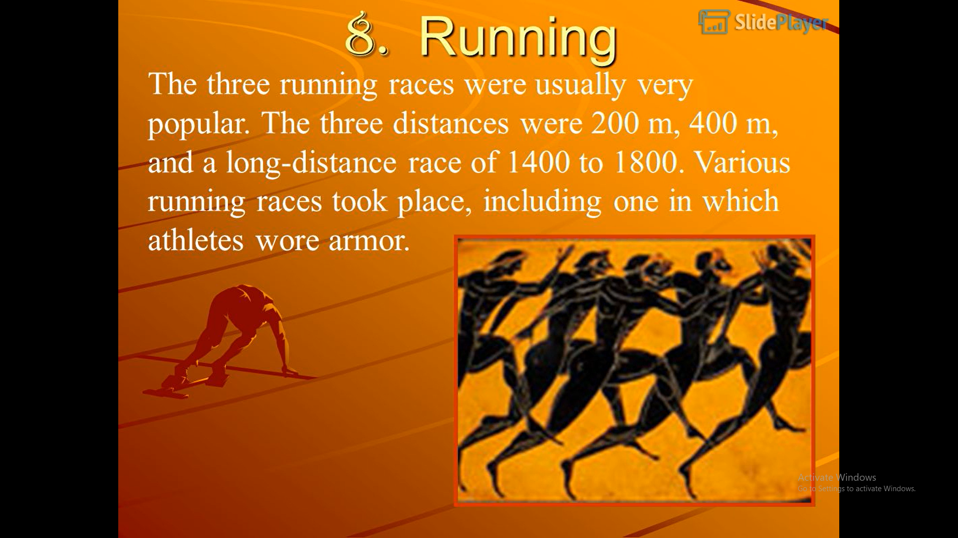

Slide 40
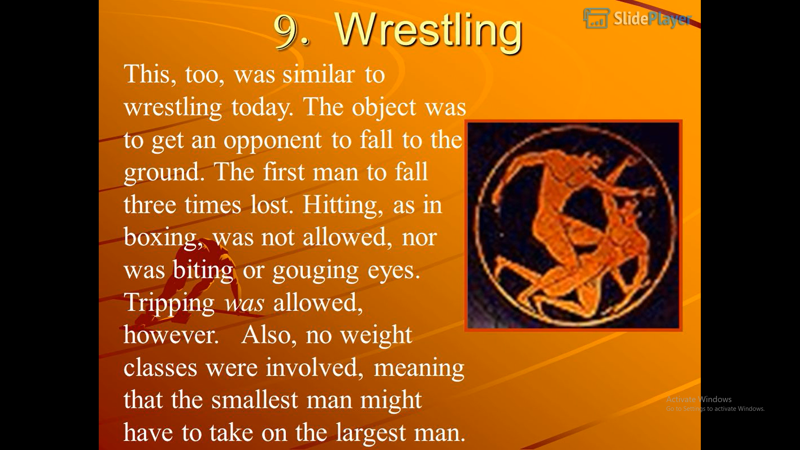

Slide 41
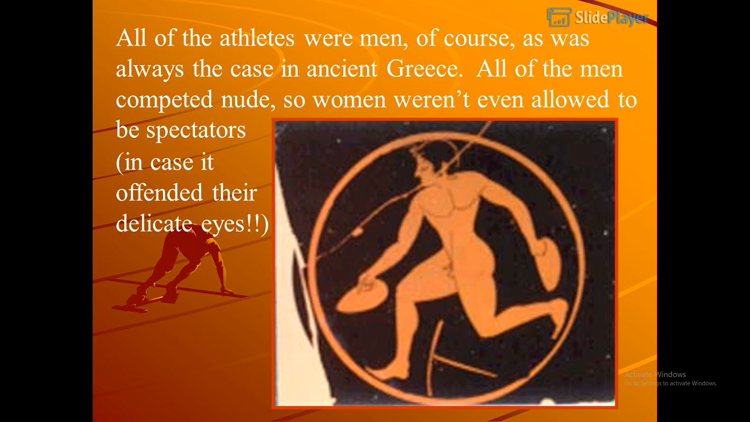

Slide 42
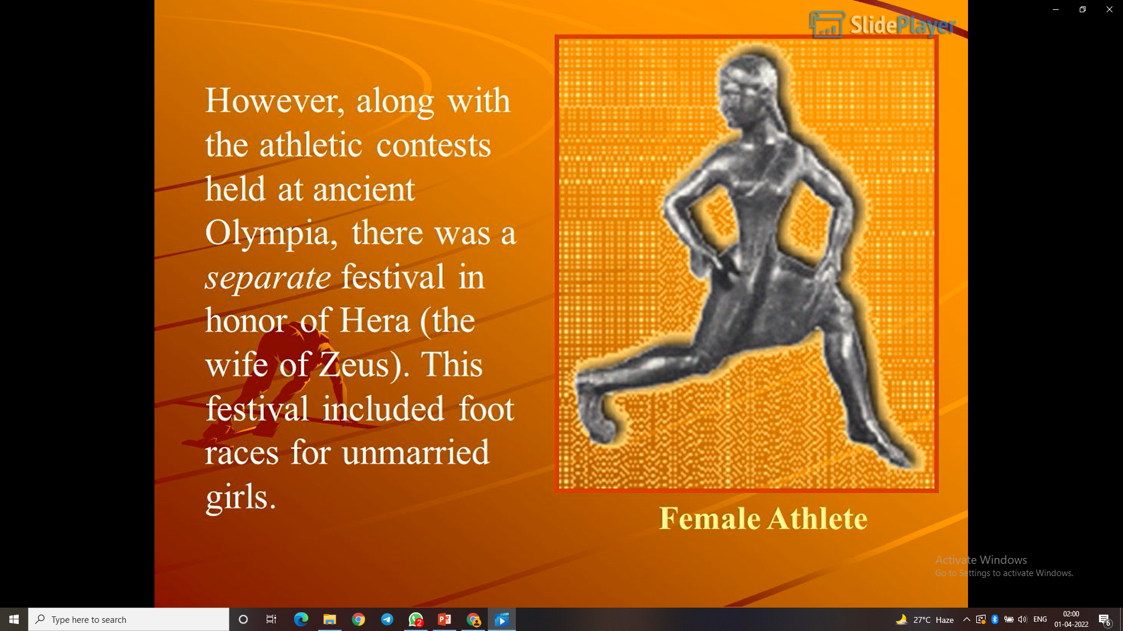

Slide 43
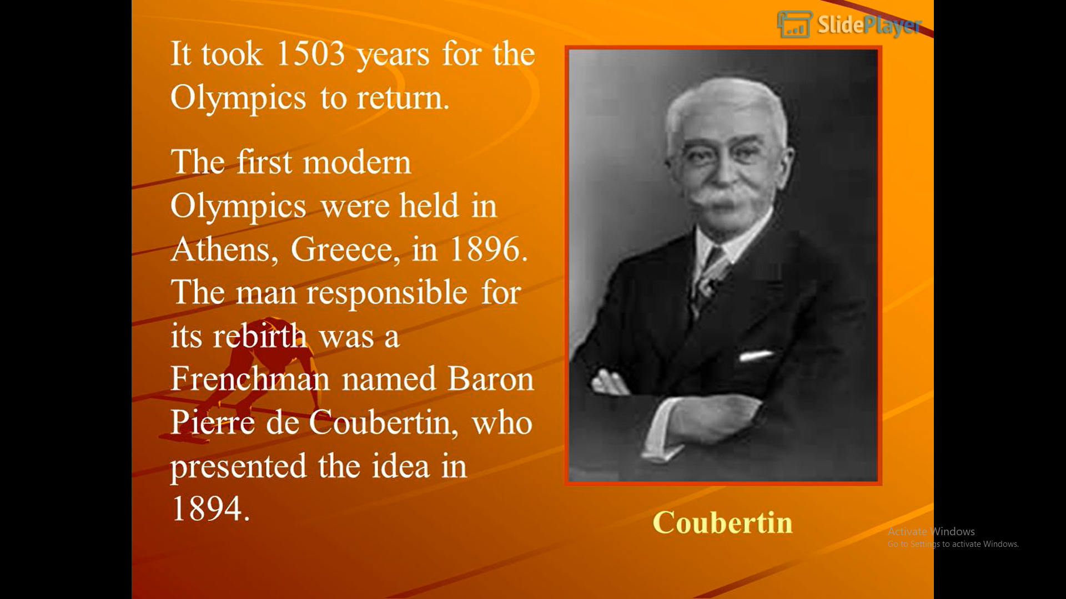

Slide 44
