Slide 1
Sports Medicine
Chapter-3
Padmakshan Padmanabhan

Slide 2
REGIONAL-SPECIFIC INJURIES RELATED TO SPORTS
&THEIR MANAGEMNT
Sports injuries are not uncommon and can be either acute (sprains, fractures, tears, etc.) or chronic (tendinitis, overuse, etc.) Learn how to recognize and treat the most common sports injuries so they heal properly. Some can be treated at home, and some require a trip to the doctor. It's important to understand your options. Almost anyone who exercises on a regular basis will develop an ache, pain or sports injury at some time or another. The number and types of sports injuries are as varied as the individuals who play sports, but some injuries are more likely than others.

Slide 3
How do sports Injuries Occur?
Injuries happen in three distinctive ways and they can be the result of:
External Violence Eg. are contacts collusion, contact with ground/equipment/on players etc.
Internal Violence Eg. are Pulled Muscle, Torn Muscle, Ruptured Tendon, Pulled Ligaments, Cramp, Joint injuries, Impact injuries etc.
(c) Over-use Eg. are When one part of the body is used over and over again. This places a strain on the body part causing repetitive strain

Slide 4
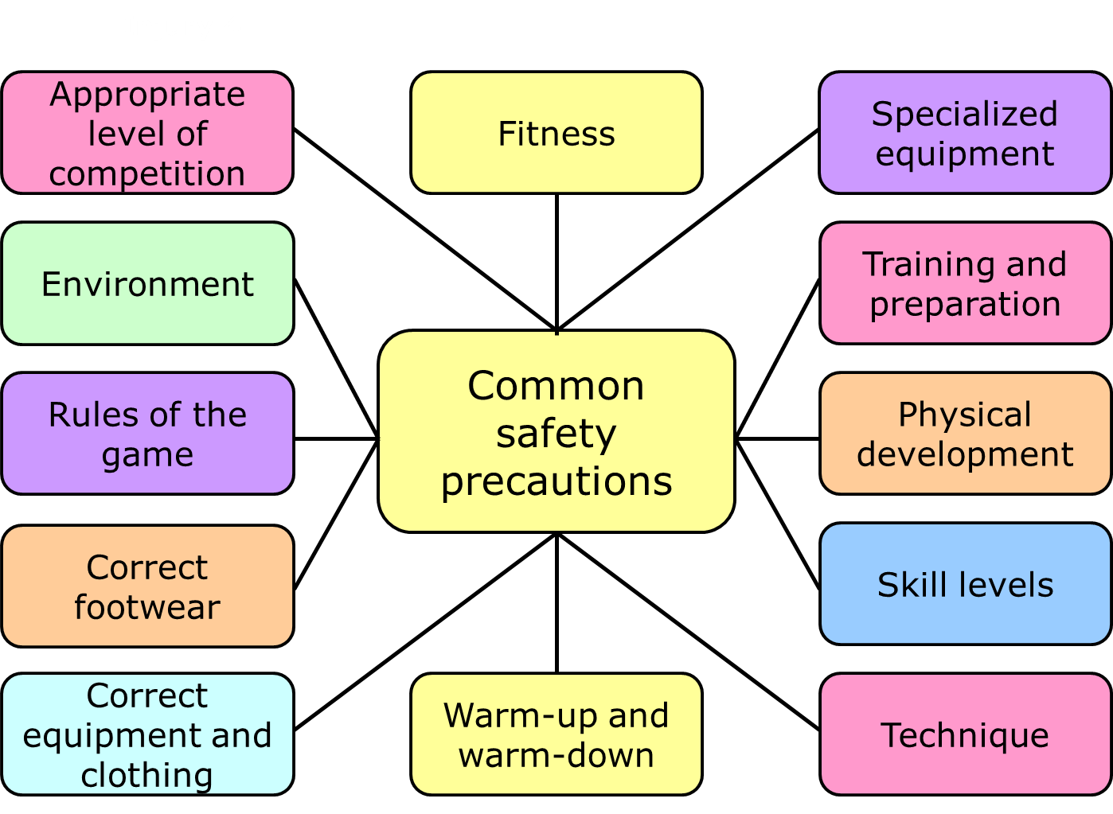

Slide 5
HEAD INJURY & ITS MANAGEMENT
Mild Head injuries usually require no treatment other than rest and over-the-counter pain relievers to treat a headache. However, a person with a mild head injury needs to be monitored closely at home for any persistent, worsening or new symptoms.
If severe head trauma occurs, until medical help arrives, keep the injured person lying down and quiet, with the head and shoulders slightly elevated. Don't move the person unless necessary, and avoid moving the person's neck. Stop any bleeding.
You also need to Asses the head injury of patient by checking airway, cervical spine protection, breathing, circulation, haemorrhage control and the Glasgow Coma Scale. Hypotension, hypoxia etc to avoid further worsening of condition until proper medical attention is to provided.
The most common short-term complications associated with Head injuries are cognitive impairment, difficulties with sensory processing and communication, immediate seizures, hydrocephalus, cerebrospinal fluid (CSF) leakage, vascular or cranial nerve injuries, tinnitus, organ failure, and polytrauma.

Slide 6
NECK INJURY & TS MANAGEMENT
Treatment / Management. Priorities are primarily securing the airway, maintaining ventilation, controlling haemorrhage, and treating shock.
For minor, common causes of neck pain following procedure can be used:
Apply heat or ice to the painful area. ...
Take over-the-counter pain relievers such as ibuprofen or acetaminophen.
Keep moving, but avoid jerking or painful activities. ...
Do slow range-of-motion exercises, up and down, side to side, and from ear to ear.
If you feel the injury is bit serous:
Before getting the medical help, you can keep the person still. Place heavy towels or rolled sheets on both sides of the neck or hold the head and neck to prevent movement.
Avoid moving the head or neck. Don't allow to roll alone.
For minor & common causes of neck pain, you can try the following:
Apply heat or ice to the painful area. Take over-the-counter pain relievers.
Keep moving, but avoid jerking or painful activities. Do slow range-of-motion exercises, up and down, side to side, and from ear to ear.

Slide 7
FACIAL INJURY & ITS MANAGEMENT
Facial trauma, also called maxillofacial trauma, is any physical trauma to the face. Facial trauma can involve soft tissue injuries such as burns, lacerations and bruises, or fractures of the facial bones such as nasal fractures and fractures of the jaw, as well as trauma such as eye injuries. The major symptoms of most facial injuries are pain , swelling, bleeding, and bruising, although a fractured jaw also prevents the person from working his jaw properly.
Treatment:
Control bleeding.
Create a clear airway.
Treat the fracture and fix broken bone segments.
Prevent scars, if possible.
Prevent long-term double vision or sunken eyes or cheek bones.
Rule out other injuries.

Slide 8
THORAX INJURY &ITS MANAGEMENT
Management of chest trauma can be divided into three distinct levels of care; pre-hospital trauma life support, in-hospital or emergency room trauma life support and surgical trauma life support. At each level of care recognition of thoracic injury is crucial for the later outcome.
The most common Thorax injuries are Rib fractures. Ribs 4-10 are the ones most frequently involved. Patients usually report inspiratory chest pain and discomfort over the fractured rib or ribs. Physical findings include local tenderness and reputes over the site of the fracture. And some tomes its also involve heart and lungs
Chest Injuries: Signs and Symptoms
Swelling, Bruising, Redness, Numbness or tingling, Bleeding, Difficulty breathing.
There are four major mechanisms of chest injuries: penetrating, blunt, blast, and inhalation.
A fractured ribs and sternums take about 4-6 weeks to heal and it is usual to still feel some discomfort after this time. Bruising can take between 2-4 weeks to heal. Taking deep breaths and coughing are important normal actions that our bodies do every day.

