Slide 1
PHYSICAL EDUCTAION IN INDIA BEFORE INDEPENDANCE
Many of the historians have devoted very little space to the aspect of Indian history through Indus valley civilization was at its apex when most nation of the Europe had not opened their eyes. The greatest drown back in our civilization, without doubt, has been that the people never kept the written records of their culture and political adventures. Whatever we have received from our ancient people as our heritage based on traditions and costumes, hearsays or legends is whether really reliable , cannot be said with certainty, but excavation at prehistoric sites like Mohenjo-Daro and Harappa etc. That reminds us of a great civilization existing about 2500 years ago, revel that there were gigatic public baths as we find in later Roman period , where people used to do some exercise to keep themselves physically fit . Oil massaging seems to be a widely known to ancient people.

Slide 2
Gambling was one of the most popular sports in this period of prehistoric reckoning . Children mostly played with birds and beasts made to clay. That had pet animals also. When the Aryans occupied spat Sindhu, they pushed down the Dravidians- the aboriginal tribes of India. Certain facts connected with such a transitional period show that dancing was very vigorous and very popular activity among the inhabitants of Indian club-continent. That is why people of Indus valley civilization were very strong physically. In fact, the history of physical education in India cannot be studied along with the classification of various periods of political history of Indian which is divided into following ages:

Slide 3
Vedic period Much of the description about the Aryans who migrated to India from central Asia, comes from the Vedas . the Vedas are not only the religious books but they also contains references to the social , political and geographical life of the people of India. Inhabitants of India, at this period, were very strong and sturdy. they generally loved pastoral and agricultural life . cereals, pulses, vegetables and fruit had very important place in their diet. being strong physically, they were quarrelsome and belligerent . Archery , aiming, horse- riding. Chariot-racing were their common sports. In fact, these sports were not meant for pleasure sake only, they were devices of war as well.
Yoga seems to have originated in this period. 'Pranayama' was consciously as a sacred duty. Pranayama is yogic exercise by which one balance the respiratory circle in such a way that there is a complete 'Suppression ‘of the breath and it is through this that the old sages had the transcendental experience. Yogic asana (body posture) were frequently practised for the fortification of the body and purification of the soul. Some of the physical exercise 'Suryanamaskar' which planed keeping the body healthy.

Slide 4
Epic age The exploitation of the Indians can be gathered from the 'Ramanayana' and 'Mahabharata' which were composed during this period. Both the epics revels that this period was a period of great turmoil and wars. On the other hand , we also come to know that the system of education was quite elaborate. This system had, apart from scriptural studies, physical education as one of the compulsory items. Archery, javelin throw, sword fighting, club fighting, wrestling, horse riding, chariot racing have been elaboratly referred to in Ramayana and mahabharata, Arjun , Bhima , Krishna, Balrama, Karna, Bhishma, drona etc. Have become immortal for their valour and use of arms and armaments. There is no match to Arjuna in archery. To bhema in wrestling, to Ravana in axe-wielding.

Slide 5
To Krishna in disc throwing, Meghnath in flinging celestial weapons(braham astral) etc.in entire history of the epics in the world. There were no separate physical education teachers but the knowledge in arms and armaments was given by the same teachers who were well- versed in scriptural studies too . there used to be gurukuls (schools) where the pupils lived celebrate life upto th age of 25 years and learnt all physical activities and engaged in mental activities. gambling, as a sport for pleasure, was very common and we know that the root cause of the great Mahabharata war was gambling.By the end of this period , many centre of learning came up. Axilla ,Pataliputra, Kanauji, Mithila etc. were a few of them. Many great teachers of repute are mentioned in this period. during this period many treatises were written on astronomy, astrology, philosophy, agriculture, music, dance etc.

Slide 6
Historical age(600 b. C.) The ancient religion (the Hindu dharma) had the first jolt in this period . There was a great revolt against the existing social disparities , cast system, rigid brahmanical attitude and orthodox acceptance of the scriptural authority. Geographically India was divided in to hundreds of very tiny states ruled over by kingly clans that frequently fought with each other. When Buddhism and Jainism shot themselves into prominence, there was general discontentment against Hinduism among the messes and as such even many of good principles of life were thrown away. Both Jainism and Buddhism emphasised the ways of peace and did not envisage any body-building activities for defence purposes. However , Megasthenes who visited India during Chandragupta's Maura's period has referred to a very elaborated system of physical and weapon training for the army . for sports proposes, wrestling, running, jumping, javelin throwing, chariot and horse – racing etc. Were commend those days. Asoka had a very army . This shows that war training was both intensive and extensive.

Slide 7
Nalanda period- Nalanda was great seat of learning where more than 6000 students, not only from various part of country, but also from foreign lands, used to study . Along with religious, scriptural and philosophical discourses , physical education was taught to the student for keeping good health . Pranayama and suryanamaskar were done every day without exception all the year round. The life of the student used to be very hard during this period . Walking, some considered to be atonic for health.
Rajput period There was revival of Hinduism during this period . This period may be known as the chivalry. The Rajput were very proud and were divided in to hundreds of clans. They did not believe in a central authority and were often at daggers drawn with each other. However they remained in their full bloom unto 13th century.

Slide 8
Muslims period - No doubt, this period is also marked by much of strife in which both the Hindus and the Muslims took part for the supremacy of the one over the other. In whatever form physical education existed during this period . it existed for the purpose of preparing the individual for war. Many of the traditional activities like yoga were given asset back due to the fact that the Muslims wanted to undo what the Hindus had done during the long period of their mundane existence.
Hunting seems to be very popular sport of this period. for the purpose of getting, the following sports were practised very commonly;-

Slide 9
Wrestling:- This was patronized by the government. Many wrestler of reputed are mentioned in the mugal period. there were Akharas run by teacher -wrestler. In villages this activity caught a popular image for the purpose of keeping one physically fit.
Chaogan :- It was another popular sport of this period .Qutub- ub-din aibak seems to have died while playing the game. for physical, verve and alacrity, this was an effective sport.
Boxing :- Boxing was popularised by govt. the good boxers were brought from Iran.
Pigeons flying compaction;- Through them the massage were sent from one place to another. Emperor Akbar had 2000 pigeon. carrying the love letters.
Swimming:- swimming was very popular sport of that period. It was compulsory for military training . Baber himself was very good swimmer.
Hunting:- Hunting was an extremely popular sport of this time. even there was a full-fledged department in the government for this purpose.
Animal fighting:- during Muslim period animal fighting was very popular. in the evening the animals were taken to the places and fighting competition were organised. elephant fighting, cock fighting and fighting of other animals was organised during the period.

Slide 10
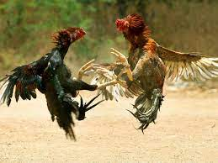
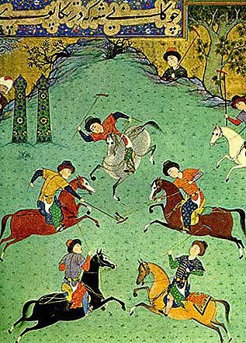
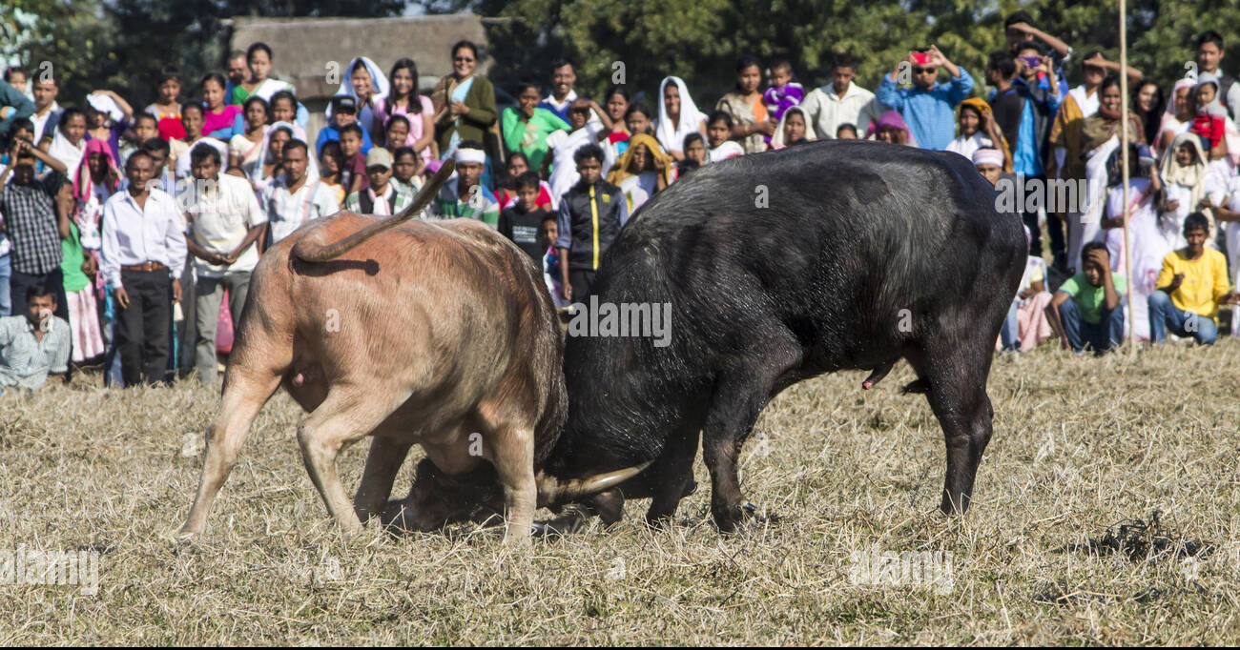
Chaogan

Slide 11
  Individual competition:- Individual competition were organised during master period. the fighting went on till one of the fighter was seriously injured or killed. fighting were also organised between men and beasts.
  Chess:- This sport came in to being in the western India. the king also patronised this sport. during 8th century it went to the China via Kashmir During Jahangir's time it was a very popular sport of the people
  Chopar:- it was an ancient Indian pass time played on a piece of cloth. The cloth had four corner and every corner had 24 squares. all the four corner had different colour Who so ever complete the round of four corners earlier than other players was declared winner.
  Emperor Akbar was a famous player of this game and he could invite 200 people at a time . Everyone had to compete 16 tmes and in the event of not completing the game one had to drink a glass of wine, which was forbidden for Masters.
  Pachisi:- Pachisi was a sport which originated in India. We can find its traces on the walls of Ajanta and Allora. Pachisi was also played on a piece of cloth. This is even now –a-days it is popular in rural India This sport was played by ‘Kauris’(shells) that were Eight in number . If the ‘kasri’ fell in the prone position the player had to move 25 quarters. From this it was given the name of pachisi . in ordinary condition, a player will move ahead the number of squares equal to the shells fallen. This recreative game was a common sight in Akbar’s time who himself was very fond of this game. Ha had a special arrangement of this game at fathehpur Sikari. There he had got made the square of marble which can see even today.

Slide 12
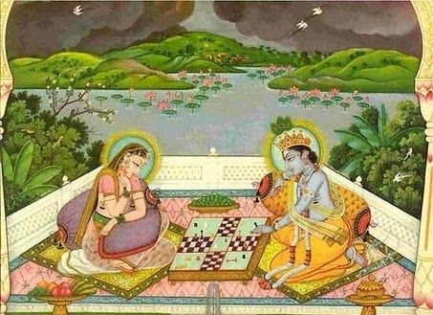
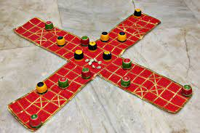

Slide 13
British period:- A flesh back to pre-independence to days:- Physical education has always existed in the Indian society in one form or the another, but had never been considered as a part and parcel of school curriculum. No doubt, the English are the sports loving people and pioneers in education but in India as ruler, they also never paid any attention to the inclusion of physical education in the school education programme. In 1833 government of India (at the centre) shouldered the responsibility of the education and in 1870, the subject of education was made a state subject—only the centre retained the supervisory power. Physical was given no place in school programme. For the first time it was the Indian education commission in 1882 that recommended “physical training be promoted in the interest of the youth by the encouragement of native games.
Gymnastic, drill, and other exercises suited to each class of school”. This spurred the interest in the school children to take physical activities as enjoyable activities. In 1894, the question of making physical education as a compulsory subject was considered but no definite policy came out of this, western game especially cricket, were becoming very popular on voluntary basis.
Private organisation for physical education like gymnastics, vyayam ,scholar Akhada,s and Kreere Mandal contributed appreciably to the spread of traditional interest in developmental and conditioning activities like dands baithaks, yogic exercises, vigorous folk dances, wrestling, lathi fight, exercise with light apparatus and indigenous game like kho-kho, atyapatya, it is heartening to note that some of the princely states also promoted some games especially pole, hockey, cricket etc.

Slide 14
Pre-independence days goes to the Y.M.C.A college of physical education , Madras founded in 1920, by Mr. H. C. Buck. Since its inspection this college has been working to promote and systematise physical education in India. In 1931, the government college of physical education Hyderabad and in 1938, Christian college of physical education Lucknow were established. In 1938, came in to existence another “training institute of physical education” kandivali (Bombay) in 1914 Vaidya brothers founded sir Hanuman Vyayam Prasarak Mandal ,Amaravati basically to serve the cause of physical education in India. In 1924, this institution started a five weeks summer course for Youngman and women in indigenous activities.
A youth completing this course was awarded “Vyayam Visharad”. Here in 1946 at the time of All India physical education conference. National Association of Physical education and Recreation of India was formed . The Mandal team gave numerous demonstration of activities in Europe and Middle east and in 1936 at Olympics games at Berlin and in 1949 at the second Lingard at Stock home.

Slide 15
New Horizon
This land of "Baharat" threw off the yoke of the British serfdom in the year 1947. This necessitated the formulation of new politics- Political and educational to suit our social set -up and to build up a new nation. The subject of education was transferred to the states but the centre retained the vital affairs of coordination and formulation of directives to the states keeping in view the national objective to be achieved. thousands of social forces started operating in the life of an Indian citizen. As a result innumerable schools were opened to give compulsory and free education up to the age of 14 years. Thousands of new colleges and many new universities came in to existence to give impetus to the cause of education, ensure industrial development, to herald a green revolution and to raise standard of living of countrymen.

Slide 16
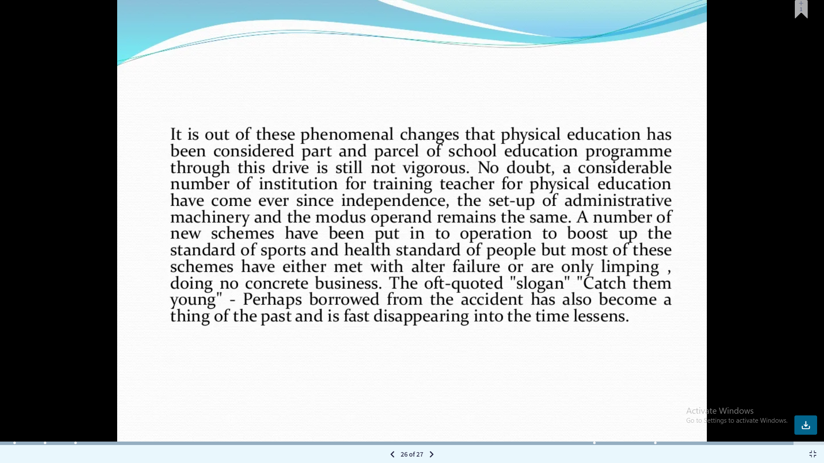

Slide 17
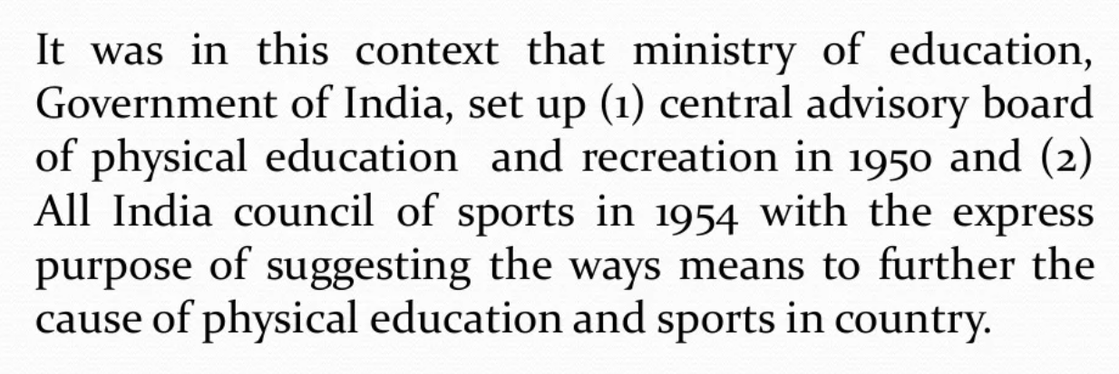

Slide 18
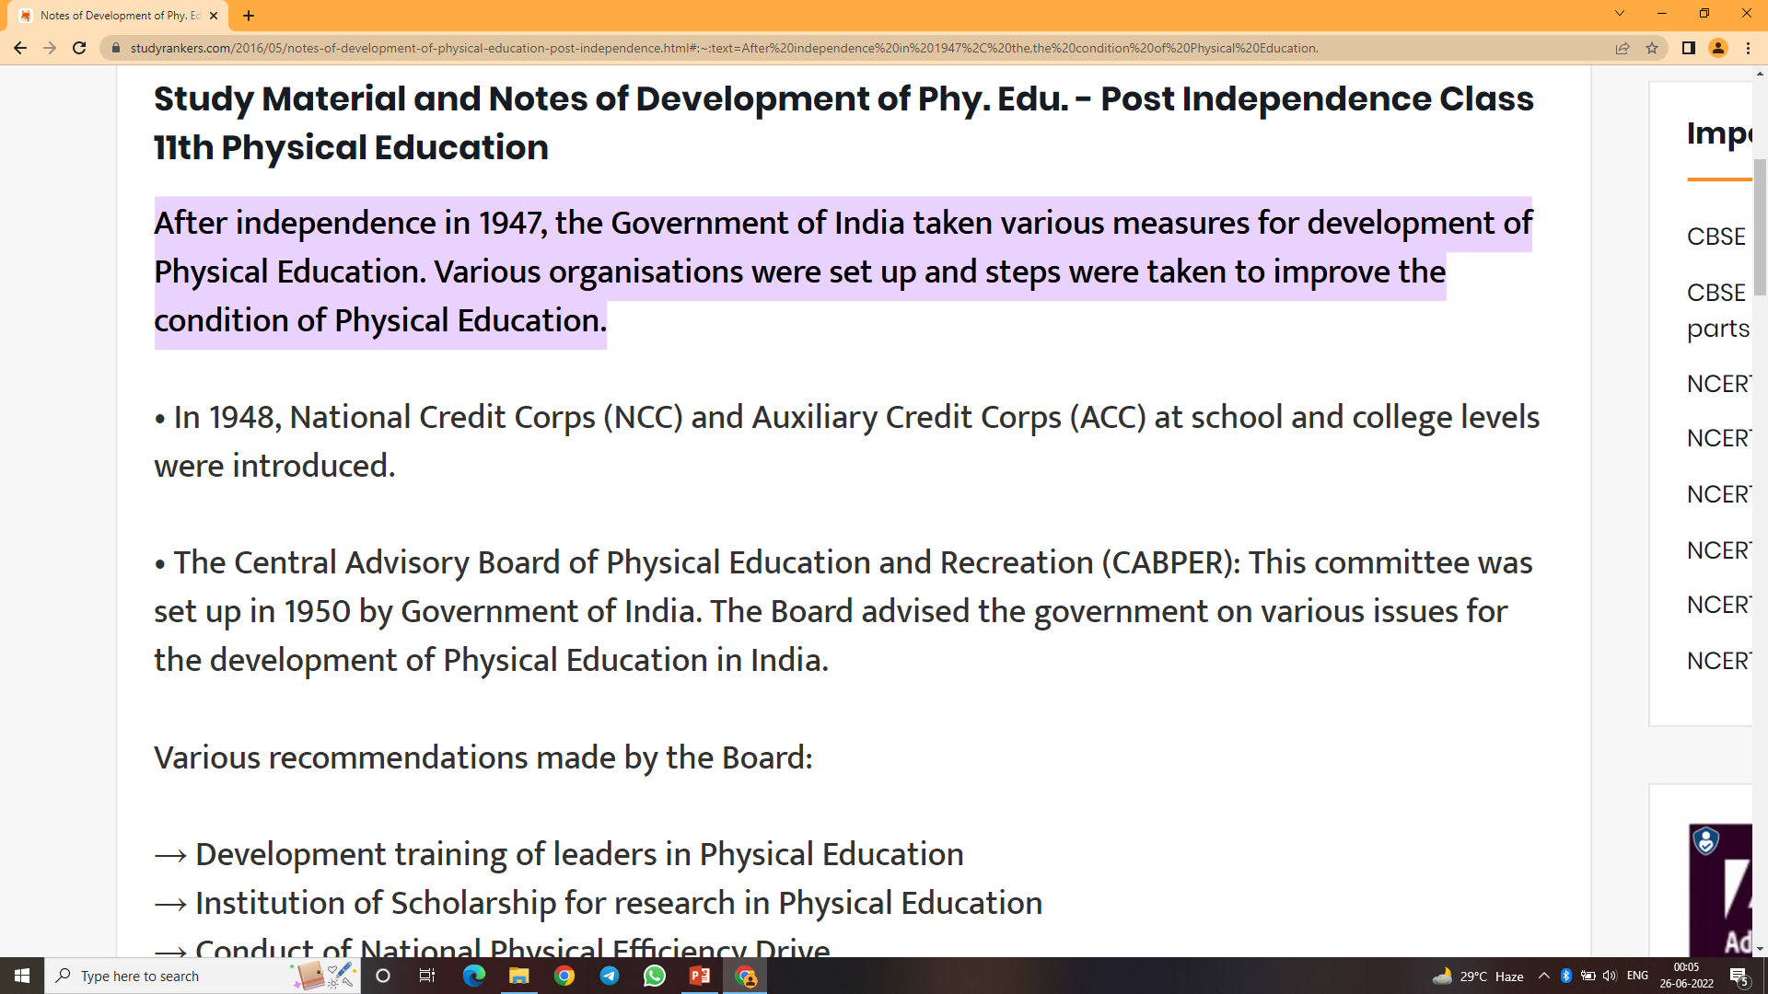

Slide 19
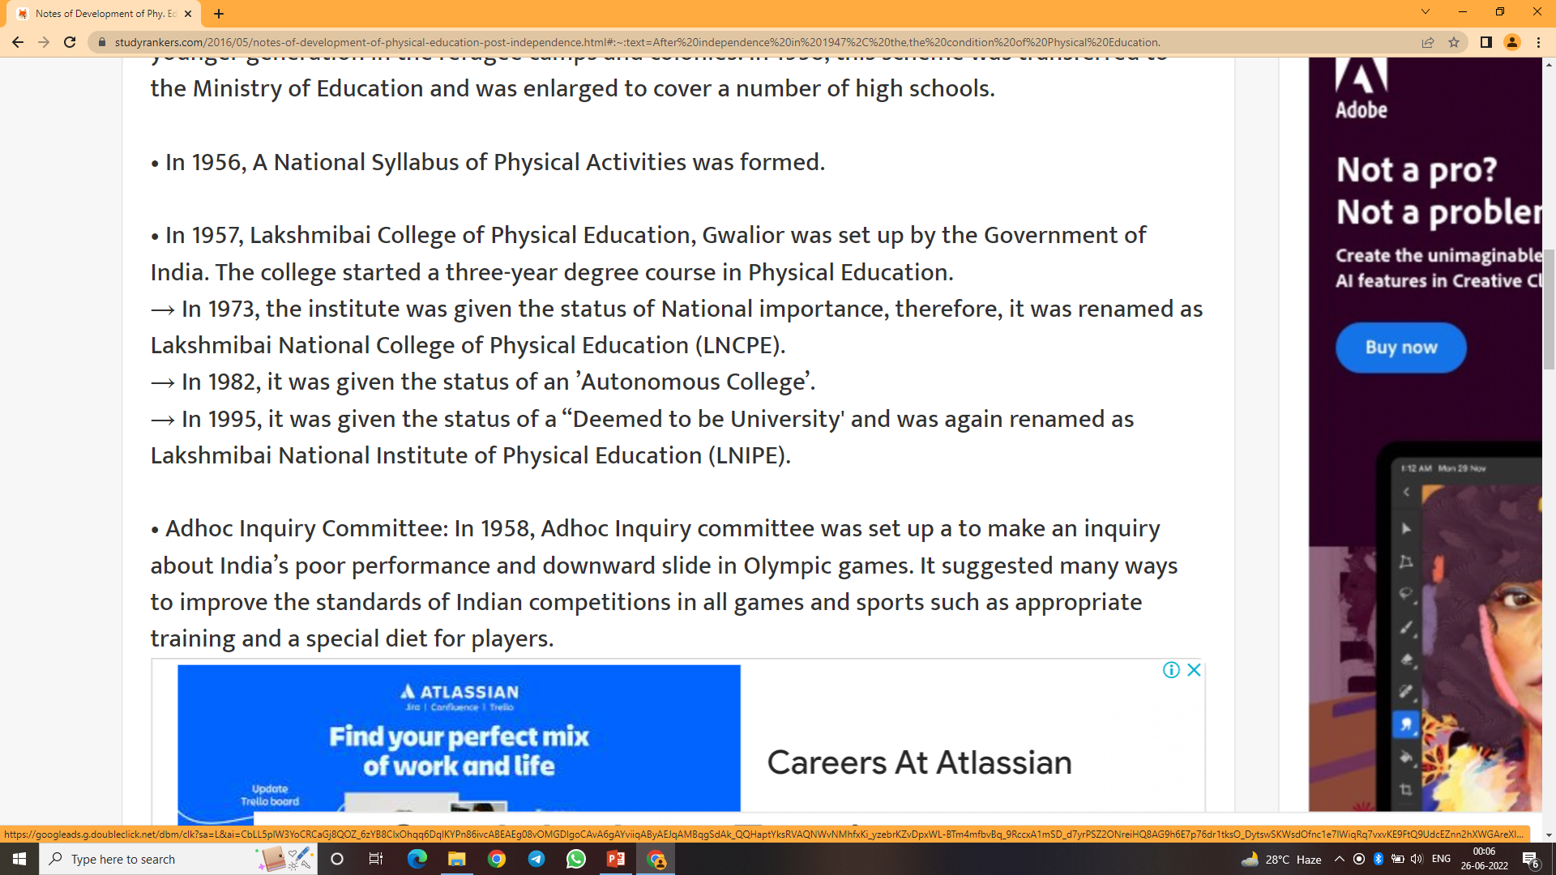

Slide 20
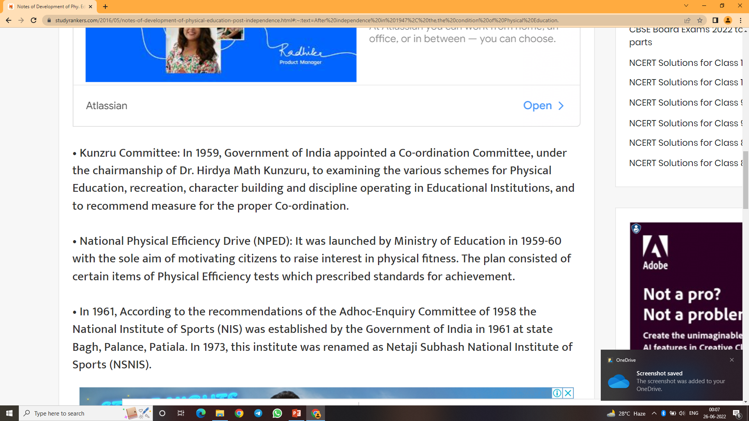

Slide 21
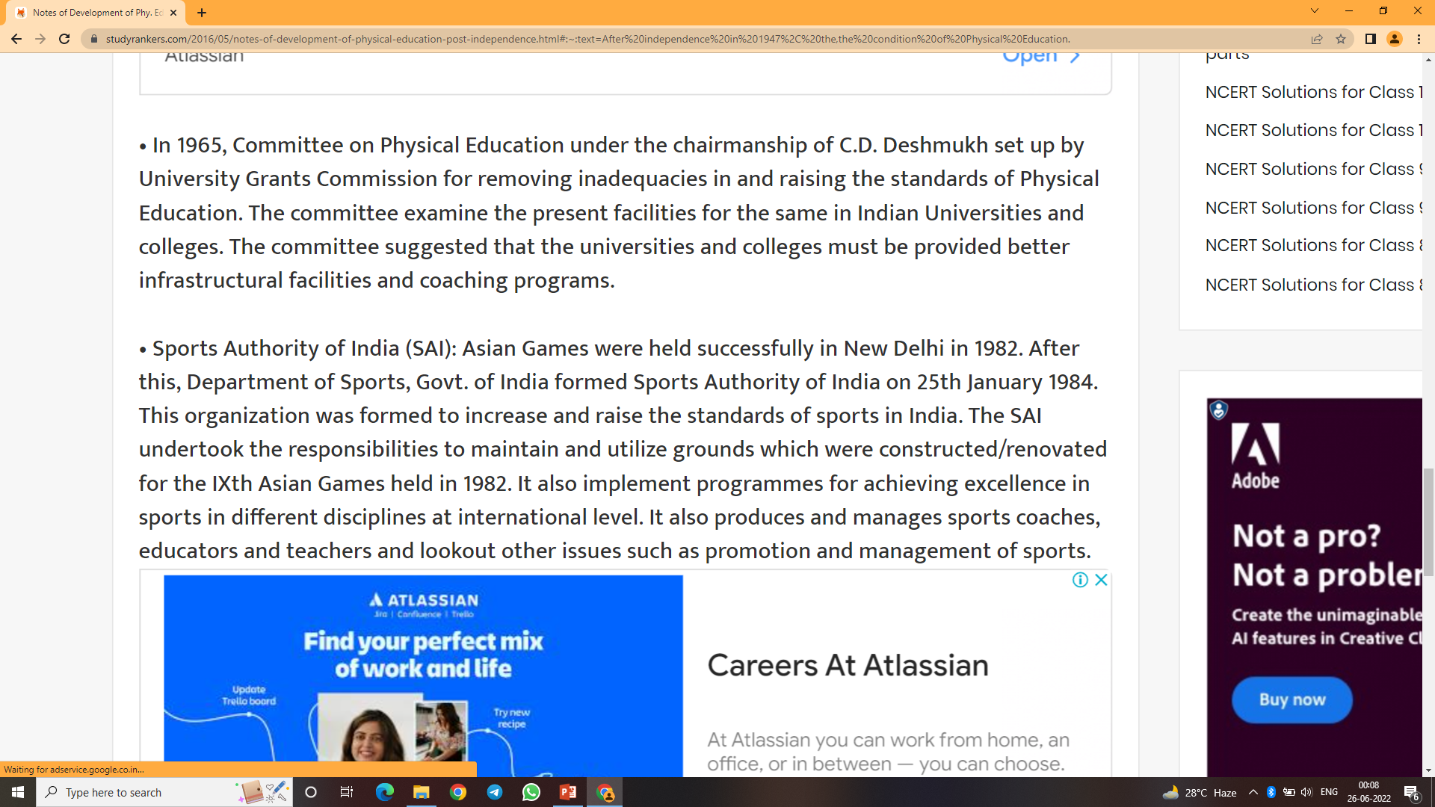

Slide 22
