Slide 1
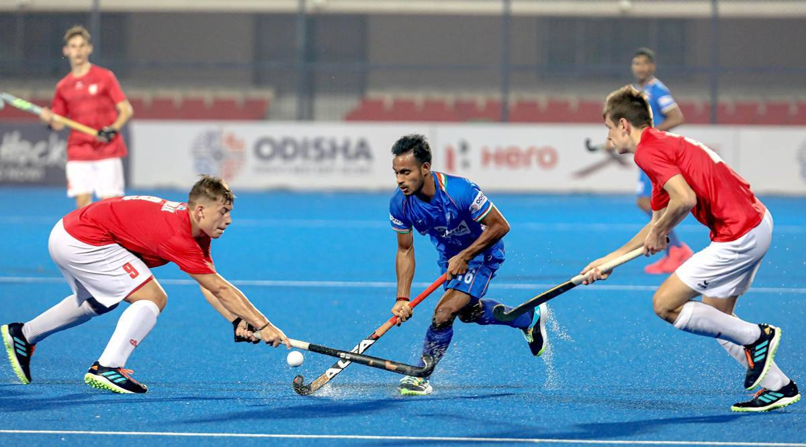
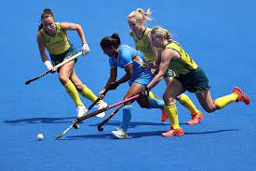
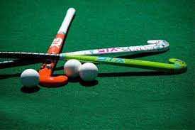
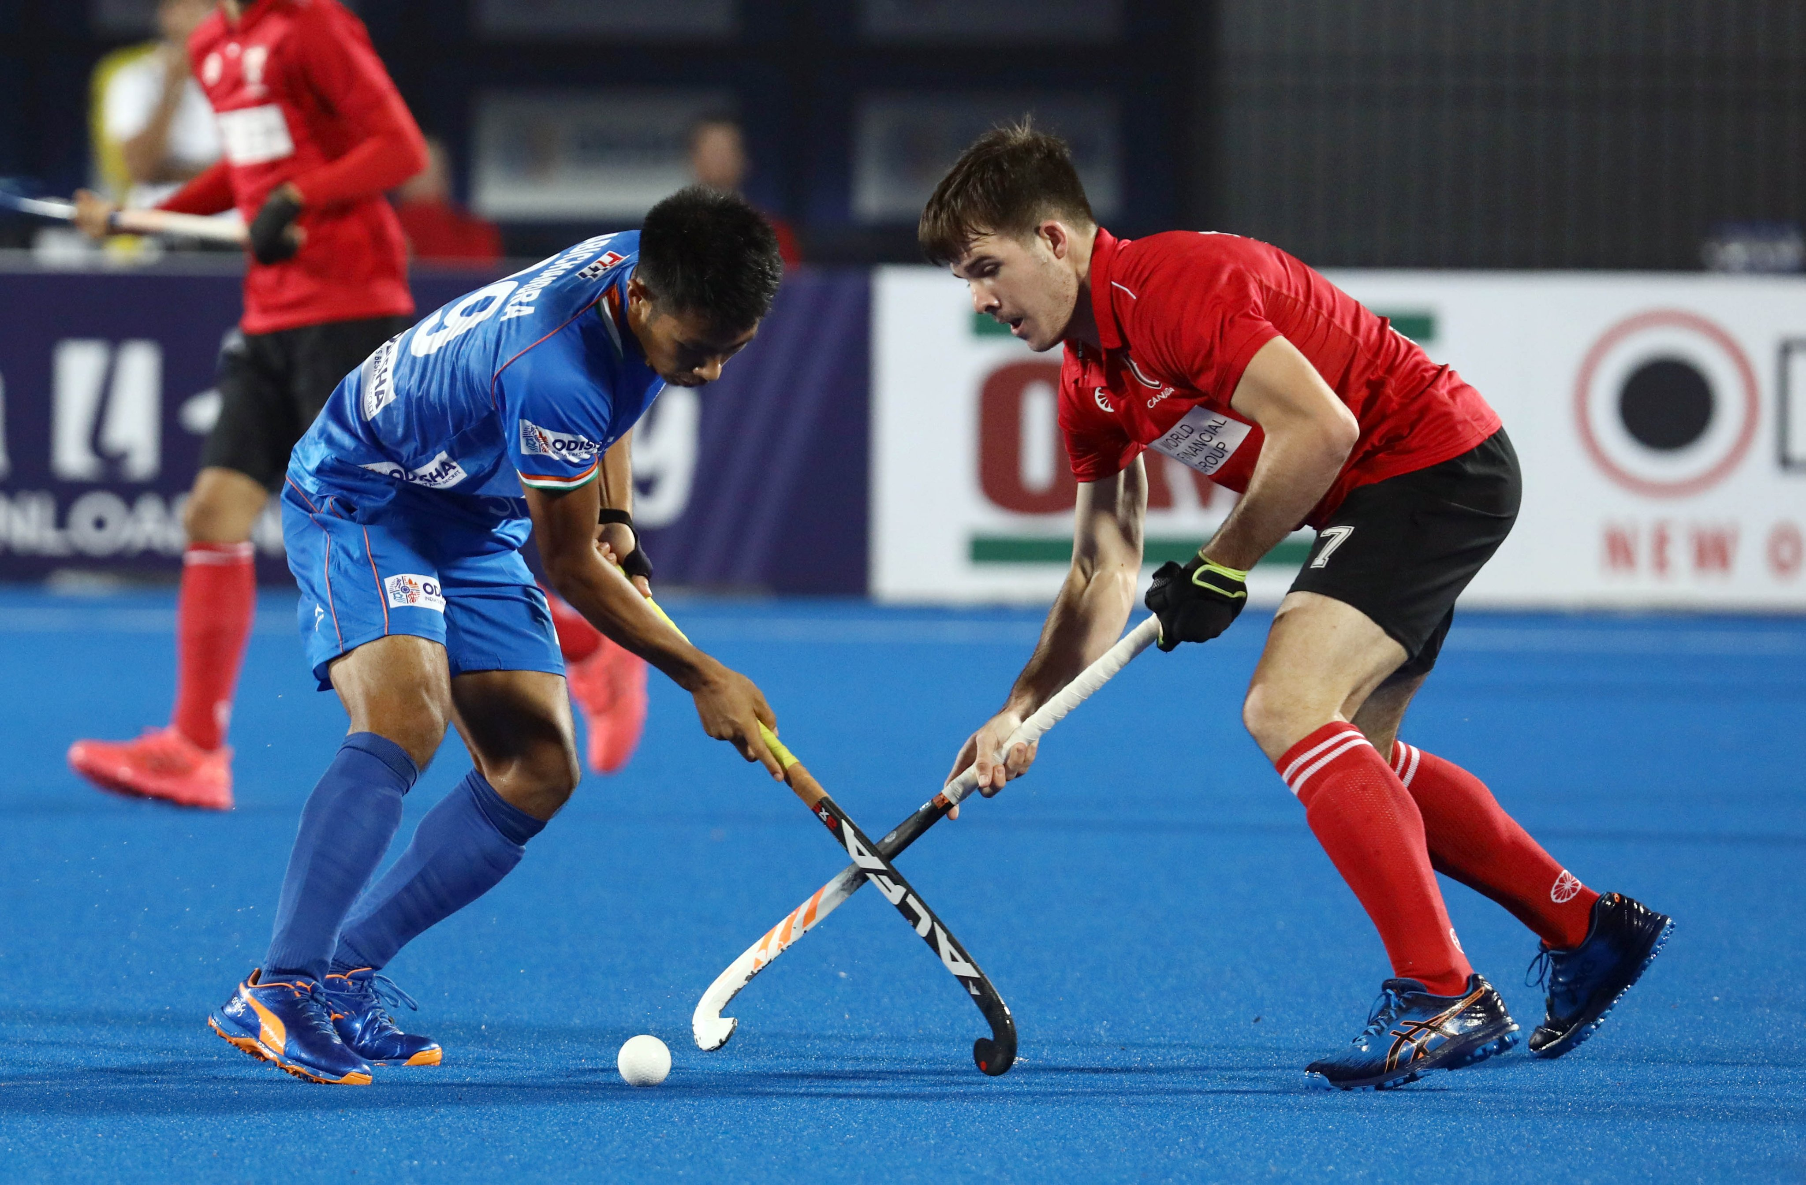
Hockey

Slide 2
History of Hockey
Historical records show that a crude form of the game was played in Egypt 4,000 years ago, in Ethiopia around 1,000BC, An ancient form of the game was played in Iran in around 2,000BC.
Various museums offer evidence that a form of the game was played by the Romans and Greeks also.

Slide 3
The modern game of hockey emerged in England in the mid-18th century.
The first Hockey Association was formed in the UK in 1876 and drew up the first formal set of rules.
The original association survived for just six years but, in 1886, it was revived again.
First Olympic Hockey Competition for men was held in London in 1908 with England, Ireland, Scotland and Wales competing separately.

Slide 4
Hockey in India
In India, the first hockey club came up in Calcutta in 1885-86 and soon Bombay and Punjab followed suit.
The first hockey association in India was formed in Calcutta in 1908 which was known as the Bengal Hockey Association.
Making its Olympic debut at the 1928 Amsterdam Games, Indian hockey team cruised home to its first Olympic gold, without conceding a single goal. The hallmark of this ruthless domination was the “Wizard of Hockey” legend – Major Dhyan Chand, who mesmerized the Amsterdam crowd with his dazzling skills.

Slide 5
Hockey in India
From 1928 to 1956, the Indian hockey team won six straight Olympic gold medals, while winning 24 consecutive matches. During this time, India scored 178 goals conceding only 7 in the process. This was the golden era of Indian hockey, when India loomed large in world hockey and produced some of the finest players the game has ever seen. During this dominance, one name that clearly comes to mind is Balbir Singh.

Slide 6
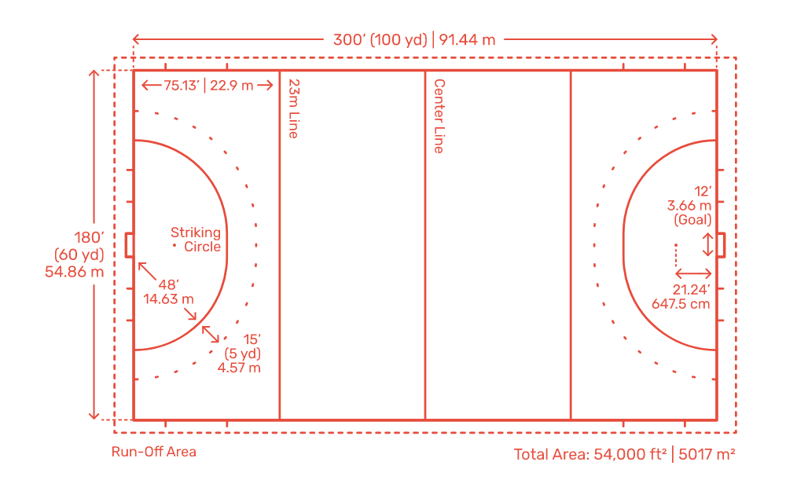
Dimensions of Hockey Ground

Slide 7
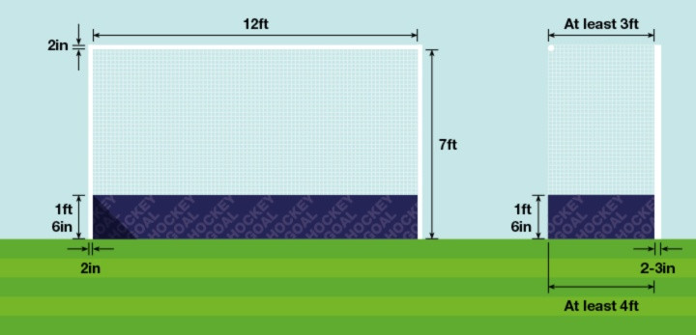
Hockey goal post

Slide 8
Rules and Regulations
Number of Players:- 11 Players (including a goal Keeper )
Duration of play:- 4 quarter of 15 minutes each (15-2-15-10-15-2-15)
Break:- 10-15 minutes

Slide 9
PENALTY CARDS :
Field hockey uses a three card system for player warnings and suspensions for deliberately dangerous play, unsportsmanlike behavior and repeated violations.
Green Card: Player must leave the field for 2 minutes and the team plays short (no replacement).
Yellow Card: Player leaves for at least 5 minutes (at the discretion of the official) and the team plays short.
Red Card: Player leaves the game and cannot be replaced. They may be suspended for subsequent games.

Slide 10
Skills in Hockey
Offensive skills- Moving the ball
Push - This skill is executed with player’s hands apart. The head of the stick stays in contact with the ball as it is pushed and there is no backswing. This allows for good control, quick movement, and is used for accurate passing or shooting.
Hit - A powerful motion where the stick is brought down swiftly from a back swing and strikes the ball with a long follow through. The hit is fast and favored for sending the ball long distances or for making a hard shot on goal.

Slide 11
Lift, Flick, Arial - A skill in which the ball stays in contact with the head of the stick as it is lifted into the air. There is no back swing. Lifts are used primarily to raise the ball over long distances or as hard shots on goal.
Forehand Sweep - Commonly used on turf or a smooth playing surface, player lowers stick parallel to ground and sweeps the ball in a circular motion. A sweep allows for more power than a push, making it effective for quick yet long hard passes and shots.

Slide 12
Reverse Sweep - Player uses the same motion as the forehand sweep with the ball starting on players left side. Player uses a different grip and must use the side of the stick with the flat side up. This is an effective motion for passing and shooting. 5 or 10 Minute halftime Good stick skills and passing are the keys to success.
Drag Flick - Considered a push, this specialty skill is used by advanced players as a variant to the straight shot or hit on a penalty corner. It can be as powerful as a hit yet requires no back swing, making it especially deceptive. It’s an important sklll to develop for high level competition

Slide 13
Defensive Skills: (Stopping the ball)
Block Tackle - Player lowers the stick close to the ground and uses the length of the stick to block a ball’s advance. Using the entire stick widens the area available to intercept or steal the ball and slows the offensive player’s motion.
Jab Tackle -Player jabs the stick toward the ball with left hand extended (flat side up), then quickly returns to both hands and regains a balanced position. This swift motion can disrupt the advance of the play and possibly cause a loss of possession.
Reverse Tackle - Used when an offensive player is on a defender’s weak (left) side, defensive player extends left arm out with stick inverted close to the ground to slow the play, block the ball’s path and try to cause a loss of possession.

Slide 14









World Rankings
Men |  |  | Women
Rank | Team |  | Rank | Team
1 | AUSTRALIA |  | 1 | NETHERLANDS
2 | BELGIUM |  | 2 | ENGLAND
3 | INDIA |  | 3 | ARGENTINA
4 | NETHERLANDS |  | 4 | AUSTRALIA
5 | GERMANY |  | 5 | GERMANY
6 | ENGLAND |  | 6 | SPAIN
7 | ARGENTINA |  | 7 | BELGIUM
8 | NEW ZEALAND |  | 8 | NEW ZEALAND
9 | SPAIN |  | 9 | INDIA
10 | MALAYSIA |  | 10 | CHINA

