Slide 1
Sports Medicine
Chapter-9
Padmakshan Padmanabhan

Slide 2
DIATHERMY
  Short wave Diathermy –which is a electromagnetic form of energy, when applied to the body causes rotation of molecules and result in friction between molecules which produce increased tissue temperature.
  Here in conversion the rate of heat transfer is depends up on the power of the energy source.
  Heat transfer by conversion does not need any direct contact between the thermal agent and the body.
  A gel, lotion or water can be used eg-(UST) other wise air comes in between and transmit US poorly.

Slide 3
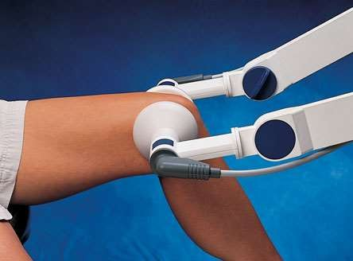
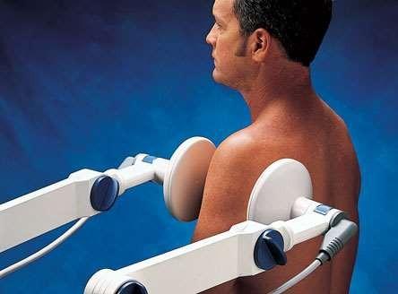
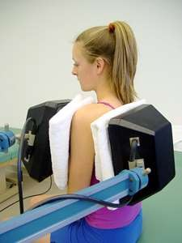
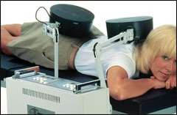



Slide 4
ULTRA SOUND(CONVERSION HEAT)
Here the heat is produced from the conversion of a non thermal form of energy such as mechanical or electrical in to heat.
Ultrasound – which is a mechanical form of energy, is converted in to heat when applied to a tissue.
The ultrasound waves causes vibration of the molecules in the tissues, thereby generating friction between molecules resulting in an increased tissue temperature

Slide 5
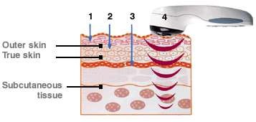
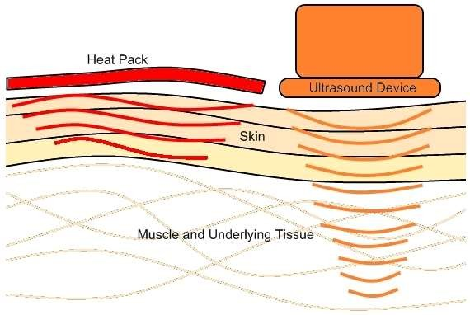

Slide 6
INFRA-RED LAMP THERAPY
Infrared light is one of several innovative therapies that are being trialed for the management of patients with acute or chronic pain. The therapy uses certain wavelengths of light that are delivered to sites of the body that have injuries. ... Infrared light is the heat people feel when exposed to the sun.

Slide 7
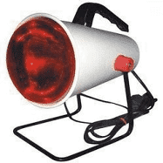
Since infrared therapy enhances and improves circulation in the skin and other parts of the body, it can bring oxygen and nutrients to injured tissues, promoting healing. It helps ease pain, relieve inflammation, and protect against oxidative stress
Infrared therapy is a method that uses light to treat acute or chronic pain. It is a simple and painless therapy that is being studied for use in various fields of medicine.

Slide 8
Unlike ultraviolet light - which has damaging effects upon the tissues and cells of the body - infrared light helps cells regenerate or repair themselves. Infrared light also improves the circulation of oxygen-rich blood in the body, promoting faster healing of deep tissues and relieving pain.
One of the characteristics of infrared light is its ability to penetrate below the skin layers, providing a much greater depth which is able to effectively provide pain relief. In fact, this invasive, natural, and painless method can provide a vast range of health benefits, without damaging the skin through UV radiation

Slide 9
APPROCH TO SPORTS RELHABILITATION
Sports injury rehabilitation is a safe, therapeutic approach that helps athletes effectively treat pain and achieve optimal performance with: Targeted exercises to help you return to pre-injury function. Reduced susceptibility to further sport-related injuries.
Reduction of pain and swelling.
Restoration of joint mobility and range of motion.
Recovery of muscle strength and endurance.
Recovery of co-ordination.
Recovery of sport-specific technical movements.

Slide 10
What is sports rehabilitation
Sport Rehabilitators help people suffering from pain, injury or illness involving the musculoskeletal system. They help people of all ages to maintain their health and fitness, recover from and prevent injury and reduce pain using exercise, movement and manual based therapeutic interventions.
Types of rehabilitation. The three main types of rehabilitation therapy are occupational, physical and speech. Each form of rehabilitation serves a unique purpose in helping a person reach full recovery, but all share the ultimate goal of helping the patient return to a healthy and active lifestyle.

Slide 11
The 4 Stages of Complete Rehabilitation
Rest and Protect the Injury. The first stage of recovery is all about minimising further damage and letting the body begin the healing process.
Recover Your Motion.
Recover Your Strength.
Recover Your Function.
Difference between sports therapy and sports rehabilitation
Physiotherapy attempts to rehabilitate patients to allow them to feel comfortable and cope in their day-to-day life, whereas Sports therapy on the other hand focus's more on whether that the patient has returned to or can maintain the required physical level for whatever sporting activity they would like to carry out.

