Slide 1
Sports Medicine
Chapter-8
Padmakshan Padmanabhan

Slide 2
SAUNA BATH
It is a receiving method, which is providing for muscular relaxation and recovery from fatigue. This method has been in use for very long time in the field of sports and games especially for high performance.
PROCEDURE :
Dry heat 2 minutes
Cold (bath) 2 minute
Dry heat 3 minute
Cold(bath) 3 minute
Dry heat 2 minutes
Normal bath

Slide 3
Sauna bath Indications& contraindications
Indications:
Temporary Weight loss
Muscular relaxation
Release toxins from body
Recovery from fatigue
Contra indications:
Heart desese
Infection deseases
High BP
Pregnency

Slide 4
Post- proceedings
Laydown on the bed for 30 minutes
After that take plenty of water/fruit juice
No Alcohol/smoking till 2.5 hrs

Slide 5
JACUZZI
A hot tub is a large tub or small pool full of water used for hydrotherapy, relaxation or pleasure. Some have powerful jets for massage purposes. Hot tubs are sometimes also known as spas or by the trade name Jacuzzi.
Difference between Bath tub and Jacuzzi
A Jcuzzi is actually a brand name for a company that produces both bathtubs, (indoor tubs installed in bathrooms) and hot tubs or spas (generally outdoor tubs). ... Bathtubs on the other hand are generally installed indoors and are filled with water heated by the residential in-home water heater for each use.

Slide 6
How does Jacuzzi works
The vacuum power of the pump draws water in, while the screen prevents bath accessories and arms, fingers and toes, from being suctioned into the valves. The pump's motor creates force, which expels water from the jets at varying pressures. ... The tub itself is turned on and off by a switch located on the bathtub.

Slide 7
How long you can stay in a jacuzzi
Ideally, you should aim to time your hot tub sessions to last between 15 and 30 minutes. Depending on the factors at play (i.e. water temperature), you might be able to extend your soak to 45 minutes. Keep in mind that you can always re-enter your hot tub later on!

Slide 8
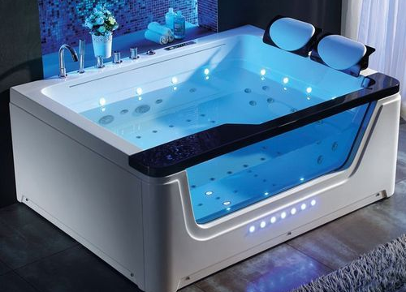
A hot tub can be amongst the more enjoyable tools in your weight loss toolkit. While soaking in a hot tub doesn't burn many calories—it's estimated that sitting in hot water only burns about 3% more calories than sitting on your couch—there are, in fact, several impressive hot tub health benefits for weight loss.

Slide 9
Whirlpool bath
whirlpool bath one in which the water is kept in constant motion by mechanical means and has a massaging action that can promote improved circulation and relaxation; often used in the treatment of soft tissue injuries and management of open wounds such as burns.
A whirlpool bath reduces the amount of pain you feel in your joints or your muscles when you indulge in the treatment every few days. The warmth of the water helps increase your circulation, improving blood flow around the body. This in turn improves the function of various organs and also helps to protect the heart

Slide 10
Principle of application
-THE PRINCIPLE OF WHIRLPOOL THERAPY IS TO
COMBINE THE EFFECTS OF TEMPERATURE WITH
THE MECHANICAL EFFECTS OF WATER
-WARM WHIRLPOOL CONTAINS WATER AT
TEMPERATURE RANGES BETWEEN 36-45 DEGREE
CELECIUS AND A JET OF WATER OR AIR STREAM
ALLOWED TO PRODUCE TURBULENCE IN WATER
THIS TURBULENCE IS PRODUCED BY A
ELECTRICAL MOTOR INCORPORATED INTO THE
APPARATUS
DEPENDING UPON THE
APPARATUS,WHIRLPOOL BATH CAN BE USED
FOR THE TREATMENT OF LIMBS OR WHOLE
BODY

Slide 11
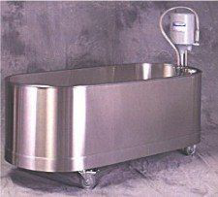
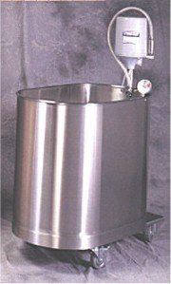
Types of Whirlpool Baths
-Low boy tank
-High boy tank
-Hubbard tank
-Extrimity tank
Low boy tank- The Low Boy Tank can be used to
allow an adult to sit in the tank and can range in
capacity from 75 to 105 gallons
High boy tank-
sometimes referred to as a
hip or leg tank, can allow
for the immersion of both
lower extremities
Capacity can range from
60 to 105 gallons

Slide 12
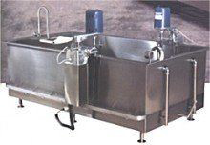
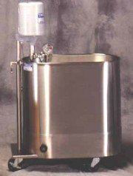
Full body immersion/Hubbard tank- The Hubbard
Tank has a greater potential for exercise during
treatment due to it's size and can accommodate a full
body treatment
-Capacity can range anywhere from 200 gallons to
more than 400 gallons
Extrimity tank- The Extremity Tank is usually used
for the upper or lower extremities and has a capacity
of 10 to 45 gallons of water

Slide 13
How whirlpool works on body
Warm whirlpools can increase circulation, as the heat helps to open up small arteries in the body. Increased circulation can bring fresh blood, oxygen, and cells to the injured area, which can promote healing. The typical temperature of a warm whirlpool is 98-110 degrees Fahrenheit.
The main danger of whirlpools is misuse; you shouldn't stay in a hot whirlpool for more than 20 minutes, but many people do. When your whirlpool timer shuts off and the jets or the water start to cool, it's probably time to get out. Staying longer can be detrimental to your health.

Slide 14
Benefits of Whirlpool bath
Whirlpool Baths are Good for the Skin
Relaxation and Luxury Improve Your Mental Wellbeing
Treat Arthritis and Muscle and Joint Pains
Whirlpool Baths Increase the Circulation
Reduce Insomnia and Beat Stress
Enhance the Respiratory System with a Whirlpool Bath
Benefits for the Immune System and Digestive System

