Slide 1
Marketing management
MODULE – VII
PRODUCT LIFE CYCLE

Slide 2
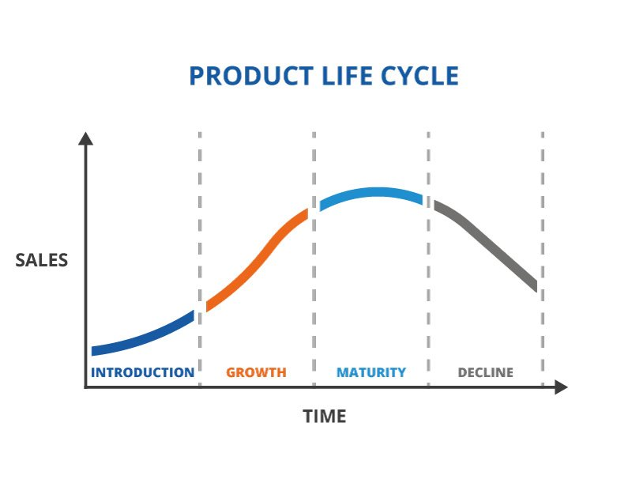
INTRODUCTIO TO PLC
What is PLC?
Biological analogy
Introduction (lag) phase – Growth (exponential) – Maturity (stationary) – decline (down turn)

Slide 3
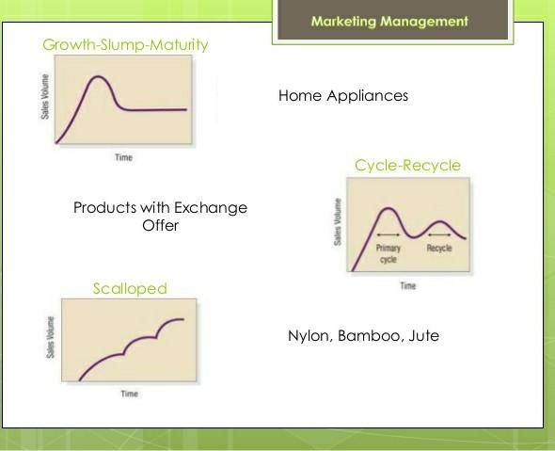
INTRODUCTION TO PLC

Slide 4
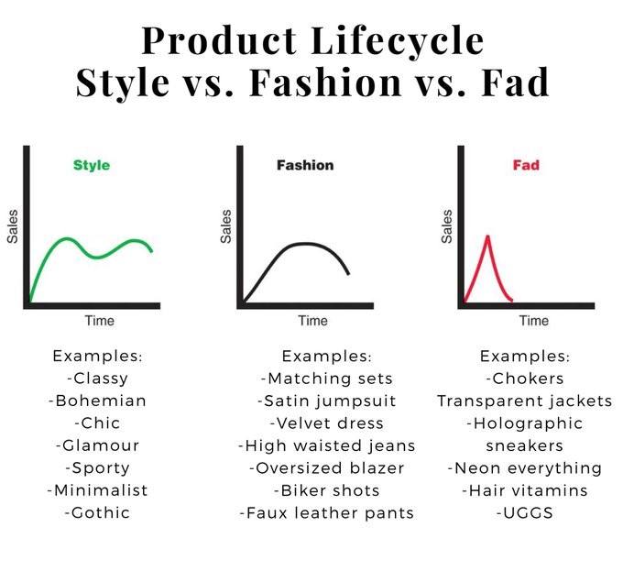
INTRODUCTION TO PLC
Style – basic and distinctive mode of expression in homes, clothing and art.
It can last for generations.
Fashion – Currently accepted/popular style.
4 Stages – distinctiveness-emulation-mass fashion-decline
Fads – fashions that come quickly and decline very fast.
Acceptance is short – limited customers.
Does not satisfy a strong need.

Slide 5
MARKETING STRATEGIES : INTRODUCTION STAGE
“Commercialization stage” – Consumer awareness and acceptance is minimal.
Sales are low and promotional costs are high due to spend in advertisements and sales promotions etc.
Problem of “Poor distribution strategy” – Retailer issues.
Market-by-market & region-by-region.
As the consumer acceptance is low – Only innovative consumers may buy.
Length of the Introduction stage – product complexity/degree of newness/positioning or perception/competition/substitutes/effective marketing expenditure.
Pioneer/1st mover’s advantage.
2nd mover’s advantage.
PROMOTION
PRICE |  | HIGH | LOW
 | HIGH | Rapid Skimming Strategy (Iphone) | Slow Skimming Strategy (Mercedes)
 | LOW | Rapid penetration strategy (Netflix) | Slow penetration strategy (Gillette disposable razor)

Slide 6
MARKETING STRATEGIES : GROWTH STAGE
Rapid sales due to strategies at Introduction stage.
Trial purchases – adoption stage – WOM communication.
Competitors also start promotions making the total category demand to increase with increased profit.
Sales and profits grows rapidly.
Improving quality/adding features will expand market.
Increased promotion – from market awareness to market preference.
Distribution channels strengthened and new channels for individual markets.
Examples – Smart phones since 2010.

Slide 7
MARKETING STRATEGIES : MATURITY STAGE
Strategies | Description
MARKET MODIFICATION | Expand the number of users – Convert non-users (shampoo sachets) / enter new market segments (Johnson & Johnson baby shampoo – adult diapers) / attract competitors’ customers (Surf Vs Ariel) | Increase the usage rates among users – Condensed milk brands Milkmaid (Nestle) Vs. Mithaimate (Amul) for making variety of dessert preparation at home. Monaco biscuit with toppings.
PRODUCT MODIFICATION | Improve product characteristics by improvement, features, or style. | Quality Improvement – increasing product functionality. Wheat to wheat flour for freshness – Pillsbury advertises as ‘chakki fresh atta”, “rich in fibre”, “more hygienic”, fortified with vit & minerals” | Feature Improvement – Car models with new features | Style Improvement -Change of logo in car manufacturers
MARKETING MIX | Pricing – reduce? When? High? | Distribution – more outlets? New channels? | Promotion – Increase Adv? Sales promotions? Personal selling?

Slide 8
MARKETING STRATEGIES : DECLINING STAGE
Nothing lasts forever – all good things must come to an end – Successful products.
Zero profits – players leave the market – customers are called laggards.
Customer switch is the highest.
A company can maintain it’s position in the market hoping that the competitors will eventually drop out.
A company can harvest – by reducing the overall costs of promotion. Maintenance, advertising and sales force management hoping that sales will be profitable for some time to come.
A company can drop the product from the portfolio. Could be sold to another company with a profit.

Slide 9
QUIZ
Which of the following is a true statement about the introduction stage of the product life cycle:
1. Profits are usually nonexistent.
2. Costs are low.
3. Sales growth is exploding.
4. There is intense competition

Slide 10
QUIZ
Which of the following is a true statement about the growth stage of the product life cycle:
1. Costs go up.
2. Competitors arrive on the scene.
3. It’s the longest-lasting stage of the product life cycle.
4. Sales increase very slowly.

Slide 11
QUIZ
Which of the following is a true statement about the maturity stage of the product life cycle:
1. Sales growth slows down.
2. Profits increase.
3. Competition becomes less intense.
4. It is the easiest stage for marketers.

Slide 12
QUIZ
What is market saturation?
When a product has reached its maximum level of productivity in the market
When a product has died in the market
When a product has just begun to succeed in the market
When a product is unable to reach the maturity stage in the product life cycle

Slide 13
QUIZ
PLC in marketing represents two main challenges. 1st an organization must be good at developing new product to replace old ones and 2nd it must be good at _________________.
(1) Functioning
(2) Marketing
(3) Selling
(4) Adapting
(5) Testing

Slide 14
QUIZ
Which of the following is not a characteristic of “Market Introduction Stage” in PLC?
(1) Demands has to be created
(2) Costs are low
(3) Makes no money at this stage
(4) Slow sales volume to start
(5) There is little or no competition

Slide 15
QUIZ
Increased competition leads to price decrease, increasing public awareness, sales volume increase significantly are the characteristics of ______________ in PLC.
(1) Mature stage
(2) Decline stage
(3) Growth stage
(4) Market introduction stage
(5) None of these.

Slide 16
QUIZ
Which phase of the Product life cycle is a downward turn in sales leading to the demise of a product.
1. Introduction
2. Growth
3. Maturity
4. Decline

Slide 17
QUIZ
Why does a company need to know what stage of the product life cycle its products are in?
1. To prevent imitators from entering the market
2. To find new uses for the product
3. To predict the length of the life cycle
4. To adapt its marketing strategies

Slide 18
QUIZ
After several years of rapid growth a business has noticed sales growth for it’s main product is slowing. Which stage of the product life cycle has been reached?
Saturation
Growth
Decline
Maturity

Slide 19
ACTIVITY
Brands cannot be expected to last forever
Vs
There is no reason for a brand to ever become obsolete.

