Slide 1
Thermotherapy is the use of heat to treat symptoms of acute or chronic pain, especially those related to muscle tension or spasm. Thermotherapy widens blood vessels and increases blood flow to the skin. It relaxes superficial muscles, decreases muscle spasm and reduces stiffness of joints.
What is thermotherapy?
The therapeutic application of heat is called thermotherapy
It is used primarily to control pain, increase circulation, increase soft tissue extensibility and accelerate healing in rehabilitation side
The heat has some role in hemodynamic, neuromuscular and metabolic processes

Slide 2

superficial
Heat modalities
Deep

Slide 3

SUPER FICIAL HEATING MODALITIES
WAX THERAP
MOIST HEAT
CONTRAST BATH
FLUIDOTHERAPY
WHIRL POOL BATH
DEEP HEATING MODALITIES
SWD(short wave diathermy)
MWD(microwave diathermy)
UST(Therapeutic Ultra Sound)
IRR(Internal Rate of Return)
UVR(Ultra Violate Radiation)
LASER
SUPERFICIAL HEATING MODALITIES
  DEEP HEATING MODALITIES

Slide 4

Vasodilatation or increased blood supply
Heat causes vasodialation in the local cutaneous blood vessels and results in an increased blood flow to the area.Thermotherapy can cause vasodilatation in many ways.
-Local release of chemical mediators of inflammation
-Indirect activation of local spinalcord reflex by cutaneous thermo receptors
-Direct reflex activation of smooth muscle of blood vessel by cutaneous thermo receptors

Slide 5
  Superficial heating stimulates the cutaneous thermo receptors and it transmit the impulses from these receptors to the nearby cutaneous blood vessels
  This release nitrous oxide which stimulate relaxation of the smooth muscles which cause vasodialation in the area where heat is applied.
  Cutaneous thermo receptors pass impulses to the dorsal/posterior horn of gray matter of the spinal cord
It synapse with sympathetic neurons in the lateral gray horn of the spinal cord to inhibit their firing and decrease the sympathetic out put.
  The decreased sympathetic activity causes reduced smooth muscle contraction resulting in vasodilatation

Slide 6
Increased tissue temperature Activates and release vasodilatation promoter such as histamine and prostaglandin which produce vasodilatation.
Reduced blood pressure
  The peripheral resistance is reduced by the generalized vasodilation, and this cause a fall in blood pressure
  Rise in temperature also reduce the viscosity of the blood which reduce the blood pressure
General rise in temperature
  As blood pass through the heated tissues it carry the heat in to other parts of the body, so if heating is extensive and prolonged a general rise in body temperature occurs

Slide 7
Neuro Muscular effects
Change in nerve conduction velocity
Heat produce a sedative effect
Increased temperature increases nerve conduction velocity and decrease conduction latency of sensory and motor nerve 2m/second in every 1ºC
These effects are still under research
increased pain threshold
Application of local heat can reduce the pain by activation of the spinal gating mechanism and reduction of ischemia and muscle spasm
Heat stimulates the sensory receptors of the skin and it pass information to heat regulating centers.

Slide 8
Change in muscles
Rise in temperature induces muscle relaxation and increases its efficiency
The strength and endurance of the muscle is found to be decreased during the initial (30mnts) after the application of deep or superficial heating
This initial decrease in muscle strength is due to the change in the firing rate of type-II muscle spindle caused by heating.
After 30 mnts and for the next 2 hours muscle strength gradually recovers and then increases to pretreatment level.

Slide 9
    SIMPLE TO UNDERSTAND
    Heat energy transfer from a point of higher concentration to a point of lower concentration
    Heat can be transferred to a body or from a body by conduction, convection, conversion, radiation and evaporation.

Slide 10
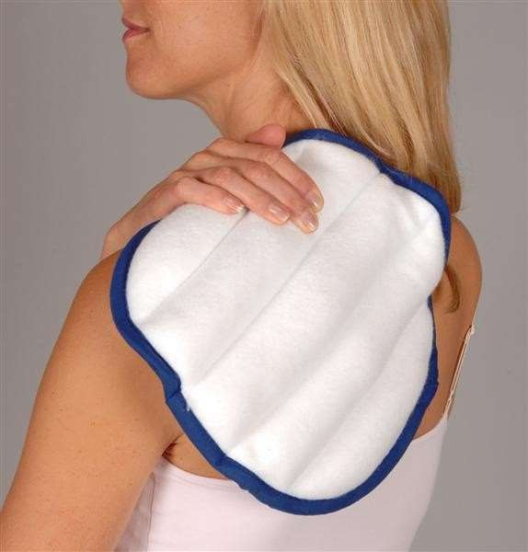


  Heating by conduction is the result of energy exchange by direct collision between the molecules (molecular agitation) of two materials at different temperature through physical contact.
  The faster moving molecules in the warmer material collide with molecules in the cooler material and cause them to accelerate

Slide 11
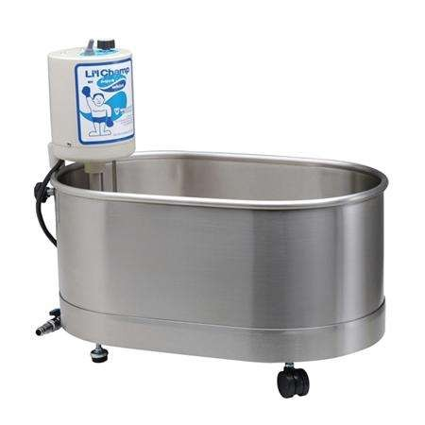
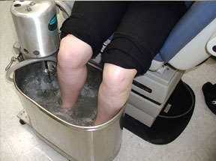
  HEAT BY CONVECTION: Here the heat transfer occurs by the result of direct contact between a circulating medium (fluid or air) and another material of a different temperature.Here the transmission occurs by the physical movements of the molecules over the cooler body parts eg- whirl pool, hydrotherapy and saline bath.

Slide 12
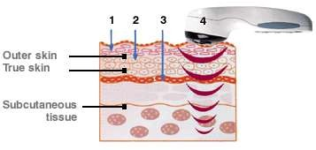
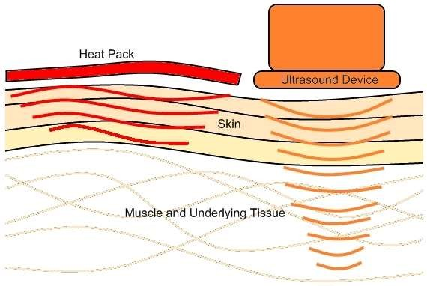
HEAT BY CONVERSION: Here the heat is produced from the conversion of a non thermal form of energy such as mechanical or electrical in to heat.
Ultrasound – which is a mechanical form of energy, is converted in to heat when applied to a tissue.
The ultrasound waves causes vibration of the molecules in the tissues, thereby generating friction between molecules resulting in an increased tissue temperature

Slide 13
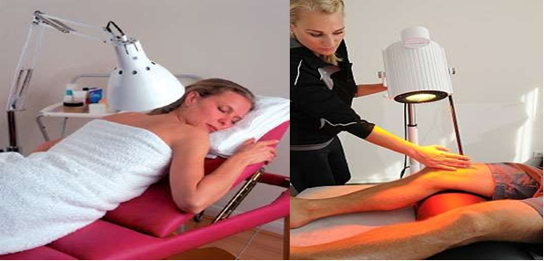
Heating by radiation involves the direct transfer of energy from a material with higher temperature to a material with lower temperature by electromagnetic radiation with out any intervening medium or contact, (IRR,UVR etc..)
The rate of temperature increases depends on the intensity of the radiation, size of the are been treated, distance of source from the treatment area and the angle of the tissue kept.

Slide 14
  For evaporation a material should absorb an energy and thus change its form from a liquid to gas or vapor.
  In human body the heat is absorbed by the liquid on the skin surface and cools the skin as it turns in to a gaseous state.
  Eg- when a vapo coolant spray is heated by the warm skin it change from its liquid form to a vapor state, during this process the spray absorbs heat and leaves the skin to cool.

Slide 15
CONTRAST BATH
It is another common treatment method fall in thermotherapy where athlete can self treat.
Take one bucket of warm water/hot water (60-70c) and take another one bucket of ice water (34F).
Immerse the injured portion 3 minute into the cold water and then 01 minute in hot water, Then 3 minute cold water and 2 minute hot water.
Then 2 minute hot water and 3 minute cold water followed by 3 minute hot and 01 minute cold water
It has to do minimum 2 times in a day around 10 minute each.

Slide 16
Paraffin wax bath
Paraffin wax bath therapy (P.W.B)is an application of the molten paraffin wax on the body part
The melting point of wax is 51-55°c.
If the molten wax at 51-55°c is poured on the body part, its may cause burn.
Some impurity like liquid paraffin or mineral oil is added to lower the melting point for safe application.
Thus the temperature of the paraffin wax is maintained at 40-44°c
Paraffin Wax Bath. A paraffin wax unit is a machine that heats and holds paraffin wax, a type of wax used for candles. The wax is intended to completely cover the hand (or other body parts such as the feet). Its warm temperature is meant to provide relief from arthritis pain, sore joints or sore muscles.

Slide 17
The combination of the wax and the mineral oil has
low specific heat
This enhances the patient’s ability to tolerate heat from the wax better than from the water of the same temperature.
The composition of the wax: paraffin: mineral oil is
7:3:1 or Wax: paraffin or mineral oil is 7:1.
The mode of the transmission of heat from paraffin to the patient skin is through conduction.
Paraffin has a slow thermal conductivity
Slow heat diffusion (6 times lower than water).
Paraffine wax has a low melting point (55°).
When the oil is added, the paraffin will remain at a temperature of 40° to 44°C.
This low specific heat will enhance the patient to tolerate heat from the paraffine better than from water of the same temperature.

Slide 18
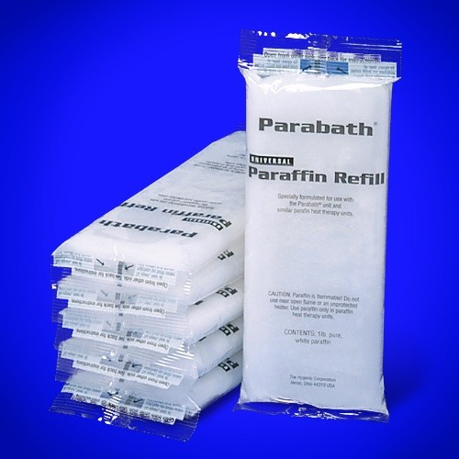
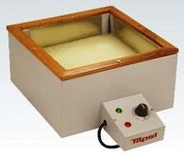
Self insulator:
It gives moist heat :there is a layer between the skin and the wax producing heat and sweating which does not evaporate. After removal the heated part cools quickly by evaporation.
It is analgesic: This insulating layer keeps the heat and is effective in relief of pain

Slide 19
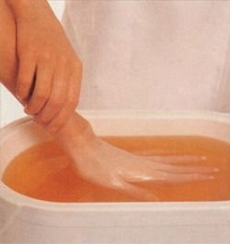
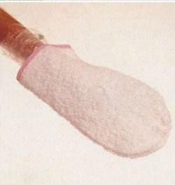
most common method.
Involves placing the body part to be treated in a paraffin bath, followed by removing it and allowing the paraffin to cool and harden.
Approximately 7 to 12 dips are done
followed by wrapping in wax paper or plastic, which is covered by towels or insulated mitts.
Application time is 20 to 30 minutes or till wax cools.

Slide 20
Dip once for having a glove
Then immerse for 15 to 20 min.
Never immerse at first for a long time without making a glove
dry before to have insultions.
Direct pouring method:
The molten Wax is directly poured by a mug or utensil on the part to be treated and
wrapped around by a towel.
The wax is allowed to solidify for about 10-20 minutes.
Several (4-6) layers can be made over the body tissues.

Slide 21
Toweling or bandaging method:
A towel or a roll of bandage is immersed in molten paraffin wax and
wrapped around the body part.
Several layers can be made over the body part.
This method is preferably used for treating proximal parts of the body.

Slide 22
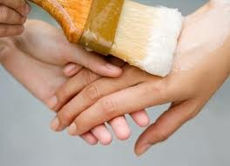
Brushing method:
It is a less commonly used method of paraffin wax application.
8-10 coats of wax are applied to the area with a paint brush using even and rapid strokes
The area is then wrapped with towel for 10-20 minutes and after this time, paraffin wax is removed and discarded

Slide 23
Physiological Effects of heat
Hemodynamic effect
Neuromuscular effect
Metabolic effect
Tissue extensibility
Pain and musle spasm: especially in the distal extremities

Slide 24
INDICATIONS
Pain and musle spasm: especially in the distal extremities.
Oedema and inflammation: gentle heat reduces: Post-traumatic swelling of the hands and feet Swelling of the hands in rheumatoid arthritis.
Swelling of the hands in degenerative joints disease. Especially in sub-acute and early chronic stages or inflammation.
Caution is needed in acute phase of arthritic pain and swelling.
Adhesions and scars : wax softens and facilitates the mobilization and stretching procedures.

Slide 25
CONTRAINDICATIONS
Ischemia. e.g., arterial insufficiency
Haemorrhage. there is an increased arterial and capillary blood flow with heat
Impaired sensation. e.g., spinal cord injury (SCI) may predispose to burns
Inability to communicate or respond to pain. e.g., dementia
Malignancy. May increase tumour growth
Acute trauma or inflammation. Diffusion across membranes is increased
Scar tissue. Elevation of temperature increases the metabolic demand of the tissue. Scar tissue has inadequate vascular supply, and is not able to provide an adequate vascular response when heated, which can lead to ischemic necrosis.
It is a passive treatment: exercise may not be performed simultaneously.

