Slide 1
Introduction to Commercial Banking

Slide 2
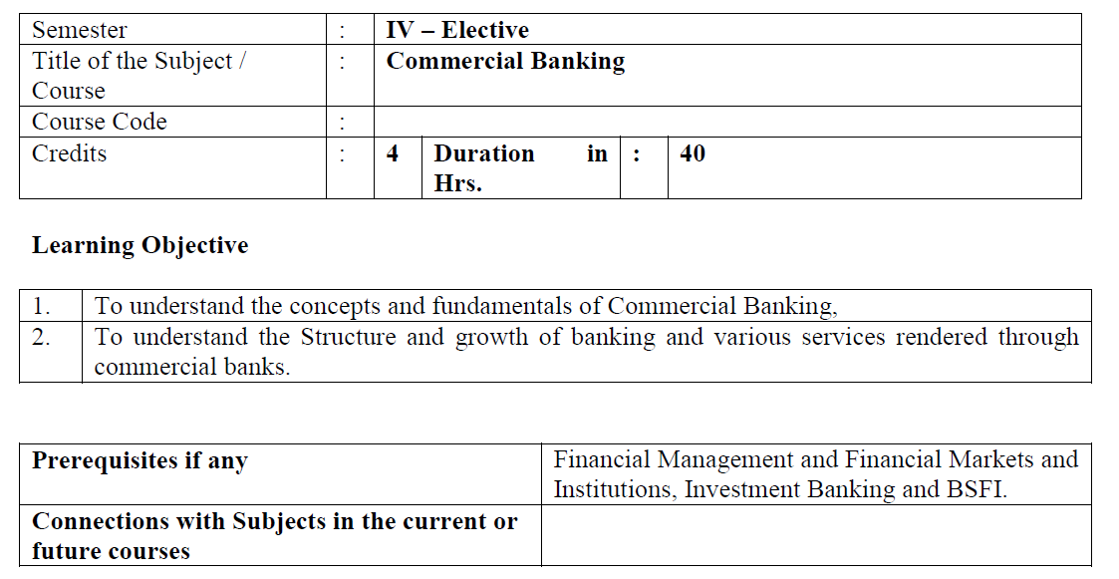

Slide 3
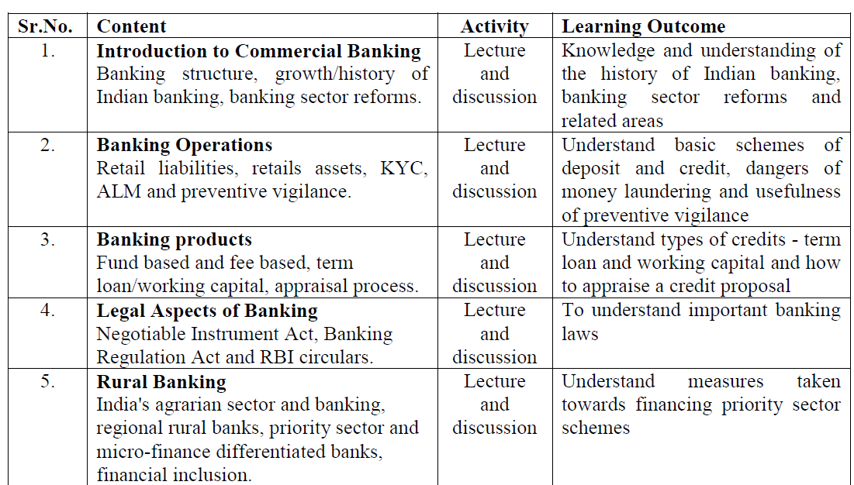

Slide 4
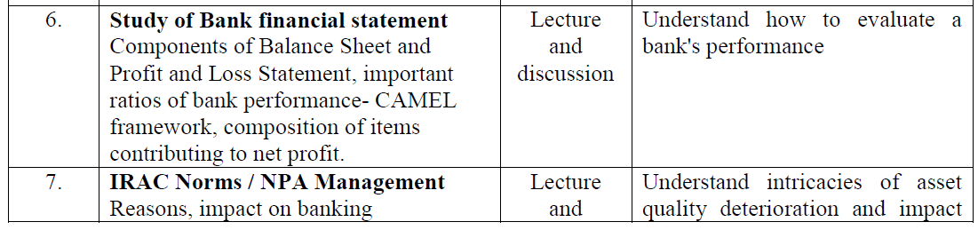


Slide 5
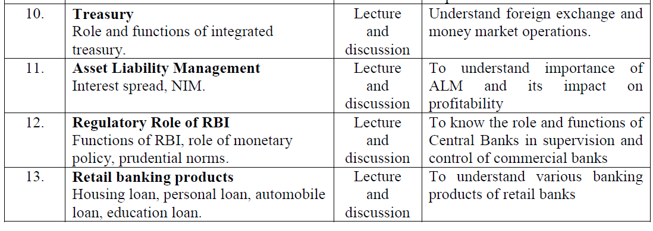

Slide 6
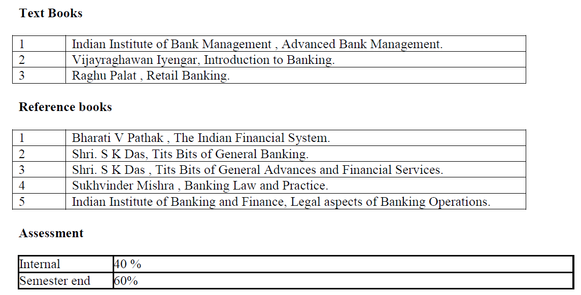

Slide 7
Assessment of the Subject
40 Marks Internal
60 Marks Final examination
40 Marks – 10 Marks for Internal Test
10 Marks for Assignments
10 Marks for Presentation
10 Marks Class participation and attendance

Slide 8
Final Exam 60 Marks
Frist Question 20 Marks ( Case Study)
Second question to 6th Question 10 Marks each.
From 2nd question to 7th question solve any 4 questions
All questions will have 3 options 5 marks each

Slide 9
Subject COs
To remember the history of Indian banking, banking sector reforms schemes of deposit and credit, dangers of money laundering and usefulness of preventive
To Understand types of credits - term loan and working capital and apply to appraise a credit proposal, banking laws, measures taken towards financing priority sector schemes.
To evaluate bank's performance, intricacies of asset quality deterioration and impact on banks, risks in banking operations and tools of management of risks, significance of capital adequacy regulation and impact on banks.
To create Commercial banking reports.

Slide 10
What is commercial Bank
Is a kind of financial institution that carries all the operations related to deposit and withdrawal of money for the general public, providing loans for investment, and other such activities.
These banks are profit-making institutions and do business only to make a profit.
Is the one that lends money to potential borrowers, accepts deposits, offers other banking services , opening savings account and other small business.

Slide 11
Non commercial Banks / Institutions
Non commercial bank is also referred to as investment bank which offers money on long term basis and doesn't contribute to credit creation.
insurance firms, venture capitalists, currency exchanges, some microloan organizations.
These non-bank financial institutions provide services that are not necessarily suited to banks, serve as competition to banks, and specialize in sectors or groups.

Slide 12


Slide 13
Commercial bank is a financial institution that performs operations related to deposit and withdrawal of money for the public, provides loans for investment, and carries out other similar activities.
The two main functions of a commercial bank are lending and borrowing.
They play a crucial role in the country's financial system by smoothing the flow of funds, offering banking products and services, and contributing to economic growth.

Slide 14
Evolution of commercial banks in India
The evolution of commercial banks in India spans several centuries, reflecting changes in economic policies, banking regulations, and technological advancements. Let's look at the evolution of commercial banks in India:
Pre-independence era (pre-1947):
Post-independence and nationalisation (1947-1969):
Liberalisation and technological advancements (1991 onward):
Consolidation and regulatory changes (2000s onward):
Current landscape (2020s onward):

Slide 15
Pre-independence era (pre-1947):
The origins of modern banking in India can be traced back to the 18th century when European trading companies established banks for conducting financial transactions.
The Bank of Hindustan (1770) and the General Bank of India (1786) were among the earliest banks in the subcontinent.
The State Bank of India (SBI) was established as the Bank of Calcutta in 1806. It later merged with the Bank of Bombay and the Bank of Madras in 1921 to form the Imperial Bank of India, eventually becoming the State Bank of India in 1955.

Slide 16
Post-independence and nationalisation (1947-1969)
After gaining independence in 1947, India witnessed a series of banking reforms to foster economic development.
The Banking Regulation Act of 1949 provided the regulatory framework for banking operations.
In 1969, the Indian government nationalised 14 major banks to achieve social and economic objectives, including increased credit flow to priority sectors like agriculture and small-scale industries.

Slide 17
Liberalization and technological advancements (1991 onward):
Through the economic liberalisation of 1991, the government initiated financial sector reforms to promote competition and efficiency.
The entry of private and foreign banks introduced a new era of competition and innovation in the banking sector.
Technological advancements revolutionised banking operations, leading to the establishment of online banking services.

Slide 18
Consolidation and regulatory changes (2000s onward):
In the 2000s, there was a trend of mergers and acquisitions in the banking sector, leading to the consolidation of banks for enhanced efficiency and scale.
The Reserve Bank of India (RBI) implemented Basel regulations to strengthen the banking system.

Slide 19
Current landscape (2020s onward):
Digital banking, mobile banking, and fintech collaborations have become prominent features of the commercial banking landscape.
The RBI focuses on maintaining financial stability, promoting financial inclusion, and addressing emerging challenges such as cybersecurity risks.

Slide 20
Public sector banks
Public sector banks are government-owned banks where the majority of the ownership lies with the government.
Examples include the State Bank of India (SBI), Punjab National Bank (PNB), and Bank of Baroda.
These banks play a crucial role in implementing government policies related to financial inclusion and priority sector lending.
There are 12 public sector banks as on date.

Slide 21
advantages of public sector banks include
Low-interest charges on loans
High-interest rate on deposits
Full job security for employees
Offers its services to a large customer base
Offers financial services through multiple branches
Offers its services to the rural areas too

Slide 22
Bank | Headquarter
State Bank of India | Mumbai
Bank of Baroda | Vadodara
Punjab National Bank | New Delhi
Union Bank of India | Mumbai
Indian Overseas Bank | Chennai
Canara Bank | Bengaluru
Indian Bank | Chennai
UCO Bank | Kolkata
Bank of India | Mumbai
Central Bank of India | Mumbai
Bank of Maharashtra | Pune
Punjab & Sind Bank | New Delhi

Slide 23
Public Sector Banks Advantages
Financial Inclusion
Public sector banks expand banking services to remote areas, promoting financial inclusion for underserved populations. For example, State Bank of India has over 22,000 branches, enabling wider access to banking facilities.
Government Backing
Public sector banks enjoy government support, ensuring stability and confidence for depositors and investors.

Slide 24
Social Welfare:
These banks actively participate in social welfare initiatives, such as priority sector lending.
Around 40% of public sector bank lending is directed towards sectors like agriculture, micro, small, and medium enterprises (MSMEs), benefiting the overall economy.
Affordable Credit:
Public sector banks often provide loans at competitive interest rates, making credit more accessible and affordable.
For instance, Canara Bank offers home loans at attractive rates, facilitating homeownership.

Slide 25
Long-term Financing:
Public sector banks have the capacity to provide long-term financing for infrastructure projects.
For instance, Punjab National Bank has supported infrastructure development with loans exceeding Rs. 1.75 lakh crore (around $23.7 billion).
Stability:
Public sector banks demonstrate stability during economic downturns due to government ownership and regulations.
This helps maintain the stability of the banking system and protects depositor interests.

Slide 26
Job Creation:
Public sector banks are significant employers, generating numerous job opportunities. State Bank of India alone employs over 2.4 lakh employees, contributing to employment generation in both urban and rural areas.
Customer Service:
Public sector banks prioritize customer service and accessibility.
They aim to cater to a diverse range of customers, ensuring efficient and satisfactory banking experiences

Slide 27
Public Sector Banks Disadvantages
Bureaucratic Processes
Public sector banks are often criticized for bureaucratic red tape, resulting in slower decision-making. This can hinder their ability to respond swiftly to market changes and customer needs.
Government Interference
Government ownership can lead to political interference in the operations of public sector banks. This can impact their autonomy and decision-making processes.
Limited Flexibility
Public sector banks may face limitations in terms of flexibility and agility compared to their private sector counterparts. This can affect their ability to adapt to changing market dynamics and implement innovative strategies.

Slide 28
Capital Constraints
Public sector banks sometimes face capital constraints due to reliance on government capital infusion. Insufficient capital can restrict their lending capacity and hinder their ability to meet regulatory requirements.
Efficiency and Productivity
Public sector banks often have higher operating costs and lower efficiency compared to private banks. According to a report by the Reserve Bank of India, public sector banks had a cost-to-income ratio of around 57% in 2020, higher than the 48% for private sector banks.

Slide 29
Competitiveness
Public sector banks may face challenges in offering competitive products and services compared to private banks. This can affect their ability to attract customers and retain market share.
Non-performing Assets (NPAs)
Public sector banks have faced challenges in managing non-performing assets, which are loans that are in default or at risk of default. As of March 2021, public sector banks in India had a gross NPA ratio of around 8.5%, higher than the 4.5% for private sector banks.

Slide 30
Private sector banks
Private individuals or entities own these banks and operate them.
They operate on a profit motive and are known for their efficiency and innovation.
Examples include ICICI Bank, HDFC Bank, and Axis Bank.
Despite being owned by private companies or individuals, these banks have to follow the rules and regulations of the central bank.
These banks provide good services and are efficient.
Private sector banks provide numerous excellent services but at an additional cost.

Slide 31
Private banks were set up in India after 1990 when the Government of India gave permission to establish them.
Before 1990, the major stakeholders were the public sector banks.
As of today, both the public sector and private sector contribute largely to the Indian economy.
People choose between public sector banks and private sector banks based on their requirements and the type of service they want.
At present, there are 12 public sector banks and 21 private sector banks in India.

Slide 32
Private Sector Banks Advantages
Efficiency and Innovation
Private sector banks are often more efficient and agile in their operations compared to public sector banks. According to the Reserve Bank of India, private sector banks had a lower cost-to-income ratio of around 42% in 2020, indicating better operational efficiency.
Technology and Digital Banking
Private sector banks are at the forefront of technological advancements and digital banking services. They have invested heavily in digital platforms, mobile banking apps, and online services, offering customers convenient and user-friendly banking experiences.
Customer Service
Private sector banks generally focus on providing excellent customer service and personalized banking experiences. They strive to understand customer needs and offer tailored solutions, leading to higher customer satisfaction

Slide 33
Product Innovation
Private sector banks are known for their ability to innovate and introduce new financial products and services.
They often bring innovative offerings, such as customized loan products, wealth management solutions, and specialized banking services catering to various customer segments.
Risk Management
Private sector banks typically have robust risk management practices, ensuring the soundness of their operations and minimizing risks.
Their focus on risk assessment and mitigation helps maintain a healthy loan portfolio and reduces non-performing assets (NPAs)

Slide 34
Private Sector Banks Disadvantages
Higher Interest Rates
Private sector banks often charge higher interest rates on loans and credit products compared to public sector banks. This can make borrowing more expensive for individuals and businesses.
Limited Rural Penetration
Private sector banks tend to focus on urban and semi-urban areas, resulting in limited access to banking services in rural and remote regions. This can hinder financial inclusion and access to banking facilities for rural populations.
Profit-Driven Approach
Private sector banks prioritize profitability and shareholder interests, which can sometimes lead to a focus on high-net-worth individuals and corporate clients. This may result in less emphasis on serving low-income groups and small businesses.

Slide 35
Lower Government Support
Private sector banks do not have the backing of the government, unlike public sector banks. In times of financial crisis, they may face challenges in obtaining government support and bailouts.
Concentration of Power
In some cases, private sector banks may become dominant players in the market, leading to concerns about the concentration of power and potentially anti-competitive practices.

Slide 36
benefits of private sector banks include:
Offers quick services to the customers
Offers customied services according to the financial needs of the customers
Quick financial decision-making
Have a streamlined management system

Slide 37
Bank name | Headquarter
HDFC Bank | Mumbai
ICICI Bank | Mumbai
Kotak Mahindra | Mumbai
Axis Bank | Mumbai
IndusInd Bank | Pune
IDBI Bank | Mumbai
IDFC First Bank | Mumbai
Yes Bank | Mumbai
AU Small Finance Bank | Jaipur
Bandhan Bank | Kolkata
Federal Bank | Aluva
RBL Bank | Mumbai
Jammu & Kashmir Bank | Srinagar
Karur Vysya Bank | Karur
City Union Bank | Kumbakonam
Karnataka Bank | Mangaluru
Tamilnad Mercantile Bank | Thoothukudi
CSB Bank | Thrissur
South Indian Bank | Thrissur
DCB Bank | Mumbai
Dhanlaxmi Bank | Thrissur
Lakshmi Vilas Bank | Chennai

Slide 38
Difference between Public Sector Banks and Private Sector Banks
Basis | Public Sector Banks | Private Sector Banks
Meaning | The banks whose majority of stakes are held by the state or central government are known as Public Sector Banks. | The banks whose stakes are held by private companies or maybe by an individual are known as Private Sector Banks.
Governing Act or Law | Public sector banks are formed by passing an act in the parliament. | Private sector banks are registered under the Indian Companies Act.
Controlling Authority | Public sector banks are controlled by the government. | Private sector banks are controlled by companies or an individual.
Shareholding Pattern | More than 50% of the shareholding of public sector banks lies with the government (state or central). | The majority shareholding of private sector banks lies with private companies or individuals.
No. of Banks | There are 12 public sector banks in India. | There are 21 private sector banks in India.
Regulatory Body | The Reserve Bank of India issues rules, regulations, guidelines, and directions for the public sector banks under the Reserve Bank of India Act, 1934. | The Reserve Bank of India issues rules, regulations, guidelines, and directions for the private sector banks.

Slide 39
Customer Base | The customer base of public sector banks is high. | The customer base of private sector banks is comparatively low.
Interest Rate | In public sector banks, the interest rate on savings is less and the interest rate on loans is high. | In private sector banks, the interest rate on savings is high; however, the interest rate on loans is low.
Job Security | There is high job security in public sector banks. | There is less job security in private sector banks.
Trustworthy | Public Sector Banks are more trustworthy than private sector banks as they are governed by the government. | Private sector banks are less trustworthy.
Share in Banking Industry | Public Sector banks hold 72.9% of the total market share in India’s banking system. | Private sector banks hold only 19.7% of the total market share in India’s banking system

Slide 40
Foreign Direct Investment | Public sector banks allow 20% Foreign Direct Investment. | Private sector banks allow 74% Foreign Direct Investment only if there is no change in the control and management. Besides, according to RBI regulations, a single organisation or an individual cannot invest more than 10% stake in a bank.
Pension | Pension is provided to public sector bank employees. | No concept of pension is there for private sector bank employees.
Example | Public sector banks include State Bank of India, Union Bank of India, Indian Bank, and Punjab National Bank. | Private sector banks include ICICI Bank, HDFC Bank, Axis Bank, and Karnataka Bank.

Slide 41
Foreign banks
Headquartered outside India and operate within the country after obtaining the necessary regulatory approvals.
Examples include Standard Chartered, Citibank, and HSBC.
At present 46 Foreign banks are in India and has more than 300 branches.

Slide 42
Advantages of Foreign Banks in India
1. Technological advancements
Foreign banks bring with them advanced technology and digital banking solutions, which have helped improve the overall banking system in India.
This has made banking services more accessible, convenient, and efficient for customers.
2. Increased competition
The entry of foreign banks has increased competition in the Indian banking sector, which has led to better products and services being offered to customers.
This has helped improve the quality of banking services and increase customer satisfaction.

Slide 43
3. Access to global financial markets
Foreign banks have access to global financial markets and can provide their customers with access to a wider range of financial products and services.
This has helped increase the competitiveness of the Indian banking sector and attract more foreign investment into the country.
4. Improved financial services
Foreign banks bring with them international expertise and best practices, which have helped improve the quality of financial services offered in India.
This has increased customer satisfaction and greater financial inclusion, especially in rural and underdeveloped areas.

Slide 44
Challenges faced by Foreign Banks in India
1) Stringent regulations
Foreign banks in India face several regulations, including those related to capital requirements, banking licenses, and compliance with local laws and regulations.
These regulations can be stringent and can impact the efficiency and profitability of foreign banks in India.
2) Cultural differences
Foreign banks may also face challenges related to cultural differences, including different business practices and customer expectations.
This can make it difficult for foreign banks to fully integrate into the local market and compete effectively with local banks.

Slide 45
3) Competition with local banks
Foreign banks face significant competition from local banks, who are well-established in the market and have a better understanding of local customers and market dynamics.
This can make it challenging for foreign banks to gain market share and compete effectively.
4) Managing the balancing act between local and global operations
Foreign banks in India must also balance their local and global operations, which can be challenging as they need to comply with local regulations and meet the expectations of both local and international customers.

Slide 46
Impact on the Indian Banking System
1) Competition
The presence of foreign banks in India has increased competition in the banking sector, which has led to better products and services being offered to customers.
2) Improved services
Foreign banks bring with them international expertise and best practices, which have helped improve the quality of financial services offered in India.

Slide 47
3) Access to capital and expertise
Foreign banks can provide access to capital and expertise, which can help support the growth and development of the Indian economy.
4) Pressure to adopt best practices
The entry of foreign banks has also put pressure on local banks to adopt best practices and improve their services, which has helped improve the overall banking system in India.

Slide 48
Regional rural banks
Regional Rural Banks are a specialized category of banks created to cater to the banking needs of rural and semi-urban areas.
At present, there are 43 RRBs in India. Each RRB is sponsored by the Central government, the State government, and the sponsor bank.
The first RRB in India, Prathama Bank, in Uttar Pradesh, was established on 2nd October 1975 with its headquarters in Moradabad. This bank was sponsored by the syndicate bank.

Slide 49
Kerala Gramin Bank is India's largest Regional Rural Bank (RRB) with ? 20,000 crore of business, headquartered at Malappuram inKerala, India. The bank is jointly owned by Government of India, Government of Kerala & sponsored by Canara Bank.
RRBs are regulated by RBi and supervised by NABARD as their main area of activity is the rural sector. RRBs were created under the Regional Rural Banks Act, 1976 (Not Banking Regulation Act) to serve the credit need of rural areas which were largely unbanked at that time.

Slide 50
The services of RRBs are not available in the states of Goa and Sikkim.
Madhya Pradesh has second highest number of branches
While Nagaland has the least number of branches.

Slide 51
What is the minimum capital required for RRB?
Authorised capital:
The Act provides for the authorised capital of each RRB to be Rs five crore.
It does not permit the authorized capital to be reduced below Rs 25 lakh.
Central government 50%, State government 15%

Slide 52
Cooperative banks
Cooperative banking refers to a small financial institution started by a group of individuals to address the capital needs of their specific community.
Such financial institutions are owned and controlled by their members, and the board members are democratically selected to oversee the operations
Cooperative banks operate on cooperative principles, primarily focusing on meeting their members' credit and banking needs.
They can be classified into Urban Cooperative Banks (UCBs) and Rural Cooperative Banks (RCBs).
These banks play a vital role in supporting local economic activities.

Slide 53
There are a total of 34 state co-operative banks in India.
State Cooperative Banks
A state cooperative bank, as the name suggests is organised at a state level.
Central Cooperative Banks (CCBs)
Central Cooperative Banks (CCBs) are cooperatives that are established and managed in accordance with the Cooperative Societies Act.

Slide 54
state cooperative bank
Definition | A state cooperative bank, as the name suggests is organised at a state level.
Regulatory body | They are regulated by both the Reserve Bank of India (RBI) and the respective state governments.
Segment served | They provide financial services to rural and low-income populations across the country.
Services offered | They are often the primary source of credit for agricultural and allied activities, small-scale industries, & other small businesses. These banks also provide banking services to cooperatives, including credit unions, dairy cooperatives, and agricultural cooperatives.
Source of capital | The working capital of SCB is obtained from deposits, funds, borrowings from RBI, state governments and other resources.

Slide 55
Central Cooperative Banks (CCBs)
Definition | Central Cooperative Banks (CCBs) are cooperatives that are established and managed in accordance with the Cooperative Societies Act.
Regulatory body | They are supervised by the State cooperative department and are regulated by the Reserve Bank of India
Segment served | They provide financial services to rural & semi-urban populations across the country.
Services offered | They provide services such as deposits, loans, and other banking services to their members. They also promote and finance agricultural activities, such as crop insurance and input supply services.
Source of capital | The working capital for the central cooperative banks is primarily raised from individual funds, deposits, borrowings etc.

Slide 56
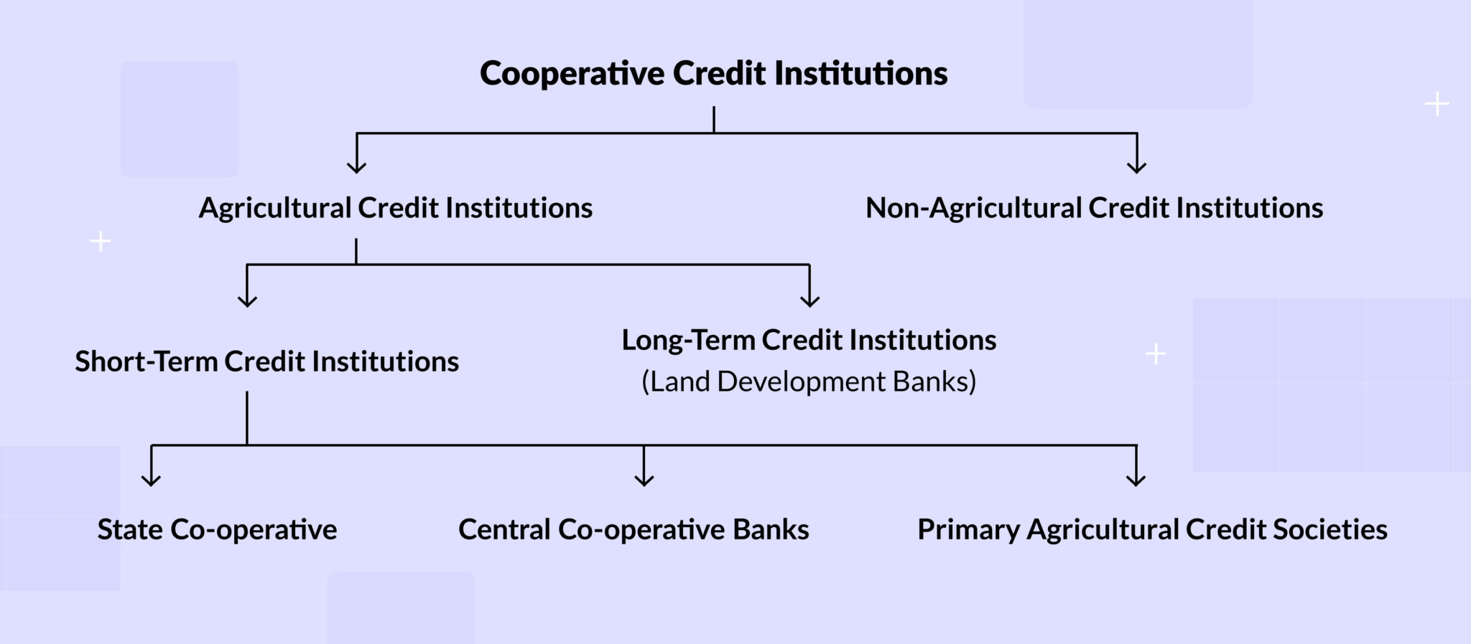

Slide 57
Primary Agricultural Credit Societies
Definition | These financial cooperatives are typically organized by farmers and other agricultural professionals to provide credit and other services to farmers.
Regulatory body | They are regulated by the Reserve Bank of India & registered under the Co-operative Societies Act
Segment served | Primary agricultural credit societies are often organized in rural areas where access to traditional banking services may be limited.
Services offered | The primary purpose of these societies is to provide loans to members, often at low-interest rates, in order to facilitate the purchase of resources and other necessities required to operate a successful farm. They also offer other services, such as crop insurance, storage services, and help marketing, that help farmers to manage their operations.
Source of capital | These societies are funded by their members who contribute both capital and labour for the benefit of the cooperative.

Slide 58
Unique Features of Cooperative Banks
One person, One Vote’: this is what Cooperative Banks follow. A chosen Board of Directors is held responsible for the administration of the organisation.
Profit Distribution: Cooperative banks are not-for-profit entities & their primary focus is to serve the financial needs of their members. Any surplus generated by the bank is distributed among the members in the form of dividends or reinvested to strengthen the bank’s capital base.
Community Development: They also play a vital role in community development by promoting financial literacy, supporting local businesses, and investing in community projects. They foster a sense of solidarity and mutual support among their members.

Slide 59
Advantages of Cooperative Banks
1. Alternative Source of Credit
The rural population benefits from cooperative banking as they provide credit at a lower rate as compared to the money lenders who tend to provide credit at a higher rate of interest. This protects the rural population from the monopoly of the money lenders.
2. Encourages Savings and Investment
Cooperative banking has enabled the rural population to save more and invest rather than hoard money. This will have a long-term benefit on the money management of the rural population.
3. Improvement in Farming Methods
Due to the lower interest rates of the credits provided by the Cooperative banks, the rural population can now utilise the same for better farming methods eg: purchasing seeds, chemical fertilizers etc.

Slide 60
Limitations of Cooperative Banks
1. Inadequate Coverage
The membership of the rural population of cooperative banking is just 45%, hence the inadequate coverage is a matter of concern.
It is restricted only to a few states like Gujrat, Maharashtra, Punjab etc.
2. Inefficient Societies
Since these banks are often run by the members themselves, they are not run efficiently and hence lose out on alternate streams of revenue.
For ex, It was observed that out of 94089 primary agricultural credit societies in the country in the year1982-83, about 34000 societies were running at a loss.

Slide 61
3. Problem of Overdues
The overdue loans of the cooperative institutions have been increasing over the years.
The overdue in the short-term credit structure is most alarming in the North-Eastern States.
In the long-term loaning sector, the problem of overdue has almost crippled the land development banks in 9 states, viz., Maharashtra, Gujarat, Madhya Pradesh, Bihar, Karnataka, Assam, West Bengal, Orissa and Tamil Nadu.
4. Regional Disparities
The distribution of credit is not equally divided in these banks.
According to an RBI report, 8 states account for about 80 per cent of the total credit whereas the credit disbursed varied from Rs. 4 in Assam to Rs. 718 in Kerala.

Slide 62
Payment banks
Payment banks are a relatively recent addition to the Indian banking sector.
They provide a limited set of banking services, primarily focused on payments and remittances.
They cannot issue loans or credit cards but can accept deposits and facilitate transactions.
Examples include Airtel Payments Bank and Paytm Payments Bank.

Slide 63
What is meant by payment banks?
A Payments Bank is a bank that does not offer loans or credit cards.
It takes deposits up to Rs 1 lakh from its customers.
It provides various other financial services such as remittance transfer services, selling of financial products of other banks etc.

Slide 64
In August 2015, the Reserve Bank of India (RBI) provisionally approved the establishment of payment banks in India for 11 entities, among which was the Department of Posts.
This move was part of a broader initiative to enhance financial inclusion across the country, providing a platform for small businesses, low-income households, and others to access banking services more conveniently.

Slide 65
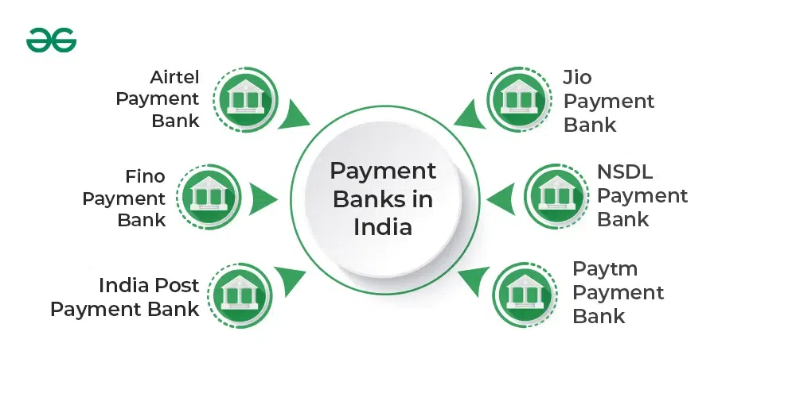
How many Payments Bank are in India?
India currently has 6 Payment Banks namely,

Slide 66
Which is the No 1 payment bank in India?
Airtel Payment Bank is the first Payment Bank in India.
It was set up in January 2017 by Bharti Airtel, India's largest telecom provider.
This helps in the cashless revolution as indicated by the Government of India.

Slide 67
Features of Payment Banks
1. Limited Banking Function: A payment bank is a distinct type of bank that exclusively carries out the specific banking functions permitted by the Banking Regulation Act of 1949.
2. Business Correspondent: Activities encompass deposit acceptance, payment and remittance services, provision of internet banking, and functioning as a business correspondent for other banks.
3. Deposits Limit: Initially, they can accept deposits of up to ₹1 lakh per individual.
4. Fund Transfer: They can provide support for financial transactions such as money transfers, insurance services, and the marketing of mutual funds.

Slide 68
5. Issue Debit Cards Only: Furthermore, they possess the capability to solely provide ATM/debit cards, excluding the option of issuing credit cards.
6. Prohibited from Forming Subsidiaries: They are forbidden from establishing subsidiaries to offer non-banking financial services.
7. Lending Prohibited: They are prohibited from participating in any lending activity.
8. Prohibition Against Loans: Payment Banks are prohibited from granting loans and are ineligible to receive deposits from Non-Resident Indians (NRIs).
9. Minimum Capital: The minimum capital requirement for a payment bank is ₹100 Crore.

Slide 69
Activities That Can be Performed by Payment Banks
1. Deposits: Payment banks accept ₹2,000,000 deposits. It accepts savings and current account demand deposits.
2. Government Securities: Deposits can only be invested in secure government securities as Statutory Liquidity Ratio. This must be 75% of demand deposit. Other designated commercial banks will hold 25% as time deposits.
3. Cross Border Remittances: On current accounts, payments banks can make personal payments and receive cross-border remittances.
4. Issue Debit Cards: Payment banks issues debit cards.

Slide 70
Activities That Cannot be Performed by Payment Banks
1. Payment Bank Can Not Lend: Payment banks cannot lend since they have an RBI ‘differentiated’ bank licence.
2. Cannot Issue Credit Cards: No payment banks have the authority issue credit cards.
3. Payment Banks Don’t Accept Time Deposits: It doesn’t accept NRI or time deposits.
4. Subsidiaries: It cannot create non-banking financial subsidiaries.

Slide 71
Basis | Payment Banks | Commercial Banks
Scope of Activities | Concentrate on offering basic financial services, such as receiving deposits and carrying out money transfers. They are prohibited from providing loans or issuing credit cards. Payment banks aim to facilitate financial inclusion by targeting individuals and communities that do not have access to traditional banking services or have limited access to them. | Commercial banks provide diverse financial services such as deposit acceptance, loan provision, credit card issuance, and a variety of investment products. Payment banks have a narrower range of activities in comparison to them.
Ownership and Regulation | Payment banks are subject to regulation by the central bank or financial regulatory authorities of the country. Ownership of the entity might be either private or corporate. | Commercial banks have diverse ownership arrangements, like private, public, or a hybrid composition. They are governed by extensive rules to preserve stability and safeguard the interests of customers.
Interest Rates | Payment banks typically provide interest on deposits, but at potentially lower rates compared to commercial banks. Their money is generated by collecting fees and charges on transactions. | Commercial banks provide a variety of interest rates for deposits and loans, which vary based on the specific account or loan. They create revenue through the interest spread, which is the difference between the interest accrued on loans and the interest disbursed on deposits.
Credit Card | They are prohibited from issuing credit cards | They can issue credit cards
Primary Focus | The main emphasis is on the transfer of funds and remittances. | Remittances offering is not the main focus of Commercial banks
Balance Limits | The maximum balance limit is ₹1 lakh in savings account. | There is no limits on deposit account balances.

Slide 72
Small finance banks
Small finance Banks cater to the banking needs of underserved and unserved sections of the population, including small businesses and low-income individuals.
Examples include Equitas Small Finance Bank and Ujjivan Small Finance Bank.
As of 2023, there are 12 Small Finance Banks in India.

Slide 73
How do Small Finance Banks work?
Basically work as savings vehicles as well, as they are engaged in offering credit facilities to small business units, micro and small industries, small and marginal farmers and other unorganised sectors through their advanced technology & low-cost operations.
SFBs in India primarily carry out basic banking activities to serve unserved and underserved sections in the country.
They can offer deposits as well as loan products but cannot set up any subsidiaries to offer any non-banking financial services.

Slide 74
Products and services offered by Small Finance Banks
Small Finance Banks offer basic banking services such as Savings Accounts, Current Accounts, Fixed Deposits, Recurring Deposits, Loans, etc.
The banks can undertake such simple activities with prior approval of the RBI and after complying with the requirements. The activities do not require any commitment of own funds and they can be engaged in the distribution of mutual fund units, pension products, insurance products, etc.
The SFBs can even become Authorised Dealer in foreign exchange business as per the requirements of their clients.

Slide 75
What is the difference between NBFC and Small Finance Bank?
Parameters | NBFCs | SFBs
Meaning | Engaged in the business of loans and advances, acquisition of bonds/debentures/shares, securities issued by the government of India or local authority. | Small Finance Banks are government authorized entities aimed at offering basic banking facilities to unserved & underserved areas
Regulated by | The Department of Non-Banking Supervision (DNBS) under the provisions contained under Chapter III B and C and Chapter V of the Reserve Bank of India Act, 1934. | RBI under Banking Regulations Act, 1949; RBI Act, 1934 and others
Credit Creation | NBFCs do not offer Credit | SFBs offer Credit facilities
Demand Deposit | NBFCs do not accept demand deposits | Demand deposits are acceptable by SFBs
Transaction Services | Not offered | Offered by SFBs

Slide 76
Investment norms and asset structure of commercial banks
Commercial banks in India adhere to specific investment norms and maintain a well-defined asset structure to ensure financial stability and regulatory compliance. These norms are established by the Reserve Bank of India (RBI), the country's central banking authority.
Commercial banks in India allocate a significant portion of their funds to government securities, meeting statutory liquidity requirements. Additionally, they invest in a diverse portfolio of assets, including loans and advances to various sectors such as agriculture, industry, and services.
Prudent risk management practices guide their asset structure to maintain a balance between profitability and risk mitigation.

Slide 77
Functions of commercial banks in India
Functions of commercial banks in India are varied and range from accepting deposits to promoting financial inclusion.
These aid in the country's economic development. The primary functions of commercial banks are

Slide 78
Accepting deposits
Commercial banks provide a safe and secure place for the public to deposit their money. They offer various types of deposit accounts, including savings accounts, current accounts, and fixed deposits.

Slide 79
Providing loans and advances
Commercial banks extend loans and advances to individuals, businesses, and industries.
Credit creation: Commercial banks create credit. When they lend money, they create new money in the form of bank deposits, contributing to the overall money supply in the economy.

Slide 80
Electronic funds transfer
Commercial banks enable electronic funds transfer through channels such as online banking, mobile banking, and electronic payment systems.
This facilitates quick and secure money transfers between accounts.

Slide 81
Providing overdraft facilities
Commercial banks offer overdraft facilities to account holders, allowing them to withdraw more money than is available in their accounts up to a certain limit.
Investment in securities: Commercial banks invest in a variety of securities, including government bonds, corporate bonds, and other marketable securities.

Slide 82
Foreign exchange services:
Banks in India engage in foreign exchange operations, facilitating international trade and providing services such as currency exchange and outward remittances.

Slide 83
Financial inclusion:
Commercial banks help in financial inclusion by extending banking services to underserved and rural areas.
Commercial Banks In India: Types And Functions - Forbes India

Slide 84
Public Sector Banks in India History
Nationalization: In 1969, the Indian government nationalized 14 major private banks, transforming them into public sector banks. This move aimed to enhance financial inclusion, mobilize resources for economic development, and promote social welfare.
Expansion: Following nationalization, public sector banks underwent significant expansion across the country. Branch networks were established in rural and remote areas, making banking services more accessible to the general population.

Slide 85
Priority Sector Lending
Public sector banks played a crucial role in promoting priority sector lending. They were directed to allocate a specific percentage of their lending to sectors such as agriculture, small-scale industries, and marginalized sections of society to support inclusive growth.
Social Development Initiatives
Public sector banks have been actively involved in various social development initiatives. They have contributed to poverty alleviation programs, rural development schemes, financial literacy campaigns, and government-led initiatives such as Pradhan Mantri Jan Dhan Yojana and Mudra Yojana.

Slide 86
Priority Sector Lending
Public sector banks played a crucial role in promoting priority sector lending. They were directed to allocate a specific percentage of their lending to sectors such as agriculture, small-scale industries, and marginalized sections of society to support inclusive growth.
Social Development Initiatives
Public sector banks have been actively involved in various social development initiatives. They have contributed to poverty alleviation programs, rural development schemes, financial literacy campaigns, and government-led initiatives such as Pradhan Mantri Jan Dhan Yojana and Mudra Yojana.

Slide 87
Public Sector Banks Advantages
Financial Inclusion
Public sector banks expand banking services to remote areas, promoting financial inclusion for underserved populations. For example, State Bank of India has over 22,000 branches, enabling wider access to banking facilities.
Government Backing
Public sector banks enjoy government support, ensuring stability and confidence for depositors and investors.
Social Welfare
These banks actively participate in social welfare initiatives, such as priority sector lending. Around 40% of public sector bank lending is directed towards sectors like agriculture, micro, small, and medium enterprises (MSMEs), benefiting the overall economy.
Affordable Credit
Public sector banks often provide loans at competitive interest rates, making credit more accessible and affordable. For instance, Canara Bank offers home loans at attractive rates, facilitating homeownership.

Slide 88
Long-term Financing
Public sector banks have the capacity to provide long-term financing for infrastructure projects. For instance, Punjab National Bank has supported infrastructure development with loans exceeding Rs. 1.75 lakh crore (around $23.7 billion).
Stability
Public sector banks demonstrate stability during economic downturns due to government ownership and regulations. This helps maintain the stability of the banking system and protects depositor interests.
Job Creation
Public sector banks are significant employers, generating numerous job opportunities. State Bank of India alone employs over 2.4 lakh employees, contributing to employment generation in both urban and rural areas.
Customer Service
Public sector banks prioritize customer service and accessibility. They aim to cater to a diverse range of customers, ensuring efficient and satisfactory banking experiences.
These advantages showcase the crucial role public sector banks play in financial inclusion, social welfare, and economic development in India.

Slide 89
Public Sector Banks Disadvantages
Bureaucratic Processes
Public sector banks are often criticized for bureaucratic red tape, resulting in slower decision-making. This can hinder their ability to respond swiftly to market changes and customer needs.
Government Interference
Government ownership can lead to political interference in the operations of public sector banks. This can impact their autonomy and decision-making processes.
Limited Flexibility
Public sector banks may face limitations in terms of flexibility and agility compared to their private sector counterparts. This can affect their ability to adapt to changing market dynamics and implement innovative strategies.
Capital Constraints
Public sector banks sometimes face capital constraints due to reliance on government capital infusion. Insufficient capital can restrict their lending capacity and hinder their ability to meet regulatory requirements.

Slide 90
Competitiveness
Public sector banks may face challenges in offering competitive products and services compared to private banks. This can affect their ability to attract customers and retain market share.
Efficiency and Productivity
Public sector banks often have higher operating costs and lower efficiency compared to private banks. According to a report by the Reserve Bank of India, public sector banks had a cost-to-income ratio of around 57% in 2020, higher than the 48% for private sector banks.
Non-performing Assets (NPAs)
Public sector banks have faced challenges in managing non-performing assets, which are loans that are in default or at risk of default. As of March 2021, public sector banks in India had a gross NPA ratio of around 8.5%, higher than the 4.5% for private sector banks

