Slide 1
Marketing management
MODULE – I

Slide 2




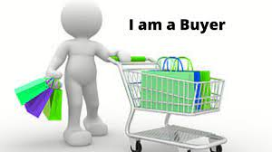
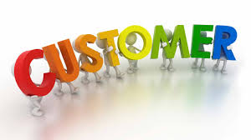

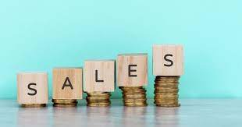

BASICS !!

Slide 3
BASICS !!
BASIS FOR COMPARISON | GOODS | PRODUCTS
Tangibility | Goods are tangible items that can be physically seen and touched. | Products can be either tangible or intangible, such as services.
Purpose | Goods are produced to meet consumer needs. | Products are created to meet consumer demands and make a profit.
Sales | Goods are sold in bulk. | Products can be sold individually or as a package deal.
Consumer Satisfaction | Goods are designed to provide basic necessities. | products are designed to offer consumers a unique and satisfying experience.

Slide 4
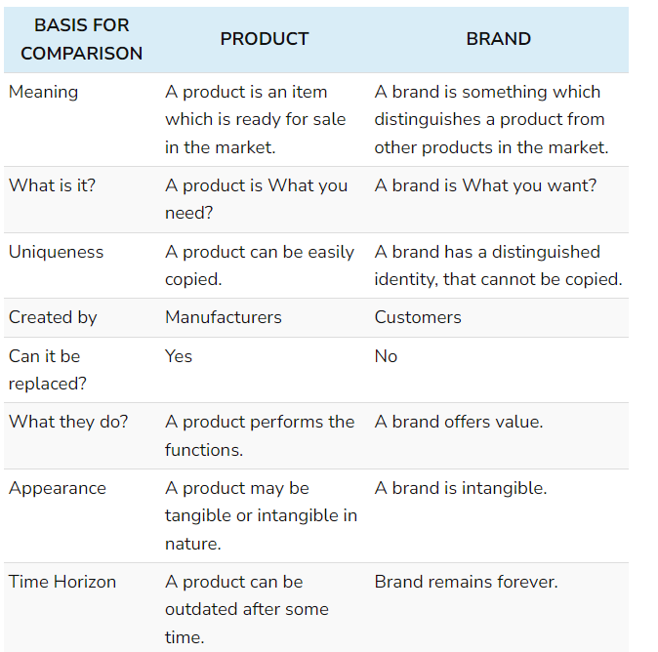
BASICS !!

Slide 5
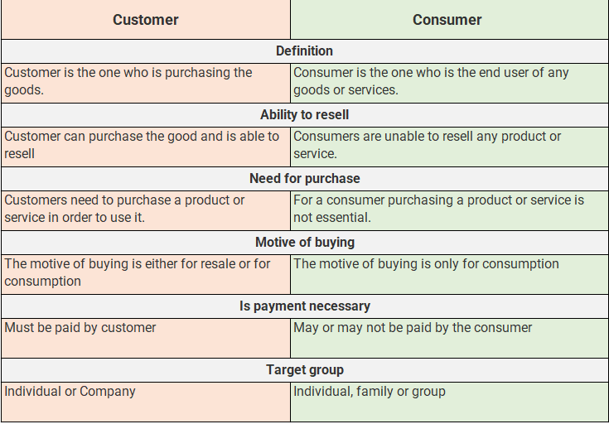
BASICS !!

Slide 6
BASICS !!
 | MARKETING | SALES
DEFINATION | Getting the customer interested in goods and services | Selling the goods and services
STRATEGY | Pull | Push
DURATION | Long term | Short term
FOCUS | Promotion & brand awareness | Fulfill sales target
TARGET | A large base | Individual or small crowd
END POINT | Audience attention | Selling of product

Slide 7
Module -I
Introduction to marketing concept - It is the performance of business activities that direct the flow of goods & services from the producer to consumer / user.
Scope of marketing - Goods ,services, persons , experience, event , places , organization as a brand , information, ownership of property & ideas.
Marketing means – promotion of the product
i.e. providing information to the desired customer/ market
What is the motto of marketing ?
Either sale or future sale (convince to buy later)
Marketing orientation – Need , want, demand i.e. first we need to fix the approach for marketing. e.g. if you want to go from point A to point B – we fix the approach how to go ?
Marketing orientation is basically all about keeping something in center (which approach) & market as per that.

Slide 8
5 types of orientation
The production concept- 1st produce at large scale , when the manufacturing cost reduces then market it ( since costs are spread over a large number of goods) e.g. Jio / Hindustan Motors / Bajaj . when we emphasize on production related variable ( raw material , machinery purchase etc).
The product concept - You have communicate certain qualities / advantages of the product. e.g. Mobile phones – durability /camera etc. this is product centralized marketing.
The selling concept – Focus only on selling . Only sales should grow e.g. pepsi Rs.45 / coco-cola Rs.45 = Competition / Jio 1st sell and we will start charging once people are used to
The Marketing concept – From “make and sell” to “sense and respond”. To find the right products for your customers than finding the right customers for your products.
The Holistic Marketing concept – “Everything matters” in marketing. It has 4 broad components characterizing holistic marketing – Relationship marketing / integrated marketing, internal marketing and performance marketing.

Slide 9
HOLISTIC MARKETING
Holistic Marketing
Internal marketing
Integrated marketing
Relationship marketing
Performance marketing
Marketing is not a dept but a company orientation – Vertical & horizontal alignment
4Cs – Coherent/Consistency/Continuity/Complementary
PPC / SEO / SEM / SMA etc – More focused approach than DM
Customers/employees/marketing partners/financial community

Slide 10
INTERNAL MARKETING
Promoting your organization’s mission, objectives, purpose, culture, products and services, and brand your own employees. Also called as “employee marketing”
Purpose – To “sell” your business to your employees so they are more engaged, brand-aware, and knowledgeable about your organization.
Employee engagement / Company culture / Brand awareness / staff empowerment / recruitment & hiring / retention.
Target Audience Employees
Goal Company’s objectives, products, and services, employee engagement
- Taj Group (In-house magazine to all the employees)

Slide 11
Integrated MARKETING
4Cs of Integrated Marketing Approach
Coherence – different communications are logically connected?
Consistency – multiple messages across all platforms support and reinforce, and are not contradictory?
Continuity – communications are connected and consistent through time or previous campaigns?
Complementary – synergistic, or the sum of the parts is greater than the whole?
Mix & match marketing activities to maximize their individual and collective effect.
NIKE – FB/IG/LinkedIN/Twitter/Youtube/Tiktok/Reddit
[Internal Communication/PR/SM/E-mail marketing/website/Advertising/engagement/events]

Slide 12
RELATIONSHIP MARKETING
Emphasizes customer retention, satisfaction, and lifetime customer value.
long-lasting relationships with customers.
Increased customer lifetime value
Lower long-term marketing costs
Higher customer satisfaction
Deeper customer understanding
Reliable customer base
Starbucks Loyalty program | Starbucks rewards app as in-store digital card
Starbuck personalization – Names / events / festivals etc

Slide 13
RELATIONSHIP MARKETING
Fever FM 104 announces it is shutting down due to 'evolving trends' in media
(30th Jan 2024)
Targeted towards youth with more than 27 million listeners.
Come back with in 2 days.
User curated content strategy – Songs / RJs / Topics / Shows etc.

Slide 14
PERFORMANCE MARKETING
Marketing strategy driven by results
only pay when your goals are met (unlike traditional marketing)
Advantages – less risk / guaranteed ROI / Better control on Ad spend
3 Key players – Advertiser | Publisher | Tracking network
Types -
Affiliate Marketing
Influencer Marketing
Paid Marketing & Advertising
SEM
SMM
Paperboat - #Floataboat
Domino’s – “Pizza Tracker”

Slide 15
The societal marketing concept (sustainability) – To provide & satisfy the consumers wants ,needs while simultaneously being aware of the environmental impact of marketing decisions on future generations ability to meet their needs .
Customer
CEO
Frontline Management
Employees
Top
Management
Communication
Middle
Management
Middle
Management
Top
Management
Frontline Management
Employees
CEO
Customer
Notes:
Communication

Slide 16
e.g. A company replacing its packaging with reusable plastic, then printing this information on the product container . This way , customer are aware about the company’s sustainable practices .
Sustainable marketing :- Broader work ethics /economics.
Green Marketing :- Focus only on environmental aspects. [4 Green Ps]
Green Washing :-. E.g., ‘Coco-Cola life’ – sweetness from natural sources – But 6.6% sugar was far from a healthy drink.
How to know if a brand is read?
Accountability (Transparency)
Accreditation (Audits)
Clear Labelling (Simple language)
Traceability (Bar code)

Slide 17
MARKETING MIX
It virtual Mob/Tab/ PC
Buyer & Seller Interact
Place
Providing Info
Via many modes
Promotion
Product
Items which seller
offer for sale
4 Ps
Price
Not the selling price

Slide 18
NEW AGE MARKETING MIX
4Ps
Power of data
Phygital
Platform
Personalization

Slide 19
Marketing management
MODULE – I I

Slide 20
CONCEPT OF NEED, WANT & DEMAND
NEEDS
States of deprivation
WANTS
Form that needs take as they are shaped by culture and individual personality
DEMANDS
Physical – food, clothing, warmth, safety
Social – belonging and affection
Individual – Knowledge and self-expression
Wants backed by buying power

Slide 21
TYPES OF NEEDS
Stated Needs [Inexpensive car]
Real Needs [Low maintenance]
Unstated Needs [Good after sales]
Delight Needs [Accessories]
Secret Needs [friends to see]

Slide 22
WHY TO UNDERSTAND NEEDS IN MARKETING ?
Developing new products or service
Innovation – Solution to a problem
Stronger relationship
Example:
We have a need to connect with others. We can do it in person, but if that someone is not close, we can choose to send a letter, send a telegram, call them on their cell phone, text them, video call them, you name it. These are all different ways of satisfying one need. Some are more supreme than others. Introducing a touch screen on your cell phone did not create a new need. It created a new want, a desire. A more supreme way of satisfying the simple need of connections and the need of prestige. It just made it more convenient, fun to use, and indirectly a status symbol.
Question - Do you create needs or wants?

Slide 23
TYPES OF DEMAND
Type | Description | Example
Negative demand | product is disliked by all its target customers in general. | Dentist / Insurance / personal loan
Unwholesome demand | consumer badly wants the product but shouldn’t desire or take the decision to buy it. | Cigarettes / alcohol / firearms
Latent demand | Customer realizes it later | Evolution of mobile phones
Declining demand | Product whose demand is declining with time | Pen drives / portable HDD
Irregular demand | seasonal or time-based needs of the product. | AC / Air cooler / Unbrellas
Why to understand types of demand in Marketing?

Slide 24
QUICK REVIEW
What is marketing?
Different marketing concepts?
Production concept?
Product concept?
Selling concept?
Marketing concept?
Holistic marketing concept (Relationship / Internal / Integrated / performance) ?
Societal/sustainable marketing concept?
Green marketing?
Marketing Mix / New age Marketing Mix?
Needs, wants and demands?
Types of needs?
Types of demands?

Slide 25
QUIZ
1) When a manager focuses on making whatever products are easy to produce, & then trying to sell them, that manager has a ________ orientation.
  A. Production
  B. Marketing
  C. Sales
  D. Profit

Slide 26
QUIZ
2) Which of the following is the feature of marketing ?
Needs and wants
Creating a marketing offering
Customer Value
All of the above
None of the above

Slide 27
QUIZ
3) Under which concept do the companies push for the betterment of the quality of their products in their efforts for marketing?
Product concept
Selling concept
Production concept
Marketing concept

Slide 28
QUIZ
4) Which of the following statements is true?
  A. Marketing is a managerial function involving analysis, planning & control marketing activities in an organization.
  B. The essence of marketing is a transaction or an exchange.
  C. Marketing orientation is philosophy, which has to pervade the organization structure.
  D. All of the above

Slide 29
QUIZ
5) A deliberate & careful choice of organization, product, price, promotion, place strategies & policies best define the concept of:
  A. Product Mix
  B. Marketing Mix
  C. Market Penetration
  D. Market Segmentation

Slide 30
QUIZ
  6) Distribution is a decision primarily regarding ___________
  Product
  Price
  Place
  Promotion

Slide 31
QUIZ
  7) The term “marketing mix” describes:
  A composite analysis of all environmental factors inside and outside the firm
  A series of business decisions that aid in selling a product
  The relationship between a firm’s marketing strengths and it’s business weaknesses.
  A blending of four strategic elements to satisfy specific target markets.

Slide 32
QUIZ
8) World Premiere of Seltos by Kia Motors is an example of .....
  Sponsored Marketing
  Event Marketing
  Promotional offer
  Personal Selling
  Database Marketing

Slide 33
QUIZ
  9) Select the theme for integrated marketing
  Many different marketing activities communicate and deliver value
  When coordinated, marketing activities maximize their joint effects
  Both A & B
  None of the above

Slide 34
QUIZ
  10) Internal marketing requires _________ alignment with senior management and _________ alignment with other departments, so everyone appreciates, understands and supports the marketing efforts.
  Vertical, horizontal
  Horizontal, vertical
  Vertical, vertical
  Horizontal, horizontal

Slide 35
QUIZ
  11) Things that are required in order to live are known as ....?
  Wants
  Needs
  Desires
  Demands

Slide 36
QUIZ
12) ______ and ______ are unlimited and never end
  Goods & Services
  Needs & Desires
  C. Product & Services
  Needs & Wants

Slide 37
Internal Assessment
  Presentation on “Holistic Marketing” – A Case study approach (India)
  Presentation on “Marketing Mix Models for Success” – Choose anyone of the below industries (A Case study approach)
  Pharma & Healthcare
  Banking
  FMCG
  Food Industry
  Fashion Industry
  Consumer durable Industry
  Automobile Industry
  Electronics Industry (Mobile phones)
  E-commerce Industry
  Retail Industry

