Slide 1
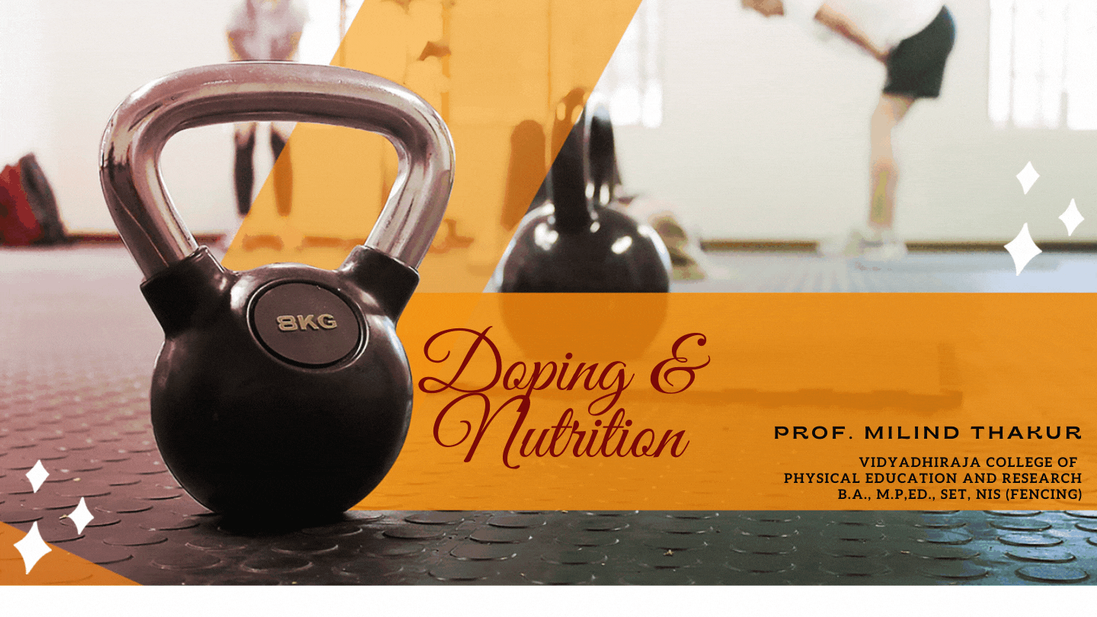

Slide 2
SEM 1
COURSE 1
FOUNDATION OF EDUCATION,
PHYSICAL EDUCATION & SPORTS
UNIT 2
MEANING, AIM & OBJECTIVES OF
PHYSICAL EDUCATION

Slide 3
WHAT IS PLAY?
WHAT IS GAMES?
WHAT IS SPORTS?
WHAT IS PHYSICAL EDUCATION?

Slide 4
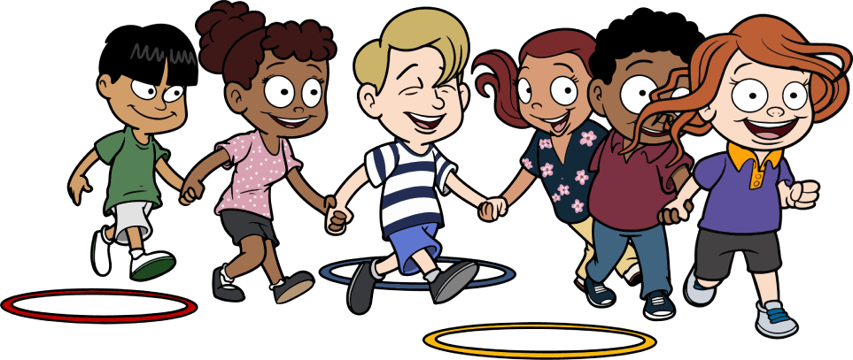
Play is unstructured activity. Youngsters are creative when they engage in play. Tell a five-year old boy to go play and he will run, jump, skip, and do somersaults. He may take time out to look at a bug or smell a flower. Give a young girl a ball and she will kick it, throw it, roll it, and bounce it. Kids instinctively know how to play – they don’t need coaches, clinics, officials, scoreboards, or cheerleaders. Play is physical activity in its purest form. Games are activity with a minimal set of rules, equipment, and coaching.

Slide 5
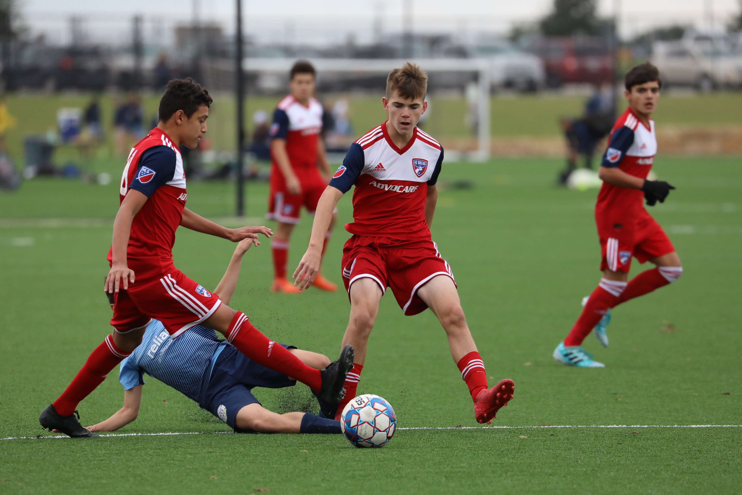
Games may be competitive or cooperative and a scoreboard is optional. Young basketball players may play a game of horse or they may work together to make twenty free throws as a team. When games are played it is possible to have multiple winners.
Sports are a structured form of physical activity. There are teams, coaches, officials, and a scoreboard. Sports are played by amateurs for the “love of the game”. There was a time when college athletics and the Olympics could be classified as sports.

Slide 6
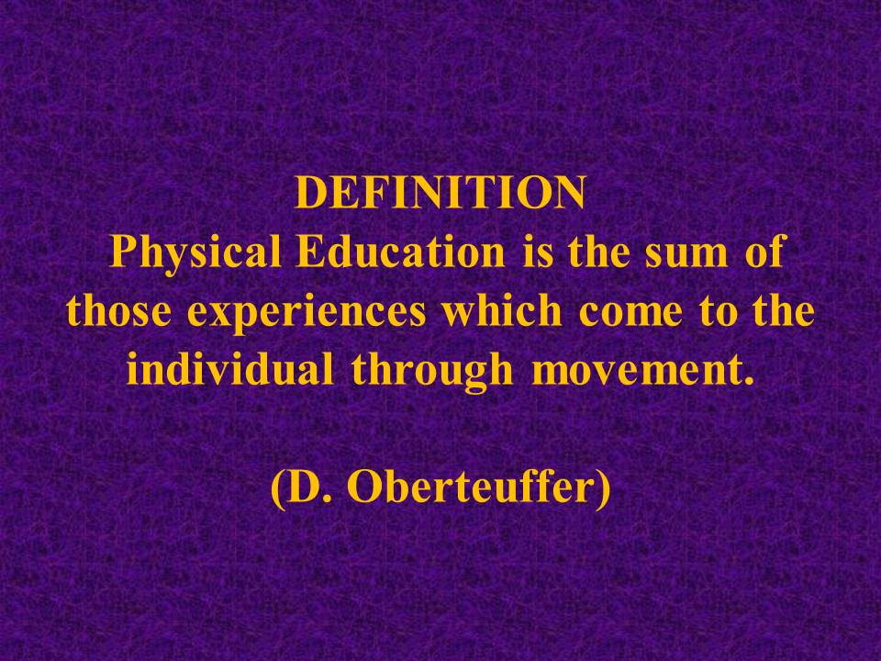
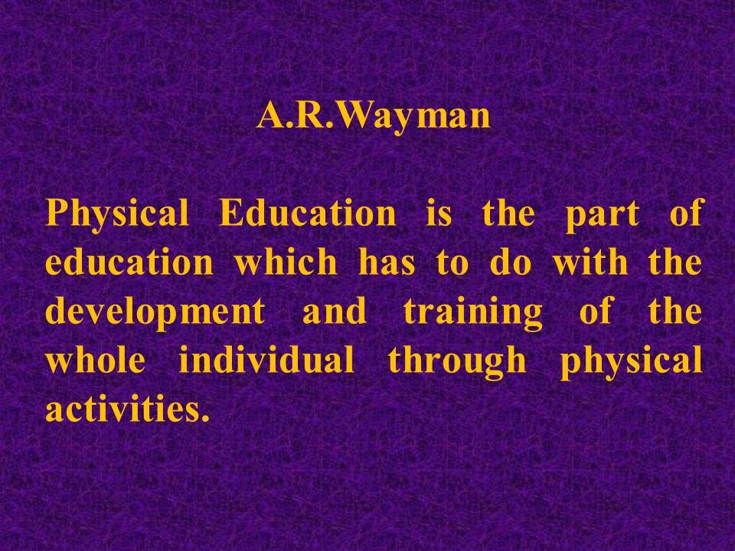

Slide 7
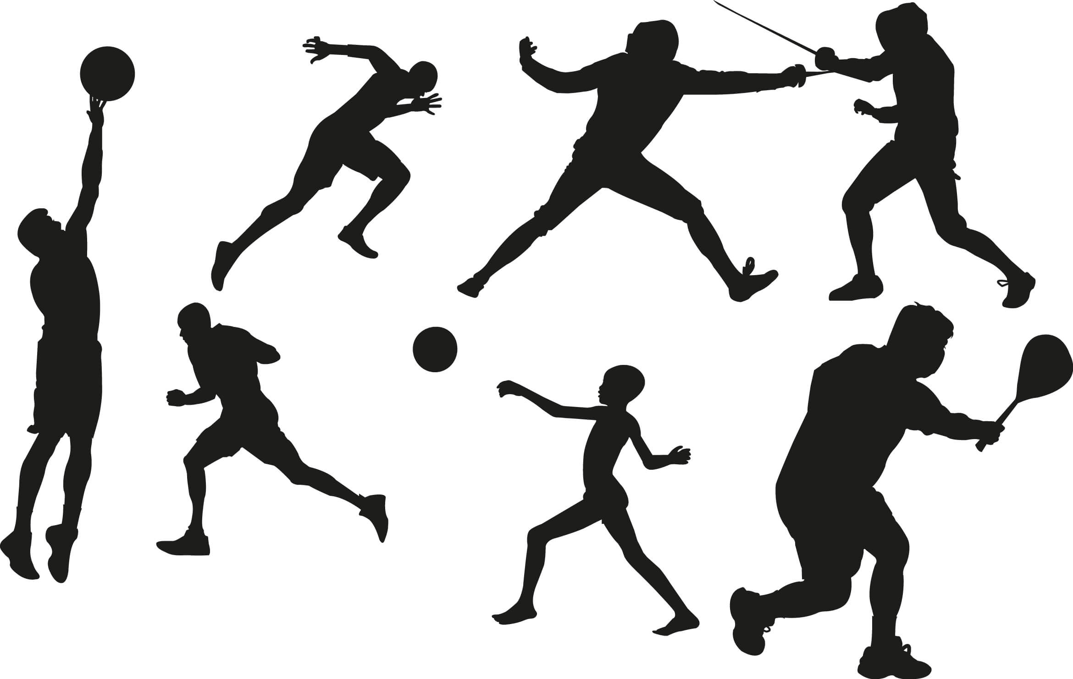
Delbert oberteuffer - विविध हालचालींतून व्यक्तींना प्राप्त होणाऱ्या अनुभवांचे संघटन म्हणजे शारीरिक शिक्षण होय.
रुसो - बालकाच्या सर्व अवयवांचा व प्रवृत्तीचा विकास म्हणजे शारीरिक शिक्षण होय.
Swami Vivekanand - माणसातील पूर्णत्वाचा अविष्कार म्हणजे शारीरिक शिक्षण होय.

Slide 8
Physical education is a course taught in school that focuses on developing physical fitness and the ability to perform and enjoy day-to-day physical activities with ease. Kids also develop skills necessary to participate in a wide range of activities, such as soccer, basketball, or swimming. Aims and objectives of Physical Education:
(i) To develop the organic systems of the body;
(ii) To develop euro-muscular co-ordination or skill;
(iii) To develop right attitude towards physical activities in general;
(iv) To develop a desirable social attitudes and conduct;
(v) Development of psychomotor skills;
(vi) Development of understanding and appreciation of the techniques and strategies of sports;
(vii) Preparation for leisure time;

Slide 9
(viii) Elimination of worries and anxieties through deve­loping appropriate interests and habits of engaging in exercise and sports;
(viii) Attainment of knowledge of proper health procedure as related to physical exercise.
(x) To develop correct health habits;
(xi) To serve as an out let for surplus energy, which if pent up, make the child tens, nervous and irritable.
(xii) To meet the challenge of growing indiscipline among the student community by instilling in the younger generation a sense of patriotism, self-reliance and discipline.
(xiii) To give adequate scope for bringing out the aptitu­des and talents of the child.
(xiv) To promote the spirit of certain qualities like sports-man ship, team spirit, leadership, patience, self-restrain co-operation, sociability and those other qualities of character and citizenship.

Slide 11
Aims
The aims of physical education are to enable the student to: appreciate and understand the value of physical education and its relationship to a healthy, active lifestyle work to their optimal level of physical fitness become aware of movement as a creative medium connected to communication, expression and aesthetic appreciation develop the motor skills necessary to participate successfully in a variety of physical activities experience enjoyment and satisfaction through physical activity develop social skills that demonstrate the importance of teamwork and cooperation in group activities demonstrate a high level of interest and personal engagement showing initiative, enthusiasm and commitment show knowledge and understanding in a variety of physical activities and evaluate their own and others’ performances demonstrate the ability to critically reflect upon physical activity in both a local and intercultural context demonstrate the ability and enthusiasm to pass on to others in the community the knowledge, skills and techniques that have been learned.

Slide 12
Objectives
The objectives of any MYP subject and of the personal project state the specific targets set for learning in the subject. They define what the learner will be able to do, or do better, as a result of studying the subject. The objectives of MYP physical education are split into five sub-groups that correlate with the final assessment criteria.
Knowledge and Understanding At the end of the course students should be able to: demonstrate an understanding of the principles and concepts related to a variety of physical activities understand the importance of physical activity to a healthy lifestyle recall and understand the various components that contribute to health-related fitness.
Movement Composition At the end of the course students should be able to compose and communicate meaning and ideas through movement.

Slide 13
Performance and Application At the end of the course students should be able to: display acquired motor skills necessary to perform a variety of physical activities apply tactics, strategies and rules in both individual and group situations use movement concepts appropriately in relation to themselves, others and their physical environment apply health and fitness principles effectively through a variety of physical activities.
Social Skills At the end of the course students should be able to: work cooperatively respect themselves and their social and physical environment support and encourage others (towards a positive working environment)develop attitudes and strategies that enhance their relationship with others show sensitivity to their own and different cultures.
Personal Engagement At the end of the course students should be able to: show initiative, creativity and a willingness to improve themselves take responsibility for their own learning process and demonstrate engagement with the activity, showing enthusiasm and commitment show self-motivation, organization and responsible behaviour recognize, analyse and evaluate the effects of a variety of physical activities on themselves and others reflect upon and evaluate their own performance in order to set goals for future development.

