Slide 1
Laws of Electromagnetic Induction
By
Ms. Supriya Shigwan

Slide 2

Lenz’s law
Lenz’s law of electromagnetic induction states that the direction of induced current is such that it opposes the change that causes it.
The direction of this current flow can be determined using Fleming’s right-hand rule.
Where:
ε = Induced emf
δΦB = change in magnetic flux
N = No of turns in coil

Slide 3
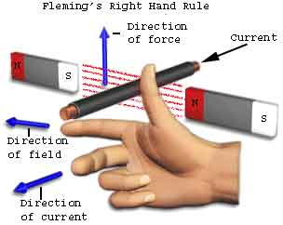
Fleming’s right-hand rule
Fleming's right-hand rule (for generators) shows the direction of induced current when a conductor attached to a circuit moves in a magnetic field. It can be used to determine the direction of current in a generator's windings.
The right hand is held with the thumb, index finger and middle finger mutually perpendicular to each other (at right angles), as shown in the diagram.
If forefinger represents the direction of the line of force, the thumb points in the direction of motion or applied force, then second finger points in the direction of the induced current”.

Slide 4
Faraday’s First Law
Any change in the magnetic field of a coil of wire will cause an emf to be induced in the coil. This emf induced is called induced emf and if the conductor circuit is closed, the current will also circulate through the circuit and this current is called induced current.
Method to change the magnetic field:
By moving a magnet towards or away from the coil
By moving the coil into or out of the magnetic field
By changing the area of a coil placed in the magnetic field
By rotating the coil relative to the magnet

Slide 5
Faraday’s Second Law
It states that the magnitude of emf induced in the coil is equal to the rate of change of flux that linkages with the coil. The flux linkage of the coil is the product of the number of turns in the coil and flux associated with the coil.

Slide 6
Losses in Magnetic Circuit[10 M]
There are two types of magnetic losses
a) Hysteresis losses
b) Eddy Current Losses

Slide 7
Hysteresis loss
Hysteresis is the ‘lagging’ effect of flux density B whenever there are changes in the magnetic field strength H. When an initially unmagnetized ferromagnetic material is subjected to a varying magnetic field strength H, the flux density B produced in the material varies.
Hysteresis loss is associated with the phenomena of hysteresis and is an expression of the fact when ferromagnetic material isinvolved, not all the energy of the magnetic field is returned to the circuit when mmf is removed. It is known as hysteresis loss.
The core of a transformer is subjected to an alternating magnetizing force and for each cycle of emf a hysteresis loop is traced out.

Slide 8
Where
Ph=hysteresis loss in watts
f= frequency
Bm=max freq density
n=hysteresis coeefficient {1.5-2.5}
v= volume

Slide 9
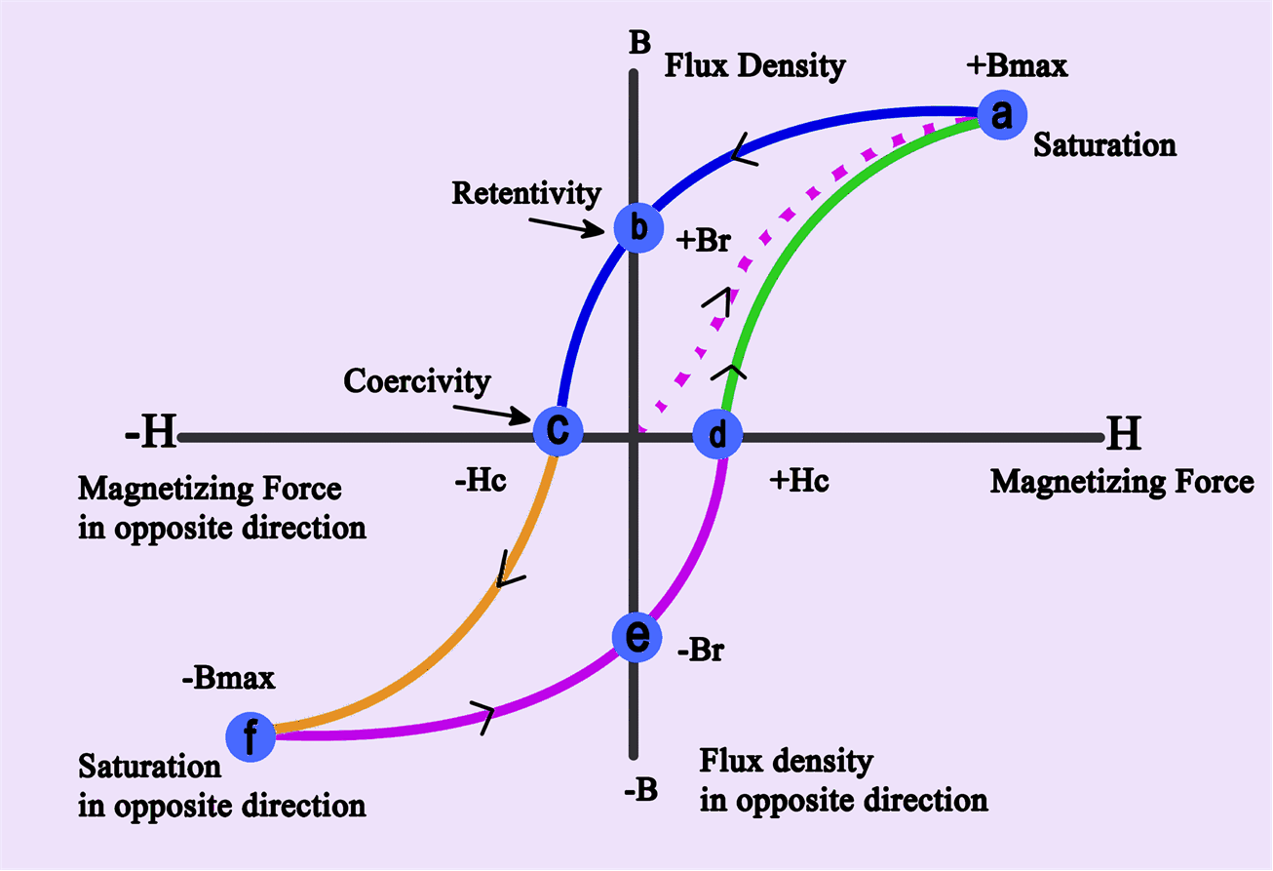
Hysteresis loop
A hysteresis loop shows the relationship between the induced magnetic flux density (B) and the magnetizing force (H).
It is often referred to as the B-H loop.

Slide 10
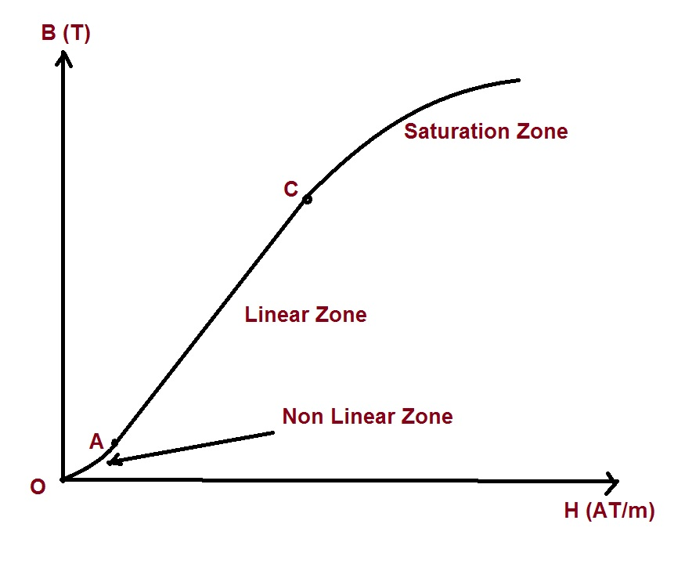
B-H Curve/Magnetisation curve/Saturation Curve
How to minimize the hysteresis loss?
By reducing operating frequency
By reducing volume of the material
By selecting a material which has narrow hysteresis loop.

Slide 11
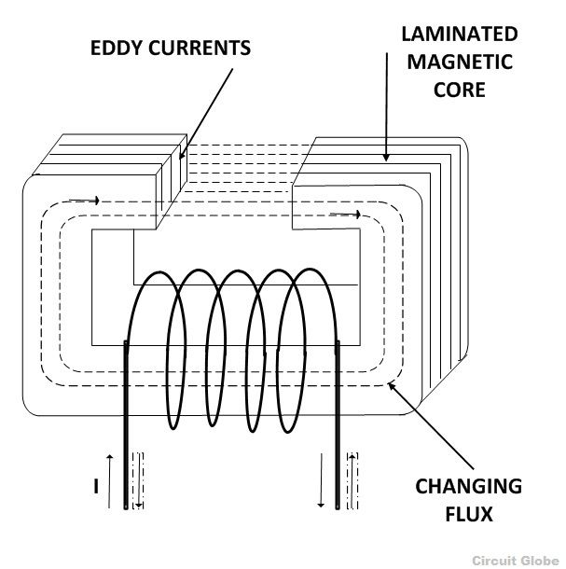
Eddy current loss
When an alternating magnetic field is applied to a magnetic material, an emf is induced in the material itself according to Faraday’s Law of Electromagnetic induction. These circulating currents are called Eddy Currents. As these currents are not responsible for doing any useful work, and it produces a loss (I²R loss) in the magnetic material known as an Eddy Current Loss.
Eddy current losses can be minimize by using materials of high resistivity such as silicon, steel.
Where
Pe= Eddy current loss
Ke= Eddy current coefficient
Bm=Max flux density
t=thickness of lamination
v= volume

Slide 12
Separation of core loss
The sum of hysteresis and eddy current losses is called core loss as both the losses occur within the core (magnetic material).
For a given magnetic circuit with a core of ferromagnetic material, volume and thickness of the plates are constant and the total core loss can be expressed as follows.
Core loss = Hysteresis loss + Eddy current loss
The hysteresis and the eddy current losses in a magnetic material are also known by the name iron losses or core losses or magnetic losses.

