Slide 1
BADMINTON
HISTORY AND ORIGINS.
The beginnings of badminton can be traced to the mid-1800s in British India, where it was created by British military officers stationed there. It became very famous in Poona in 1873, a British town, so that is why it first know name was also Poona game. At the beginning they used champagne bottle corks with some feathers stabbed on it. The first official badminton rules were published in England. Finally, almost one century later, it became Olympic sport in the Barcelona Olympics. Nowadays, since Atlanta Olympics in 1996, it is a mixed sport: men and women can play together.

Slide 2
Court and Court Equipments
The court:
Dimensions of Court are 44 x 20 feet
The court shall be a rectangle marked out with lines 40 mm wide
The lines marking out the court shall be preferably be coloured white or yellow.
Diagonal length of full court = 14.723m.
Court as shown below can be used for both singles and doubles play.

Slide 3
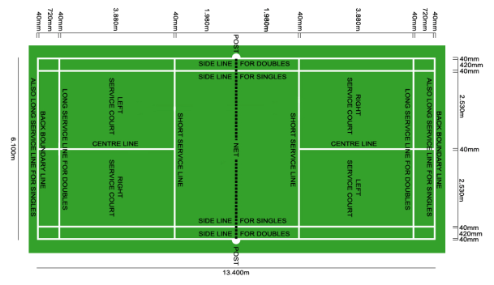

Slide 4
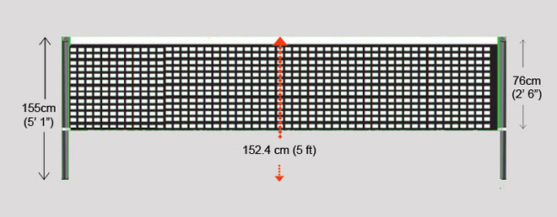
The net
It consists of a dark or black mesh and with a white band of 75 mm on the upper part.
It is 1.55 m height and 6.10 m width (double court width)

Slide 5
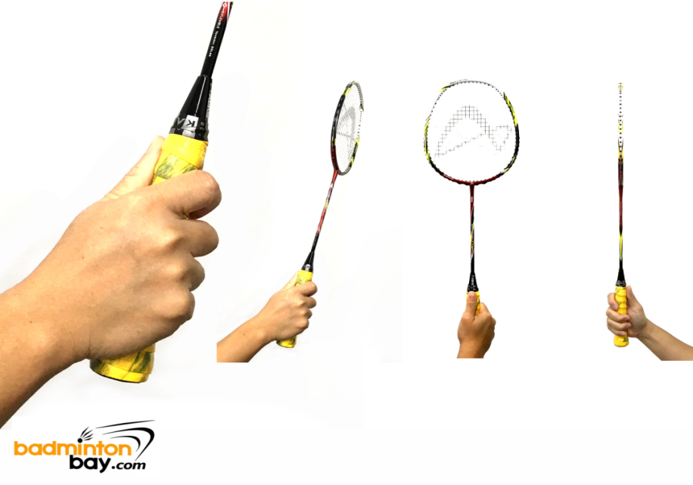
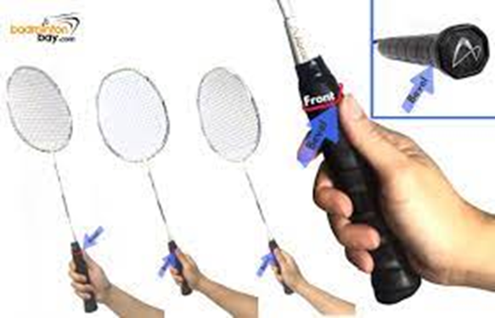
The racket
It is made of carbon fiber. This makes it lighter and more resistant than older models made of wood or metal. Its maximum length is 68cm and the head maximum width is 23cm.The grip: the basic grip is called forehand grip. To use this grip the head must be perpendicular to the ground.

Slide 6
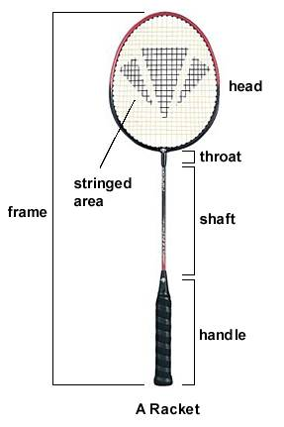
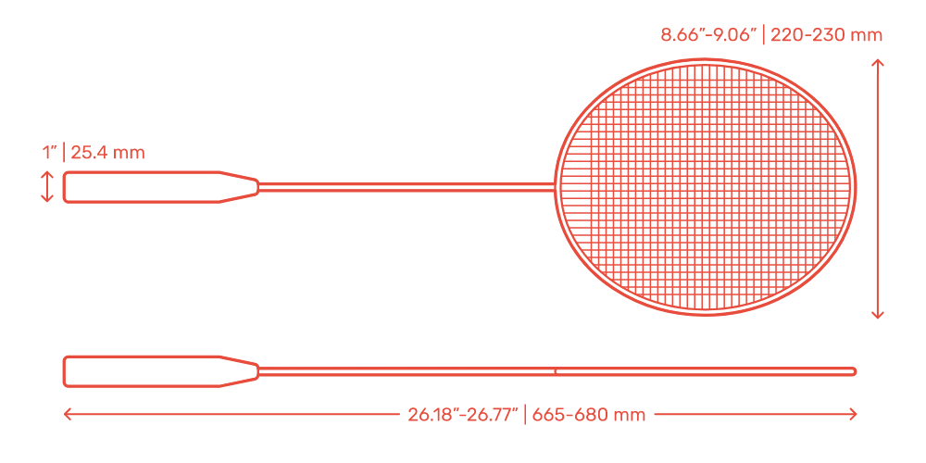

Slide 7
Shuttle
The shuttle shall have 16 feathers fixed in the base.
The feathers shall have a uniform length between 62 mm to 70 mm when measured from the tip to the top of the base.
The tips of the feathers shall lie on a circle with a diameter from 58 mm to 68 mm.
The feathers shall be fastened firmly with thread or other suitable material.
The base shall be 25 mm to 28 mm in diameter and rounded on the bottom.
The shuttle shall weigh from 4.74 to 5.50 grams.

Slide 8
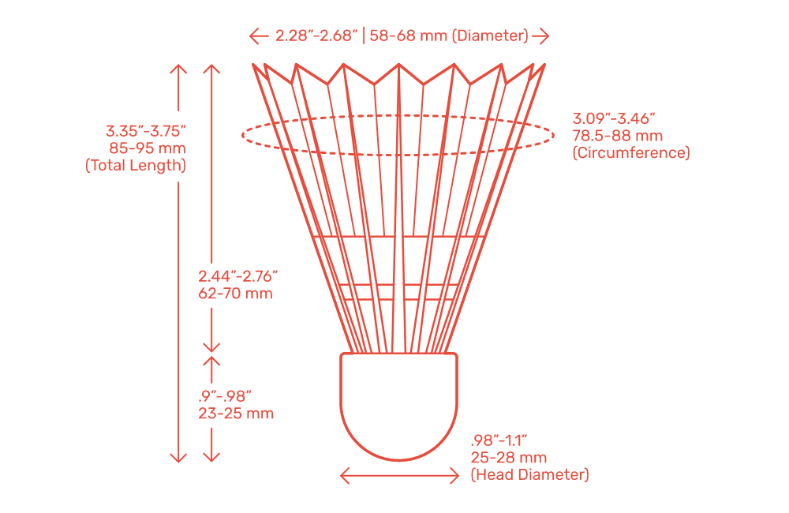

Slide 9
Game modes
Singles: 1vs1. Each player must be on opposite sides of the net.
Doubles: 2vs2. Each pair of players must be on opposite sides of the net, and each player must be on opposite sides of the center line.
Mixed double: 1 man and 1 woman can form a couple together..

Slide 10
SCORING SYSTEM
A match shall consist of the best of three games,
A game shall be won by the side which first scores 21 points
The side winning a rally shall add a point to its score. A side shall win a rally, if the opposing side commits a ‘fault’ or the shuttle ceases to be in play because it touches the surface of the court inside the opponent’s court.

Slide 11
SCORING SYSTEM
If the score becomes 20-all, the side which gains a two point lead first, shall win that game.
If the score becomes 29-all, the side scoring the 30th point shall win that game.
The side winning a game shall serve first in the next game.

Slide 12
CHANGE OF ENDS
Players shall change ends:
at the end of the first game;
at the end of the second game, if there is to be a third game; and
in the third game when a side first scores 11 points.
If the ends are not changed as indicated above, it shall be done so as soon as the mistake is discovered and when the shuttle is not in play. The existing score shall stand.

Slide 13
SERVICE
In a correct service,
Neither side shall cause undue delay to the delivery of the service once the server and the receiver are ready for the service.
The server and the receiver shall stand within diagonally opposite service courts without touching the boundary lines of these service courts;
The whole of the shuttle shall be below 1.10 metres from the surface of the court at the instant of being hit by the server's racket.

Slide 14
Some part of both feet of the server and the receiver shall remain in contact with the surface of the court in a stationary position from the start of the service until the service is delivered.
The server’s racket shall initially hit the base of the shuttle;
The whole shuttle shall be below the server’s waist at the time of being hit by the server’s racket.
The shaft and the racket head of the server’s racket at the time of hitting the shuttle shall be pointing in a downward direction;

Slide 15
The movement of the server’s racket shall continue forwards from the start of the service until the service is delivered.
The flight of the shuttle shall be upwards from the server’s racket to pass over the net so that, if not intercepted, it shall land in the receiver’s service court (i.e. on or within the boundary lines); and
In attempting to serve, the server shall not miss the shuttle.

Slide 16
Once started, the service is delivered when the shuttle is hit by the server’s racket or, in attempting to serve, the server misses the shuttle.
The server shall not serve before the receiver is ready. However, the receiver shall be considered to have been ready if a return of the service is attempted.
In doubles, during the delivery of service, the partners may take up any positions within their respective courts, which do not unsight the opposing server or receiver.

Slide 17
FAULTS
A service is not correct
If, in service, the shuttle is caught on the net and remains suspended on its top;
After passing over the net, shuttle is caught in the net; or
Is hit by the receiver’s partner;
If in play, the shuttle:
lands outside the boundaries of the court
Fails to pass over the net;
Touches the ceiling or side walls;
Touches the person or dress of a player;
touches any other object or person outside the court;

Slide 18
Is caught and held on the racket and then slung during the execution of a stroke;
Is hit twice in succession by the same player. However, a shuttle hitting the head and the stringed area of the racket in one stroke shall not be a ‘fault’;
Is hit by a player and the player’s partner successively; or
Touches a player’s racket and does not travel towards the opponent’s court;

Slide 19
if, in play, a player:
Touches the net or its supports with racket, person or dress;
Enters an opponent’s court over the net with racket or person
Invades an opponent’s court under the net with racket or person such that an opponent is obstructed or distracted; or
Obstructs an opponent, i.e. prevents an opponent from making a legal stroke where the shuttle is followed over the net;
Deliberately distracts an opponent by any action such as shouting or making gestures;

Slide 20
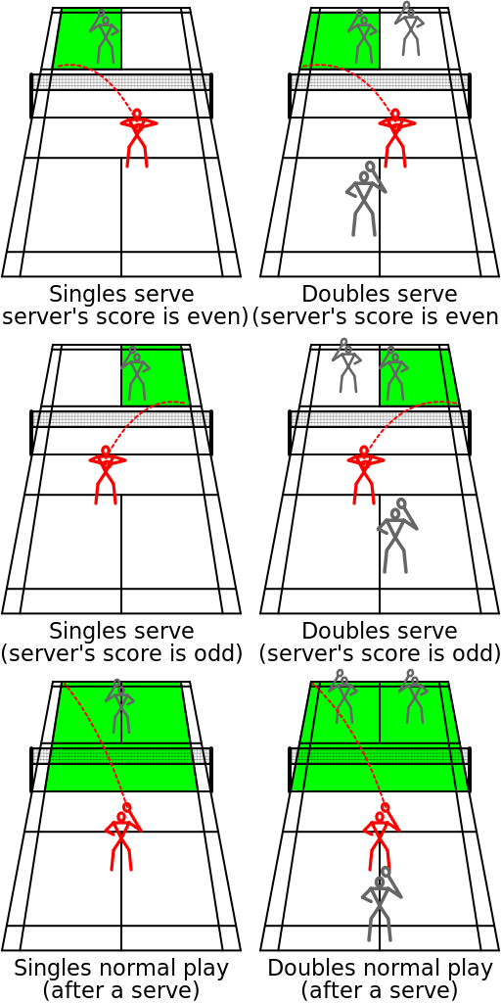
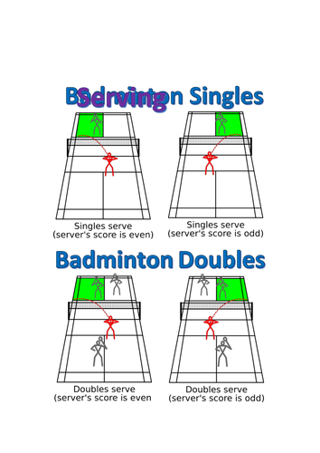

Slide 21
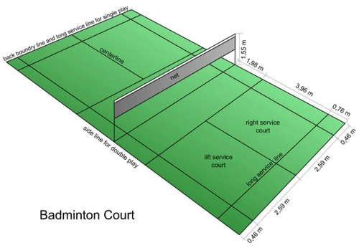

Slide 22
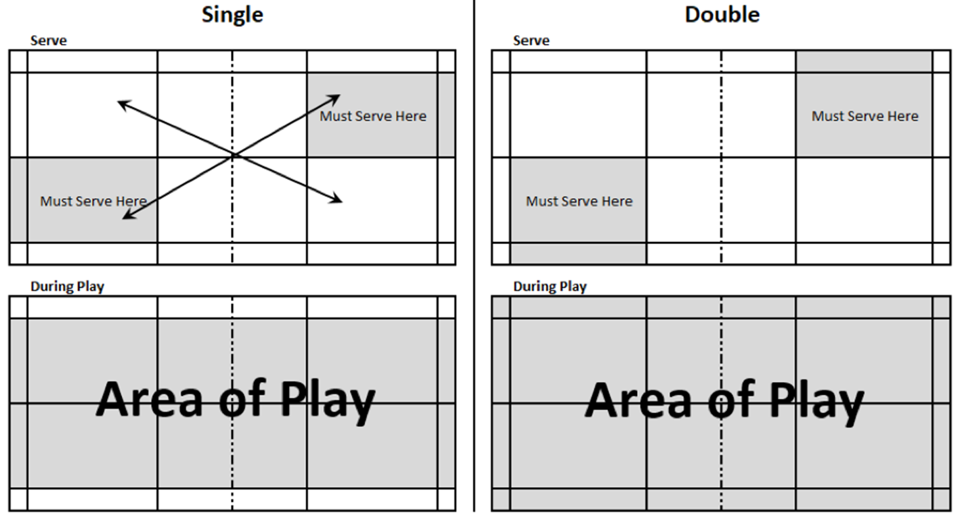

Slide 23


Slide 24
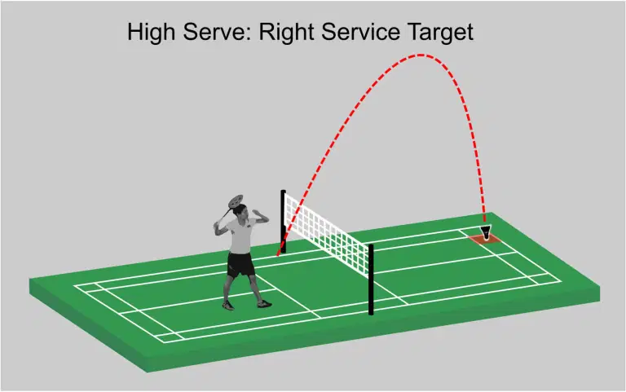

Slide 25
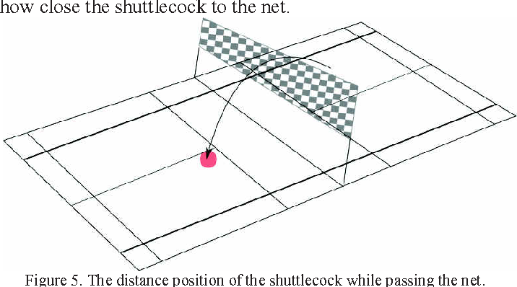

Slide 26
Thank you

