Slide 1
personal fitness
IDEAL WAY TO BE FIT
Padmakshan Padmanabhan

Slide 2
Physical Fitness
Physical Fitness is the ability of your body systems to work efficiently. A fit person is able to carry out the typical activities of living, such as work, and still have enough energy and vigor to respond to emergency situations and to enjoy leisure time activities.

Slide 3
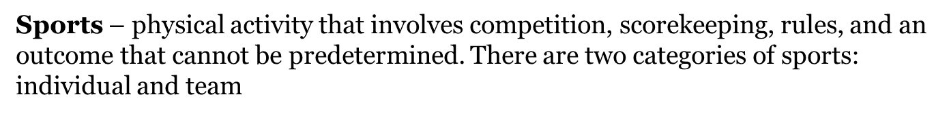
Types of Physical Activity
Aerobic - light to vigorous-intensity physical activity that requires more oxygen than sedentary behavior and thus promotes cardiovascular fitness and other health benefits (e.g., jumping rope, biking, swimming, running; playing soccer, basketball, or volleyball).
Anaerobic – intense physical activity that is short in duration and requires a breakdown of energy sources in the absence of sufficient oxygen. Energy sources are replenished as an individual recovers from the activity. Anaerobic activity (e.g., sprinting during running, swimming, or biking) requires maximal performance during the brief period.
Lifestyle – physical activity typically performed on a routine basis (e.g., walking, climbing stairs, mowing or raking the yard), which is usually light to moderate in intensity.
Physical activity play – play activity that requires substantial energy expenditure (e.g., playing tag, jumping rope). Play – activity with flexible rules, usually self-selected, for the purpose of having fun.
Weight-bearing – physical activity that requires people to move their own weight.

Slide 4

Isometric Resisted Exercise
Isometric resisted exercise is a static contraction of muscle against external resistance without appreciable change in its length or joint motion.
Advantage
Isometric exercise is valuable when joint motion is uncomfortable or contraindicated, during immobilization.
Isometric exercise is effective when weakness exist at a specific point in the ROM.
Easy to understand.
Disadvantage
Isometric strength is specific to the joint angle (joint angle dependent).

Slide 5
Isotonic Resisted Exercise
Isotonic resisted exercise is dynamic exercise that is carried out against resistance as a muscle lengthens or shortens through the available range of motion.
CONCENTRIC CONTRACTION occurs when active muscle undergoes shortening while overcoming external resistance.
ECCENTRIC CONTRACTION occurs when active muscle undergoes lengthening while being overcome by an external resistance.
Eccentric contraction performed against supramaximal resistance generates greater force production than concentric contraction.

Slide 6
Isokinetic Resistive Exercise
Isokinetic exercise is a form of active exercise in which a muscle or group of muscles contracts against a controlled accommodating resistance which is moving at a constant angular velocity.
The isokinetic exercise are performed with a specialized apparatus that provides variable resistance to a movement, so that no matter how much effort is exerted, the movement takes place at a constant speed.
  The isokinetic device are computerized training and testing device that provide maximum resistance through the entire ROM.
  The device provide multi-angle isometric resistance, resisted concentric and eccentric exercise.

Slide 7
Fitness components
Padmakshan Padmanabhan

Slide 8
Fitness components
One of the misconceptions in the sports world is that a sports person gets in shape by just playing or taking part in his/her chosen sport. If a stationary level of performance, consistent ability in executing a few limited skills is your goal, then engaging only in your sport will keep you there. However, if you want the utmost efficiency, consistent improvement, and balanced abilities sportsmen and women must participate in year round conditioning programs.

Slide 9
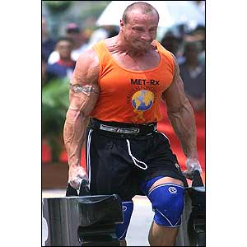
Know the Nine..
“ Fitness components”
Exercise scientists have identified nine components that comprise the definition of fitness:
"Key Methods of Sports Conditioning",
(1)Strength: The extent to which muscles can exert force by contracting against resistance(e.g. holding or restraining an object or person

Slide 10
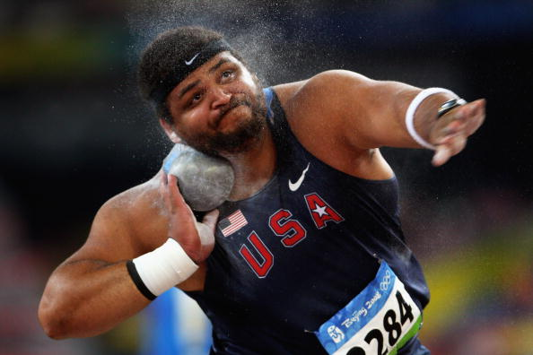
(2) Power - the ability to exert maximum muscular contraction instantly in an explosive burst of movements. The two components of power are strength and speed. (e.g. Shot Put or a sprint start)

Slide 11
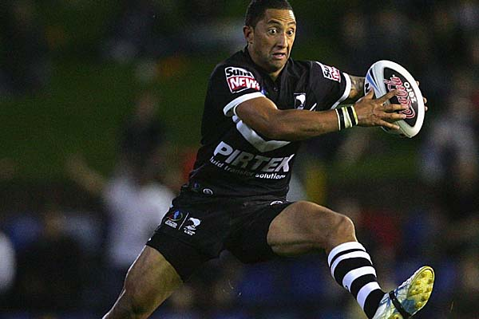
(3) Agility - the ability to perform a series of explosive power movements in rapid succession in opposing directions (e.g. Zig Zag running or cutting movements)

Slide 12
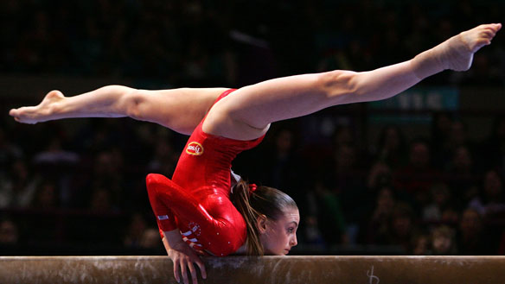
(4)Balance ability- the ability to control the body's position, either stationary (e.g. a handstand) or while moving (e.g. a gymnastics stunt

Slide 13
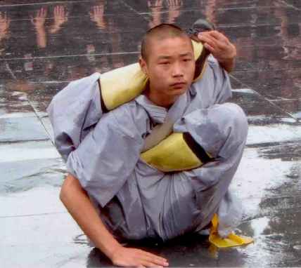
(5)Flexibility - the ability to achieve an extended range of motion without being impeded by excess tissue, i.e. fat or muscle (e.g. executing a leg split)

Slide 14
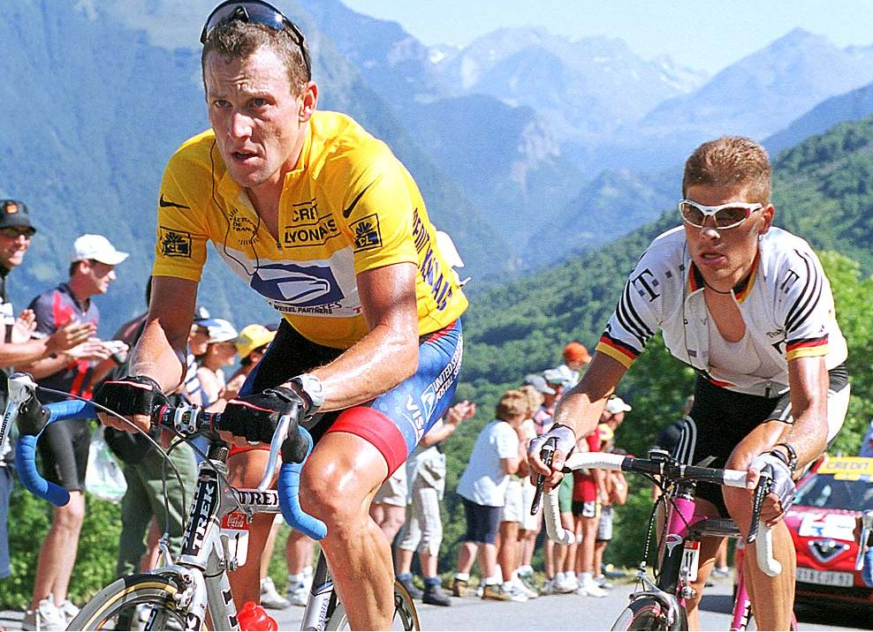
(6)Muscle Endurance - a single muscle's ability to perform sustained work (e.g. rowing or cycling)

Slide 15
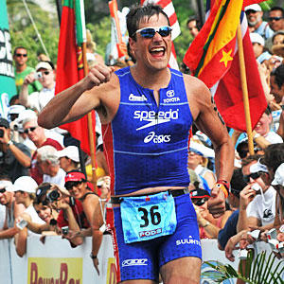
(7)Cardiovascular Endurance - the heart's ability to deliver blood to working muscles and their ability to use it (e.g. running long distances)

Slide 16
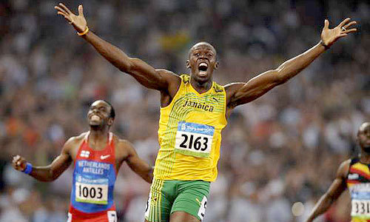
(8)Speed: Speed is the ability of a person to execute motor movements with high speed in the shortest period of time. It is equal to the distance covered per unit of time. the element of speed is involved in most of the athletic skills such as in sprint running, some skills of soccer, basketball, etc.

Slide 17
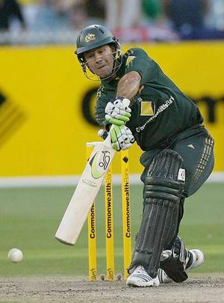
(9)Co-ordination- the ability to integrate the above listed components so that effective movements are achieved.

Slide 18
General health fitness components Versus Sports specific Fitness components
General Health | Sports specific
Muscular endurance | Co-ordination
Cardiovascular endurance | Balance
Strength | Agility
Flexibility | Power
 | Speed

Slide 19
Testing the Fitness Components
Test | Fitness Component
Speed sit-up (60sec) | Muscular Strength, Muscular Endurance
Sit-and-Reach | Flexibility
50m Sprint | Speed
Standing Long Jump | Muscular Explosive Power, Maximum Strength
Push-Ups | Muscular Endurance
1.6 km Run or Kasch-Boyer Step Test | Aerobic Capacity
Stork Stand | Balance
Shuttle run | Agility
Alternate Wall Toss | Coordination
Grip Strength | Maximum Strength
Body Mass Index (BMI) | Body Composition

Slide 20
Fitness: Ability to carry out daily tasks with vigor and alertness without undue fatigue

Slide 21
How Do You Improve Your Fitness?
The human body is an amazing piece of machinery, one that adapts to the stress we put it under. As long as we don’t overly stress our body, it will adapt and strengthen itself too cope. If you run everyday your legs will get stronger and your cardio respiratory system will become more efficient.
Sport scientists have discovered the best way to train and increase our fitness levels in each fitness component. Essentially, we do the exercise that most mimics the action and fitness components we want to train and improve. To increase swimming we swim, to increase strength we lift weights.

Slide 22
Why Do We Need Fitness
Less fatigue
Less boredom
More opportunity for meeting and making friends
Improved sleep
Why do we want Fitness?
Improved self image
Stronger muscles and bones
Greater resistance to illness and disease
Bigger heart and lungs
Improved posture and appearance

Slide 23
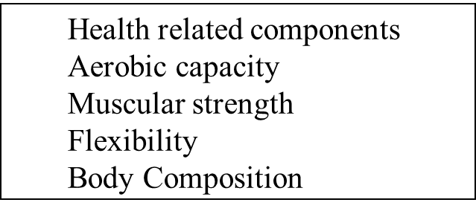
Health Related Fitness Components
Understand it for a better fitness

Slide 24
Health related Exercise
Cardio Vascular
Muscular Strength
Muscular Endurance
Flexibility
Body Composition
Football
Rugby
Tennis
Long Distance runners
Rugby
Weight Lifter
Rowing
Swimming
Running
Tennis
Cricket?
Gymnasts
Racket Sports
Running
Cricket
Rugby
Long Dist Runner (Ecto) all & Slim)
Swimmer (Mesomorphs)
Sumo Wrestler (Endo morph)

Slide 25
Health-Related Fitness
The health and fitness levels needed to carry out daily activities with little fatigue and still have energy for emergencies.
To have enough fitness for good health we need: Aerobic Capacity, Muscular Strength, Flexibility and Body Composition

Slide 26
Aerobic Capacity (Stamina or Cardio-respiratory Endurance)
Is the ability for heart and lungs to supply oxygen through the blood to the muscles. This allows us to work for relatively long periods without becoming overtired

Slide 27
Muscular Strength
Is the ability for our muscles to exert a force. This involves maximum strength, muscular power and muscular endurance. It helps to protect joints from injury.
Strength = Mass x acceleration
1 RM (MAXIMUM STRENGTH)
Strength Endurance (GENERAL STRENGTH)
Explosive strength (SPEED STRENGTH)

Slide 28
Flexibility
Is the ability to move our joints through their full range of movement.
Ballistic Method(swinging )
Slow stretch and hold
Post Isometric

Slide 29
Body Composition
Is the capacity to carry the right amount of fat and muscle.
BODY TYPES: ECTO MORPH : LEAN AND THIN
MESO MORPH: MUSCULAR
ENTRO MORPH: FATTY /BULKY

Slide 30
Body composition MUSCLE>BONE>FAT
COMPOSITION | MEN -WT.(70KG) | HT. (174 CM) | WOMEN (WT.56KG) | HIT(163CM)
TOTAL FAT | 15% | 10.5 KG | 27% | 15.12 KG
STORAGE FAT | 12% | 8.4 KG | 16% | 8.96 KG
ESSENTIAL FAT | 3% | 8.4 KG | 12% | SEX SPECIFIC
MUSCLE | 44.8% | 31.3 KG | 36% | 21.02 KG
BONE | 14.9% | 10.4KG | 12% | 6.7KG
REMAINDER | 25.3% | 17.6 KG | 25% | 14 KG

Slide 31
FATS
ESSENTIAL FAT: HEART,LUNGS,KIDNEY MUSCLE, FEMALE-SEX SPECIFIC
STORAGE FAT: SUB CUTANEOUS
Lean body mass= BODY MASS- STORAGE FATMASS(70-8.4 = 61.6 KG)
PRESENT FAT= SKINFOLD /GIRTH MEASUREMENT
FAT MASS = % STORAGE FAT /100 x BODY MASS
DESIRABLE BODY MASS = LBM/1-REDUCTION FAT
DESIRABLE FAT LOSS = BODY WT-DBM
BODY MASS INDEX=BODY WT in Kg/HIGHT in Mtrs square

Slide 32
BODY MASS INDEX(B M I)
HEIGHT :170 CM WEIGHT:66KG
SKINFOLD MEASUREMENT: BICEP:10MM SUBSCAPULAR -15MM
(A)PRECENT FAT : = BICEP FAT+SUBSCAPULAR FAT+1.47
= .43X10+.58X15+1.47
=4.3+8.7+1.47=14.47
(B) FAT MASS = PRECENT FAT/100XBODY WEIGHT
=14.47/100X66 = 9.55KG
(C )LEAN BODY MASS(LBM) =BODY WEIGHT – FAT MASS
66 – 9.55 = 56.45 KG
(D)DESIRABLE BODY MASS(DBM) = LEAN BODY MASS/1-REDUCTION FAT
=56.45/1-.05
=56.45/.95 =59.42 KG
(E )DESIRABLE FAT LOSS = BODY WEIGHT – DESIRABLE BODY MASS
=66 -56.45 = 9.55 KG
(F)BODY MASS INDEX – BODY WEIGHT IN KG/(HIGHT IN MTR)2
=66/(1.70)^2 = 66/2.89 = 22.9
WEIGHT REDUCE = 500 CAL X 7DAYS = 3500 CAL TO REDUCE 0.5 KG IN A WEEK. 250 CAL (EXERCISE &250 CAL DIET)

Slide 33
Define: BMI
Normal: BMI 18 - 24.9
Normal: BMI 18 - 24.9
Overweight: 25 -29.9
Obese: >= 30
  Class I 30 - 34.9
  Class II 35 - 39.9
  Class III >= 40

Slide 34
MUSCLE
IN MUSCLE : 70% WATER , 20% PROTEIN, 5% SALT,CALCIUM,LATIC ACID AMINO ACID ETC.
TYPE PF PROTIEN
ACTIN
MYOSIN
TRAPO MYSIN
CALCIUM
THESE FIBRE`S WILL ALLOW THE MUSCE CONTRACTION EACH OTHER FIBRILS. THIS CAN BE ACHIEVED THRUGH CALCIUM.
-FIBRIL ARE MADE OF SURCOMERE
THERE ARE THREE TYPE OF MUSCLE GROUP IN THE BODY
SKELTEL MUSCLE-VOLOUNTARY MUSCLES
CARDIAC MUSCLE – IN VOLOUNTARY
SMOOTH MUSCLE – STOMATCH , ANAS, MOUTH, INTESTINE ETC.

Slide 35
TYPE OF MUSCLE CONTRACTION
ISOTOMIC CONTRACTION : THIS TYPE CONTRACTION CAUSE A CHANGE IN THE MUSCLE LENGTH .
CONCENTRIC- WHEN MUSCLE SHORTENS
ECENTRIC – WHEN MUSCLE LENGTHENS
ISOMETRIC CONTRACTION : THIS TYPE OF CONTRACTION CAUSE NO CHANGE IN THE MUSCLE LENGTH.
ISOKINETIC CONTRACTION : THIS IS A SPECIAL TYPE OF CONCENTRIC CONTRACTION IN WHICH THE MUSCLE SHORTENING REMAIN CONSTANT

Slide 36
GENERAL TIPS FOR TRAINERS
WEGHT OF HEART = 400 -450 GRAM
WEIGHT OF LEFT VENTRICLE = 180 -200 GRAM
STROKE VOLUME IS THE AMOUUNT OF BLOOD IN ONE CONTRACTION OF VENTRICLE . NORMAL 70 -80 ML AND ATHLETE IT IS 120 -150 ML
(A) HEART RATE (HR) – NO.OF TOME RIGHT VENTRICLE & LEFT VENTRICLE CONTRACT IN A MINUTE
(B)CARDIAC OUT PUT (CO) = SV X HR IN ML
BLOOD PRESSURE(BP) – SYSTOLIC & DIASTOLIC
SYSTOLIC – WHEN CONTRAST
DIASTOLIC – WHEN DISTANT

Slide 37
Calculating TRINING HEART RATE
MAXIMUM HEART RATE (MHR)= 220
AGE = 36
RESTING PULSE RATE = 55
MHR – AGE – RPR
=220 – 36 – 55 =129
70% OF 129 = 129/100 X70= 90.3
90.3+55(RPR) = 145.3
85% OF 129 = 129/100X85 =109.65
109.65+55(RPR)= 164.65
TRAINING HEART RATE IS BETWEEN 145.3 TO 164.65

Slide 38
HEART RATE OF VARIOUS ACTIVITIES
SNO | ACTIVITY | NORMAL HR | SPORTS MEN HR
1 | RESTING | 67 -72 | 48 -65
2 | WARMING UP | 110 – 72 | 120 -140
3 | EXERCISE | 110 – 120 | 120 -140
4 | WORKOUT | 140 -150 | 150 - THR
5 | COOLING DOWN | 90 -100 | 100 -120

Slide 39
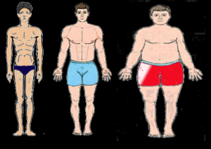
Body Types
3 types of body:
Ectomorph
Tall; lean; long, thin limbs, linear physique, challenging to gain muscle
Mesomorph
Athletic; muscular physique, large, bulky limbs, easy to gain muscle
Endomorph
Rounded shape; big abdomen; undeveloped muscles but can gain muscles quite easily

Slide 40
Levels of Body Fatness
Men Women
Essential fat 5% 10%
Borderline 6-9% 11-16%
Good fitness - health 10-20% 17-28%
Marginal fitness 21-25% 29-35%
Overfatness > 25% > 35%
Essential fat: the minimum amount of fat in the body necessary to maintain healthy living
Important for childbearing and hormone-related functions
Extremes in dieting (and exercise) can reduce essential fat stores)
Nonessential fat: extra fat, or fat reserves stored in the body.

Slide 42
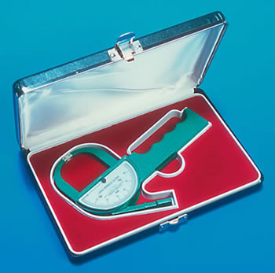
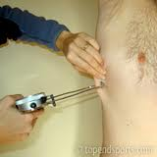
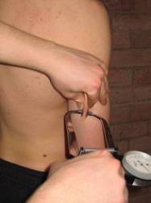
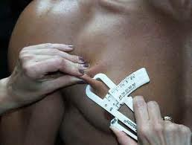
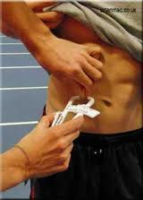
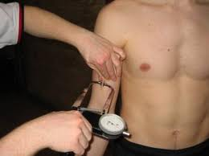
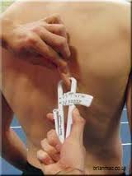
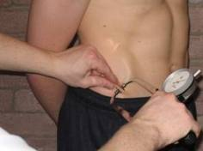
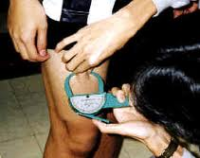
Common Skinfold Sites
4 Site
Triceps
Biceps
Subscapular
Suprailiac
7 Site
Chest
Axilla
Triceps
Subscapular
Abdomen
Supraillium
Thigh

Slide 43
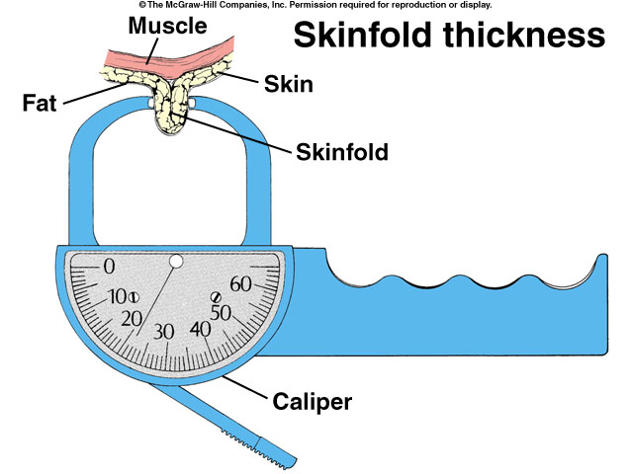
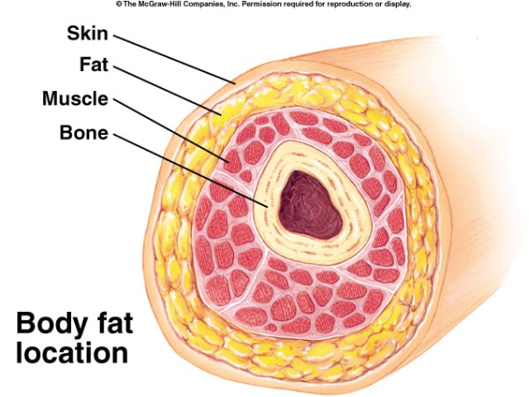
Body Composition Assessment Techniques
Skinfold Technique
Layers of subcutaneous fat are measured at different sites of body to estimate total body fat levels.
Advantages
Fairly accurate
Easy to perform
Inexpensive
Disadvantages
Human error

Slide 45
Skinfold Technique
Pg 158
Area | Description
Triceps | With the clients arm hanging loosely, a vertical fold is raised at the back of the arm, midway between the shoulder and elbow.
Biceps | A vertical fold is raised at the front of the arm, opposite the triceps site. This should be inline with the fold of the elbow.
Subscapular | This is taken 2 cm below the lowest point of the shoulder blade (inferior angle), and is taken at a 45° angle.
Suprailiac | This is taken just above the iliac crest (hip bone), directly below the front of the shoulder.

Slide 46
Males Sum of SF | Body Fat % | Females Sum of SF | Body Fat %
 |  | 14 | 9.4
 |  | 16 | 11.2
 |  | 18 | 12.7
20 | 7.1 | 20 | 14.1
22 | 9.2 | 22 | 15.4
24 | 10.2 | 24 | 18.5
26 | 11.2 | 26 | 17.6
28 | 12.1 | 28 | 17.6
30 | 12.9 | 30 | 19.5
35 | 14.7 | 35 | 21.6
40 | 18.3 | 40 | 23.4
45 | 17.7 | 45 | 25
50 | 19.0 | 50 | 28.5
55 | 20.2 | 55 | 27.5
60 | 21.2 | 60 | 29.1
65 | 22.2 | 65 | 30.2
Males Sum of SF | Body Fat % | Females Sum of SF | Body Fat %
70 | 23.2 | 70 | 31.2
75 | 24.0 | 75 | 32.2
80 | 24.8 | 80 | 33.1
85 | 25.6 | 85 | 34.0
90 | 28.3 | 90 | 34.8
95 | 27.0 | 95 | 35.6
100 | 27.6 | 100 | 38.3
110 | 27.8 | 110 | 37.7
120 | 29.9 | 120 | 39.0
130 | 31.0 | 130 | 40.2
140 | 31.9 | 140 | 41.3
150 | 32.8 | 150 | 42.3
160 | 33.6 | 160 | 43.2
170 | 34.4 | 170 | 44.6
180 | 35.2 | 180 | 45

Slide 47


Skinfold Technique
Pg 158
Take the measurements on the left hand side of the body.
Mark up the client accurately.
Using your forefinger and thumb, pinch the skin 1 cm on either side of the mark.
Pull the fat away from the muscle.
Place the caliper halfway between the top and bottom of the skinfold.
Allow the caliper to settle for one or two seconds.
Take the reading and wait 15 seconds before repeating for accuracy.
Add up the total of the four measurements.
Calculate body fat % using the table.

Slide 48


Skinfold Technique
Pg 158
The skinfold assessment test is carried out using a skinfold caliper.
Pre-measurement Instructions:
Measurements should not be taken after training or competition, sauna, swimming or showering.
Exercise, warm water and heat can produce dehydration or increased blood flow = inaccurate results.

Slide 49
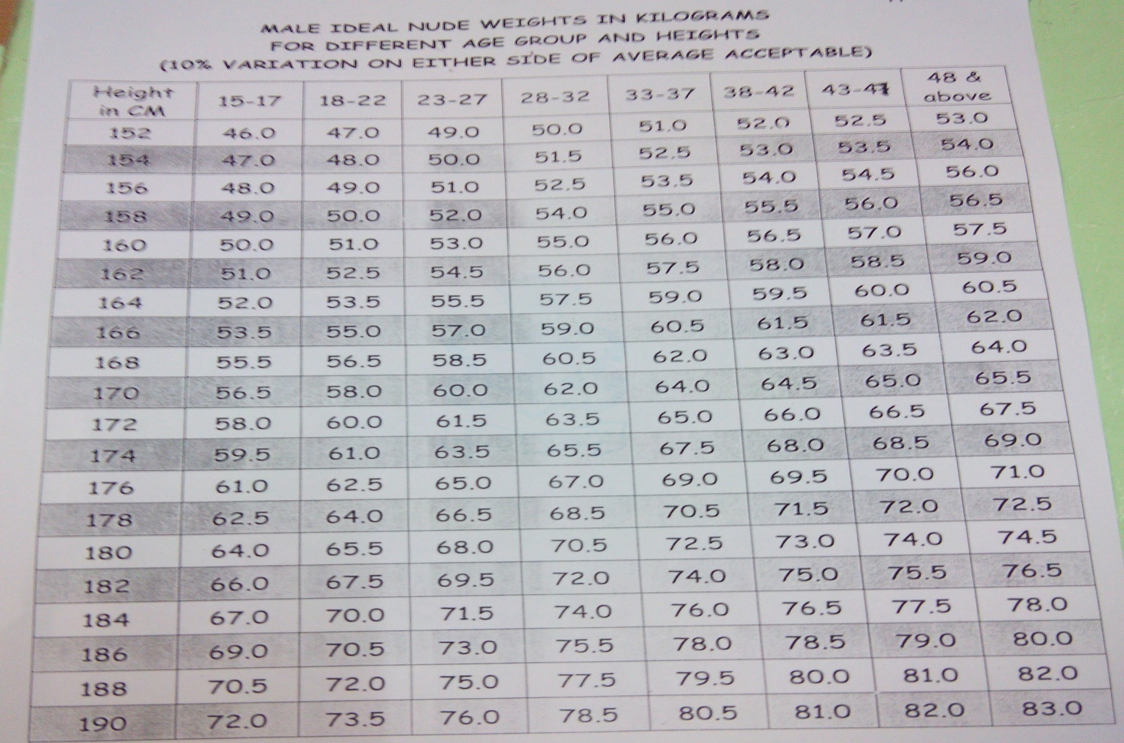

Slide 50
Sport-Related Components of Fitness
If you want to develop a high level of fitness to play competitive sport you need to develop your sport/skill-related components of fitness!

Slide 51
Sport-Related Fitness
This is the level of physical fitness needed to take on the demands of regular sporting activity.
Although we may be fit from a health point of view, we may not have the fitness required to play a sport. There are many types of sports and each has its own unique demands on the body.
  Sport related components
  Agility
  Balance
  Coordination
  Speed
  Muscular Power
  Muscular endurance
  Maximum Strength
  Reaction Time

Slide 52
Muscular Power
This is the ability to use strength quickly to produce an explosive effort, for example, when jumping or throwing a shot put.

Slide 53
Maximum Strength
Is ability to apply maximum force to an immovable object.

Slide 54
Muscular Endurance
Is the ability to work the muscles very hard for a period of time.

Slide 55
Speed (Anaerobic Capacity)
This is the ability to get your body moving quickly. Speed activities are short event requiring rapid movement, such as 100m or 100m track events or 50m swimming.

Slide 56
Agility
This is the ability to accelerate quickly, dodge weave and turn. Agility is essential in most team sports for actions such as avoiding opposition and falling over and recovering quickly.

Slide 57
Balance
Balance is the ability to stay upright and in control of your body position when you are moving or stationary. Most sporting activities require balance.

Slide 58
Coordination
Coordination is the ability to time your movements so you can perform them smoothly and accurately. All activities require some sort of coordination.

Slide 59
Reaction Time
Is the ability to respond to a stimulus quickly.

Slide 60
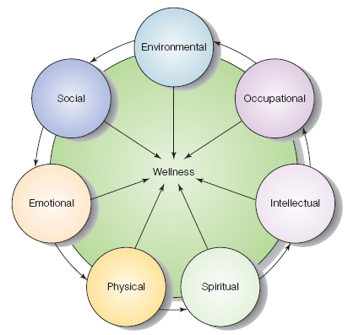
Dimensions of Wellness
Notes:
60
Figure 17-2 The seven components of wellness. (From Wellness: Concepts and Applications, 6th ed. (p. 4) by D.J. Anspaugh, M.H. Hamrick, and F.D. Rosato, 2006. Reproduced with permission of the McGraw-Hill Companies.)

Slide 61
1. Physical.
The ability to carry out daily tasks, achieve fitness (e.g. pulmonary, cardiovascular, gastrointestinal), maintain adequate nutrition and proper body fat, avoid abusing drugs and alcohol or using tobacco products, and generally to practice positive lifestyle habits.

Slide 62
2. Intellectual.
The ability to learn and use information effectively for personal, family, and career development

Slide 63
3. Social.
The ability to interact successfully with people and within the environment

Slide 64
4. Emotional.
The ability to manage stress and to express emotions appropriately, Emotional wellness involves the ability to recognize, accept, and express feelings.

Slide 65
5. Spiritual.
The belief in some force (nature, science, religion, or a higher power) that serves to unite human beings and provide meaning and purpose of life

Slide 66
6. Occupational.
The ability to achieve a balance between work and leisure time, A person's beliefs about education, employment, and home influence personal satisfaction and relationships with others.

Slide 67
7. Environmental.
The ability to promote health measures that improve the standard of living and quality of life in the community

Slide 68
Healthy Lifestyles
Regular physical activity
Eating well
Managing stress
Avoiding destructive habits
Practicing safe sex
Adopting good safety habits
Learning first aid
Adopting good personal health habits
Seeking and complying with medical advice
Being an informed consumer
Protecting the environment
Notes:
11
These are some healthy lifestyles that will be discussed in the remaining lectures.
Demonstrate the healthfinder web page to show them one place to go for additional information on a variety of health topics.

Slide 69
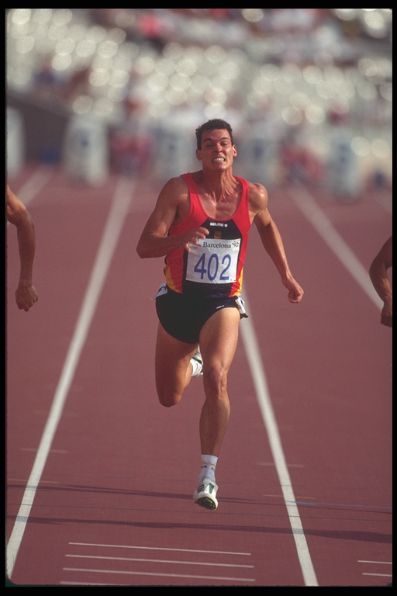
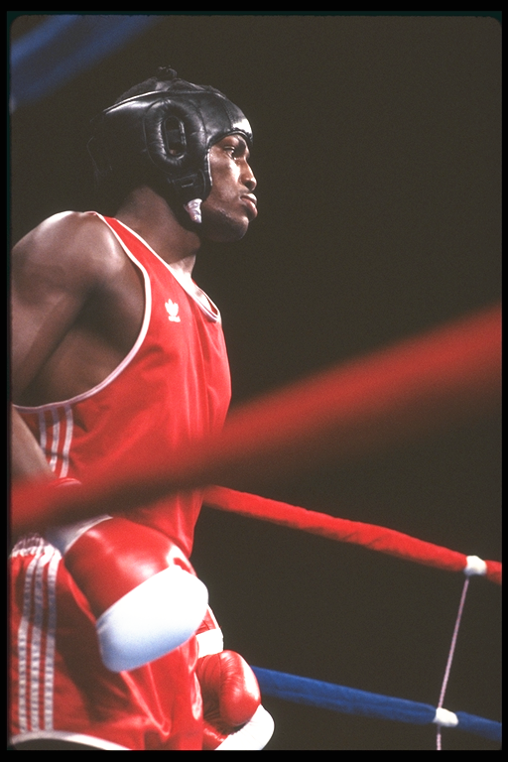
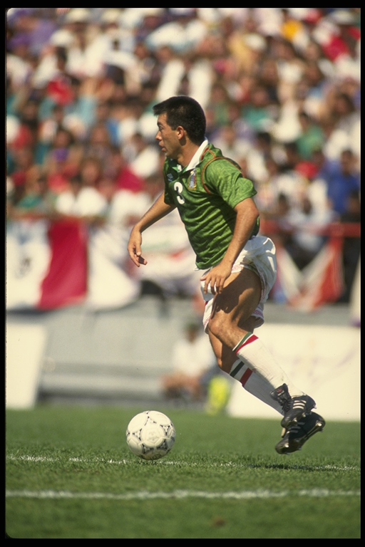
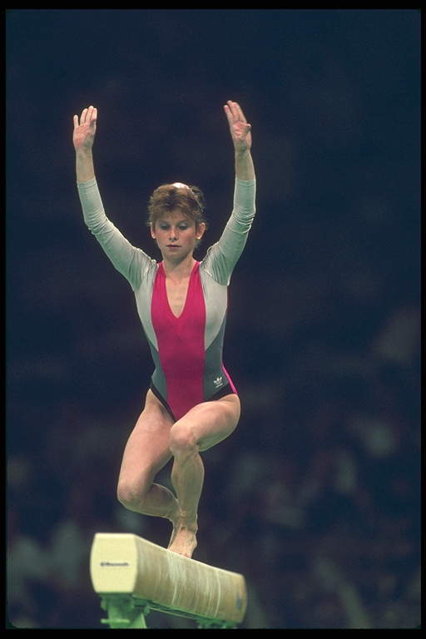
Who’s the Fittest?
Athletes excel in a variety of ways but no athlete can excel at all sports. The reason for this is the multi-dimensional nature of fitness. It would be impossible to say which of these athletes (or any athlete) is the most fittest because they all excel at different things.
A
B
C
D

Slide 70
The Stairway to Lifetime Fitness:
A Path to Independence
INDEPENDENCE
INDEPENDENCE
Problem Solver
Problem Solver
Fitness Evaluation
Fitness Evaluation
Personal Exercise Pattern
Personal Exercise Pattern
Achieving Fitness
Achieving Fitness
Regular Exercise
Regular Exercise
Notes:
17
Figure shows the 5 steps of the stairway one at a time.
First step is to do regular physical activity and to achieve a base level of fitness This is where most fitness programs stop. The goal in this class is to help you develop a personal exercise pattern so that you can identify the exercises you enjoy and fit them into your schedule. We also hope to teach you how to assess your level of fitness so that you can retest yourself. Lastly, we want to make you an independent problem solver so that you can plan your exercises to meet your individual needs.
As you ascend the stairway, you become more independent and are more likely to continue on your own!

Slide 71
FACTORS AFFECTING PHYSICAL FITNESS:
Heredity
Body Type
Age
Gender
Diet
Health Status
Life style

